Slide 1
Preliminary In-Person SWG meeting agenda (1 of 3)
23 September (Tuesday AM)
8:30 Agenda, purposes, general discussions.
8:45 Mission Status (Reynolds speaking for Reynolds and Kirby)
9:00 PI Team SOC and Data Status (PI representatives)
Where are you now on data generation and data quality?
Where do you expect to be by 31 October 2014 on promised deliveries
9:30 Independent Assessment on accessibility (Sibeck et al.)
9:45 Archiving
Mission Archiving Plan (Barnes)
Status of CDAWeb Capturing of Data (McGuire)
10:05 Break
10:30 Introduction to Preparations for Extended Mission. (Mauk et al.)
10:40 MMS: Brief description of MMS orbits (Mauk); Burch’s presentation on Wednesday AM.
10:45 ERG Status and capabilities (Ayako Matsuoka, Takahashi)
11:05 Status of orbit evolution and orbit tweaking studies (Tom S. and Fazle S.)
11:25 Instrument status + What flexibility do the instrument teams have in modifying the instrument operations for Extended Mission purposes? (PI Representatives)
12:15 Discussion of Extended Mission resources.
12:30 Lunch

Slide 2
Preliminary In-Person SWG meeting agenda (2 of 3)
23 September (Tuesday PM)
1:30PM General Discussion of Senior Review Science Themes.
2:00PM Plenary on Science Themes 1 (Injections) and 3 (Precipitation)
3:00PM Splinter on Science Theme 1 (Injections)
3:00PM Splinter on Science Theme 3 (Precipitation)
24 September (Wednesday)
8:30 Status and capabilities of MMS (Burch)
8:50 Plenary on Science Themes 2 (Waves) and 6 (Magnetopause coupling)
9:50 Splinter on Science Theme 2 (Waves)
9:50 Splinter on Science Theme 6 (Magnetopause coupling)
12:00 Lunch
1:00PM Plenary on Science Themes 4 (Solar Phase) and 5 (Microphysics)
2:00 Splinter on Science Theme 4 (Solar Phase)
2:00 Splinter on Science Theme 5 (Microphysics)
4:00 Miscellaneous Volunteer Science presentations
4:00 Splinter of those individuals who will be taking leadership in generating the Senior Review Proposal: Final themes, proposal structure action items, etc.

Slide 3
Preliminary In-Person SWG meeting agenda (3 of 3)
25 September (Thursday AM)
8:30 Planning for mini-GEM and AGU
9:00 Senior Review Proposal Discussions
Outline
Schedule
Further needed actions
Plans for AGU splinters
Etc.
10:00 Break
10:30 Work on Proposal
12:00 Lunch
1:00 Miscellaneous Team Meetings

Slide 4
Senior Review Evaluations (1 of 5)
Proposals due: 6 March 2015
Panel evaluations: Week of 22 April 2015
Performance factors to be evaluated will include
mission scientific productivity,
technical status,
budget efficiency,
data quality and accessibility, and
contribution to the “Heliophysics System Observatory (HSO).”
Each mission that is invited to this Senior Review will submit a proposal outlining how its science investigations will benefit the Heliophysics research objectives. These objectives and focus areas are described in the Science Plan for NASA’s Science Mission Directorate 2014 (the SMD Science Plan)

Slide 5
Senior Review Evaluations (2 of 5)
Proposals should outline descriptions of the project’s proposed science investigations, in a prioritized manner, the project’s most recent accomplishments, the technical status relating to the ability of the project to conduct the proposed science investigations, Mission Archive Plans, and a high-level budget for the proposed investigations.
Projects are requested to submit plans that have a set of Prioritized Science Goals (PSGs) for the next 5 years. These PSGs will also allow subsequent senior reviews to assess and measure the success of each mission in achieving its stated goals. In addition, projects are expected to show progress against the PSGs that they proposed in the 2013 Heliophysics Senior Review.
The period for this Senior Review will cover FY16 to FY20.
The actions will have the most immediate impact on the budget allocations for the portfolio in the near-term (FY16, FY17, and FY18) and will act as approximate guidelines for the level of support in the out-years; FY19 and FY20)

Slide 6
Senior Review Evaluations (3 of 5)
The panel will not be asked to evaluate or assess the current utility of real-time data for operational or commercial users. However, the relevance of ongoing or new science investigations that may transition from research to operation in the future is within the purview of the Senior Review.
When a mission has completed its Prime Phase E, NASA will accept higher operational risk, lower data collection efficiency, and instrument/mission degradation due to aging. It is anticipated that, along with this greater risk, the cost to implement will be at the level of approximately two-thirds that of Prime Phase E.
Priority will be given to maintaining an understanding of the instrument performance, monitoring progress toward accomplishing the objectives of science observations, and to involving the science community in formulating the mission observing program to make the best scientific use of NASA’s missions.
Productivity and vitality of the science team (e.g., published research, training younger scientists, etc.), as well as maintaining the continuity of the expertise in the calibration, validation, and archiving of individual instrument data sets and appropriate metadata

Slide 7
Senior Review Evaluations (4 of 5)
Promise of future impact and productivity (due to uniqueness of orbit and location, solar cycle phase, etc.);
Impact of scientific results as evidenced by citations, press releases, etc.; and
Broad accessibility and usability of the data, with a self-assessment of the utility of the data produced both as a unique mission, and contribution to system science as a member of the HSO.
The proposal shall contain:
Science and Science Implementation
Technical and Budget
Appendix - Mission Archive Plan
Acronym List
Standard Budget Spreadsheet
The scientific and the technical/budget sections combined should not exceed more than 30 pages of writing and graphics. Not included in the page limit are the appendix, the acronym list, or the budget spreadsheet. Included in the page limit are bibliographies, references, and letters of endorsement: include only the most important references, as appropriate. Letters of endorsement are not needed for the Senior Review.

Slide 8
Senior Review Evaluations (5 of 5)
Missions should describe how they will achieve their PSGs. This can be solely within the funded Mission Team, or include other components of the HSO, or can be broadened out to include the science that will be achieved through the larger community. For the latter this can be both through funded NASA research programs (Guest Investigator, Supporting Research,, LWS Targeted Research &Technology, Grand Challenge Research (Theory), etc.) and it can be through international efforts. Previous work that was performed sets the foundation and establishes the feasibility for the future work.
Given the emphasis on the systemic nature of the discipline, a discussion of the impact the mission’s unique science, as a contribution to the overall system science performed by the HSO, is necessary for the panel to understand the evolving nature of the HSO.

Slide 9
Short Presentations (1 of 4) (2 slides)
Theme #1: Injections, etc (Reeves and Gkioulidou)
J. Liu: Dipolarizing flux bundles in the inner magnetosphere and their relationship to energetic particle injections, observed by RBSP
Malaspina: Two-spacecraft observations of dispersionless injection fronts: structure and propagation in the inner magnetosphere
Gkioulidou: Temporal and Spatial Evolution of Energetic Ion Injections in the Inner Magnetosphere: Multi-Point Observations of a Substorm Event.
Foster 1: Dual S/C observations of shock-driven electron acceleration
Foster 2: Prompt local acceleration of MeV electrons during substorm injections
Fennell: Inner Zone response to external drivers (Might this belong in Theme #4?)
Possible: Dai Lei: Relativistic Injection Events.
Wygant: Nightside, highly relativistic particle “injections” during the geomagnetic storms of late May and early June.
Boyd: A Statistical Look at the Radiation Belt Seed Population
Thaller: Electric field enhancements to low L shells
Thaller: Ring Current enhancements and plasmasphere erosion.

Slide 10
Short Presentations (2 of 4) ( 2 slides)
Theme #2: Three-dimensional VLF and ULF waves (Kletzing and Hudson)
Hudson: Description: Modeling ULF waves, and comparison with observations in particular for the 8 oct 2013 event
W. Li 1: Statistical analysis of hiss wave spectrum from the EMFISIS wave data
W. Li 2: Evidence of plasmaspheric hiss originated from chorus: Coordinated Van Allen Probes and THEMIS observations
Takahashi: Orbit evolution impacts on the diagnosis of ULF wave parameters
G. Khazanov: Nonlinear Plasma Wave Coupling in the Inner Magnetosphere
J. Wygant: ULF Electric Field Measurements
X. Li: Dynamic features of plasmapause revealed by in situ measurements from Van Allen and THEMIS Probes
Motoba: SuperMAG ULF Data Products.

Slide 11
Short Presentations (3 of 4) (2 slides)
Theme #3: Particle precipitation mechanisms (Spence and Thorne)
Breneman: First Direct Experimental Measurement of loss cone scattering of energetic electrons by whistler mode hiss in the plasmasphere
Kanekal: CeREs - A Compact Radiation bElt Explorer and electron microbursts
Thorne: Does EMIC wave scattering lead to significant relativistic loss?
Blake: Description: An Air Force Project in LEO for precipitation.
Mazur: Responsive Environmental Assessment, Commercial Hosting Demonstration (REACH)
Gerrard: Ring Current He-Ions: A summery of two years of observations and observations of Pc3-induced flux modulation
Theme #4: CME vs. CIR driven dynamics (Baker and Lanzerotti)
Baker: Comparison and contrast of CME-driven rad belt changes and high-speed solar wind stream driven changes
Claudepierre/Fennell: Internal Charging Hazards in Near-Earth Space during Solar Cycle 24 Maximum: Van Allen Probes Measurements. (Work performed by Skov et al.)
Jordanova: Ring Current Dynamics During HSS-driven compared to CME-driven storms
X. Li: Upper limit of MeV electrons in the inner belt bounded by Van Allen/REPT measurements
Huang: Total Radiation Belt Electron Content
Jaynes: The pressing need for Van Allen Probe data comparisons to MHD modeling of CME vs. CIR driven storms.
Gerrard: Interior spacecraft charging of the Van Allen Probes in relation to transient interplanetary structures.

Slide 12
Short Presentations (4 of 4) (2 slides)
Theme #5: Microphysical Processes (Wygant and Bounds)
Wygant: Relativistic electron energization and associated electric fields during Geomagnetic Storms by Closely Space Van Allen Probes
Thorne: The signature of radiation belt electron acceleration by whistler-mode chorus
Theme #6: Magnetopause coupling (Sibeck)
Ukhorskiy / Fennell: Global storm time depletion of the outer electron belt.
Huang: Electron Pitch Angle Distributions During Magnetopause Shadowing
Goldstein: Plumes in the inner magnetosphere

Slide 13
Van Allen Probes Extended Mission Science Themes (1 of 3)
Spatial and temporal structures of injections and other transient phenomena and their effects on the radiation belts and ring current
New Opportunities:
Modified orbit configurations
Different modes of operation for the instruments
Additional Assets: MMS and ERG
Three-dimensional structures and distributions of VLF and ULF waves and their effects on the radiation belt and ring current populations
New Opportunities:
Tweak the orbit phases to align spacecraft along field lines
Modify orbits for longitude sampling of ULF wave structures
Operating the instruments in different modes,
ERG measurements at mid-latitudes within Probe Quadrants

Slide 14
Van Allen Probes Extended Mission Science Themes (2 of 3)
What are the detailed physical mechanisms responsible for energetic electron precipitation.
New Opportunities:
Magnetic latitude orbit separations.
New CubeSats: e. g. a) CeREs (mid-2015), and b) ELFIN (late 2016)
ERG flying at mid-latitudes.
Extended mission BARREL Campaign (beyond bridge phase).
Responses of Earth’s radiation belt regions, as the interplanetary drivers evolve from CME dominated to CIR dominated conditions?
New Opportunities:
Operating during a critical new phase of the solar cycle,
May result in stronger / more energetic electron belt enhancements

Slide 15
Van Allen Probes Extended Mission Science Themes (3 of 3)
Detailed structures and characters of the microphysical processes that act to energize radiation belt particles in the inner magnetosphere?
New Opportunities:
Operate the instrument differently in target regions
Adjust the phases of the two probes to minimize close approach
Adjust orbit phases to align spacecraft along field lines
Adjust relative apogees to increase lapping rate and close approaches.
Coupling between the magnetopause and the inner magnetosphere? Role and mechanisms of the magnetopause act as a sink of belt particles?
New Opportunities:
MMS measurement of reconnection as it skims the magnetopause
MMS measurements of energetic particle escape through the magnetopause.
Move one spacecraft apogee substantially higher.

Slide 16
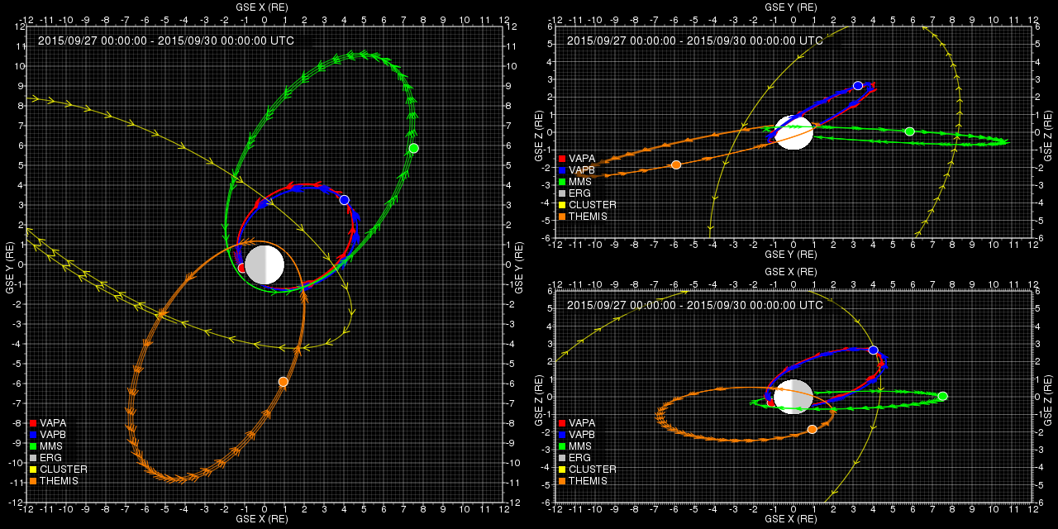
September 2015
http://athena.jhuapl.edu/ExtendedMissionOrbit

Slide 17
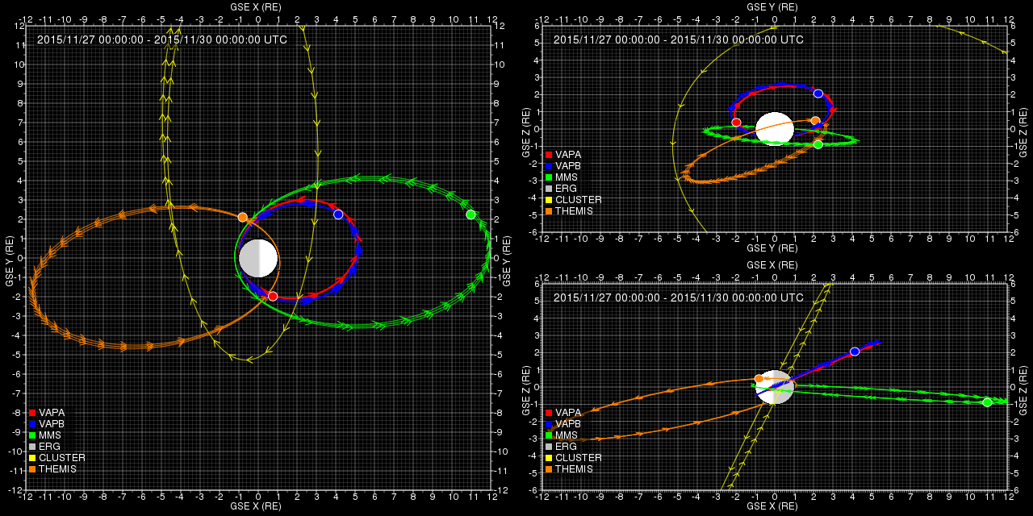
November 2015
http://athena.jhuapl.edu/ExtendedMissionOrbit

Slide 18
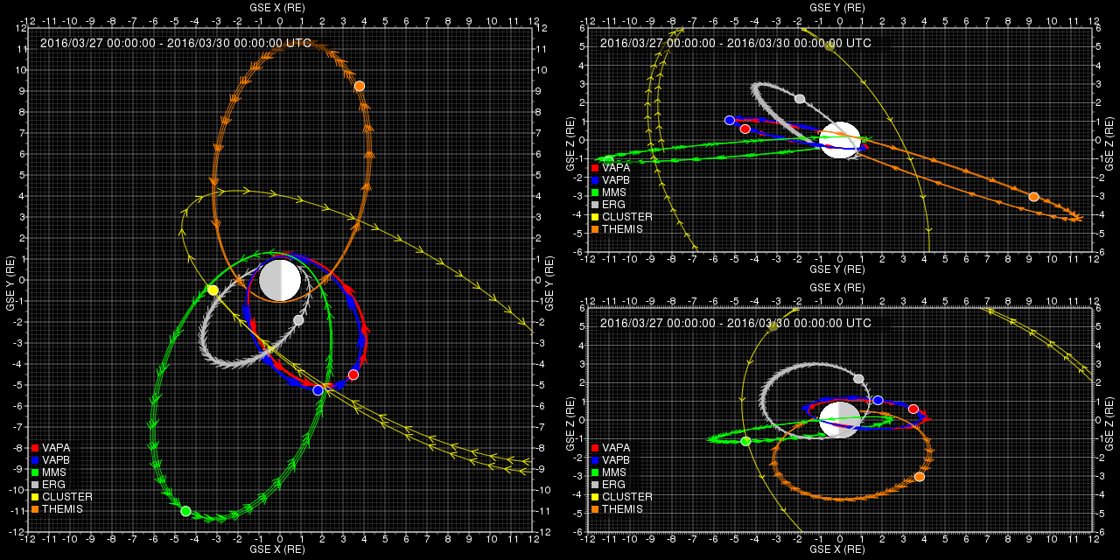
March 2016
http://athena.jhuapl.edu/ExtendedMissionOrbit

Slide 19
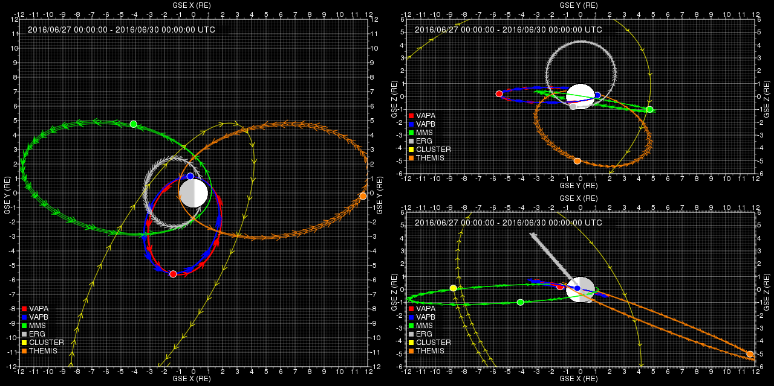
June 2016
http://athena.jhuapl.edu/ExtendedMissionOrbit

Slide 20
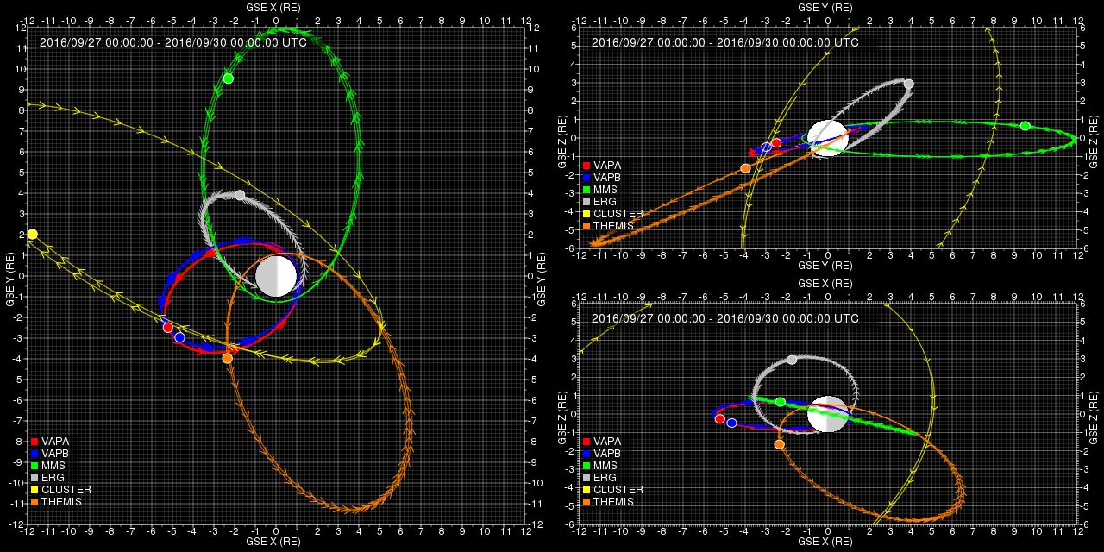
September 2016
http://athena.jhuapl.edu/ExtendedMissionOrbit

Slide 21
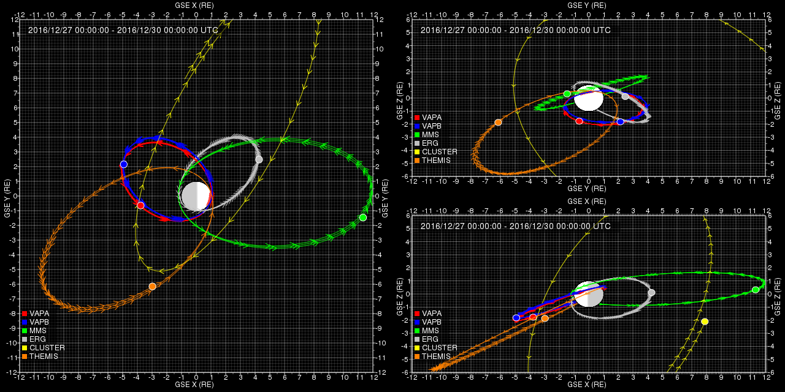
December 2016
http://athena.jhuapl.edu/ExtendedMissionOrbit

Slide 22
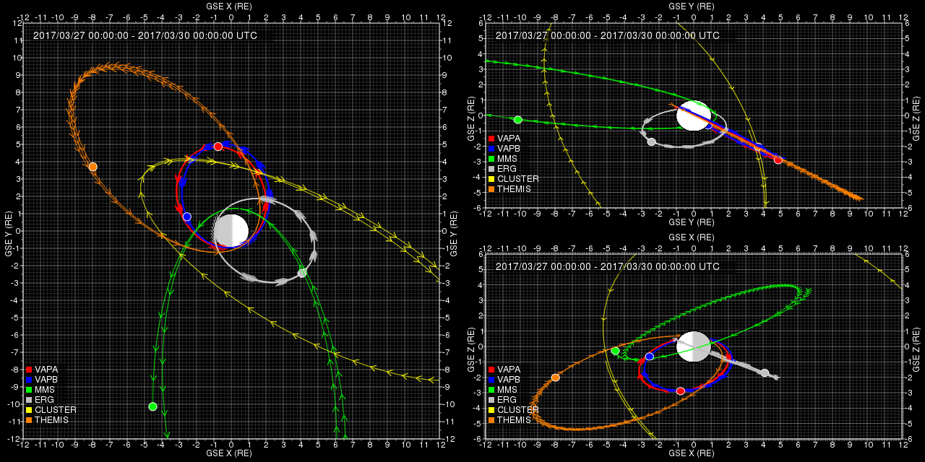
March 2017
http://athena.jhuapl.edu/ExtendedMissionOrbit

Slide 23
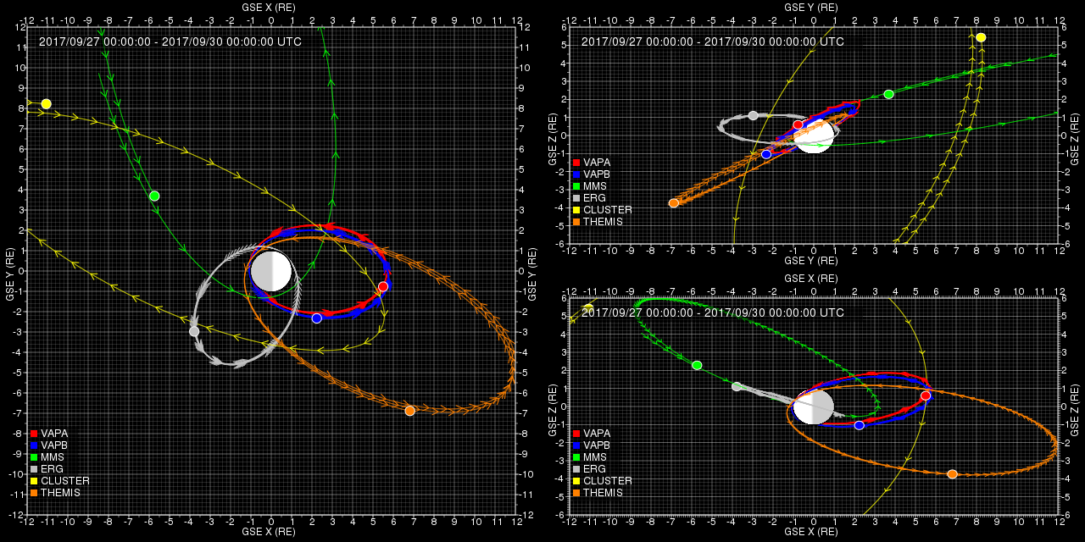
September 2017
http://athena.jhuapl.edu/ExtendedMissionOrbit

Slide 24
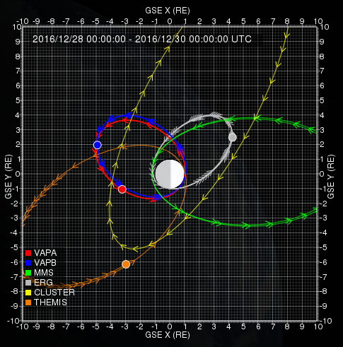
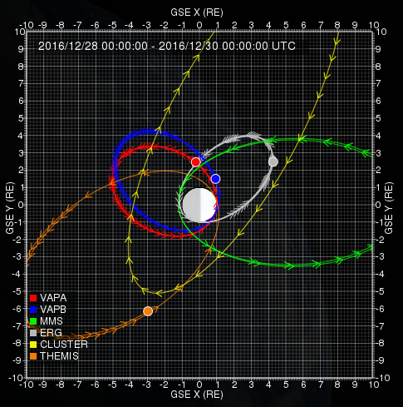
December 2016
Nominal Mission
Δ(Apogee) = 300% of nominal
Sun
http://athena.jhuapl.edu/ExtendedMissionOrbit

Slide 25
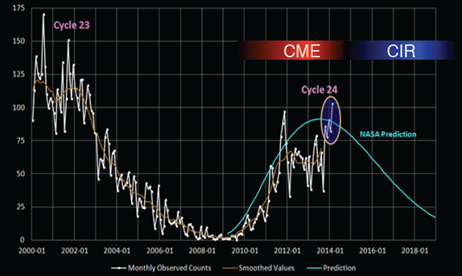
CME versus CIR Responses
Bridge
Van Allen Probes:
Prime
Extended
ERG

Slide 26
BACKUP

Slide 27
Van Allen Probes Extended Mission Science Theme Suggestions (1 of 3)
What are the spatial and temporal structures of injections and other transient phenomena such as shock-driven fronts, and how do they evolve, within Earth’s inner magnetosphere; what are the effects of those structures on the radiation belt and ring current populations? This is a central aspect for addressing the LWS objectives of Van Allen Probes. ?
New Opportunities:
Enhanced orbit evolutions of the 2 Van Allen Probes to achieve different kinds of radial and local time separations, to better sample the evolving structures.
Possible different modes of operation for the instruments
The addition of other assets to the Van Allen Probes and THEMIS: specifically MMS and ERG.
What are the 3-dimensions structures and distributions of VLF and ULF waves within Earth’s inner magnetosphere, and what are the effects those structures on the radiation belt and ring current populations? (dE, dB, k spatial coherence, spatial distributions, ULF wave structures) ?
New Opportunities:
Modifications of the phasing of RBSP-A and RBSP-B close encounters such that they are aligned along the same magnetic flux tubes
Modifications of orbit evolutions to achieve different longitude sampling of ULF wave structures
Operating the instruments in different modes, with higher available rates, to capture details of the VLF interactions.
ERG measurements at mid-latitudes along flux tubes that connect roughly to the Van Allen Probes A and B.

Slide 28
Van Allen Probes Extended Mission Science Theme Suggestions (2 of 3)
What are the detailed physical mechanisms responsible for energetic electron precipitation. This is a central aspect for addressing the LWS objectives of Van Allen Probes. The following questions were identified as key to the prime mission, but they have yet to have been satisfactorily answered: What causes microbursts? What is the efficacy of EMIC waves in the loss of radiation belt particles? Relative contributions of precipitation losses to radiation belt depletion
New Opportunities:
Magnetic latitude orbit separations.
Two new CubeSats: a) CeREs expected to launch in mid-2015 with the ability to resolve microbursts, and b) ELFIN, scheduled for launch in late 2016 to early 2017.
ERG flying at mid-latitududes with the ability to resolve particle loss cones at the same time that the Probes are measuring equatorial waves and source distributions.
Extended mission BARREL Campaign (beyond bridge phase). (???)
How do the physics and the dynamical responses of Earth’s radiation belt regions, including the ring current, change as the interplanetary drivers evolve from CME dominated to CIR dominated conditions? This is a central aspect for addressing the LWS objectives of Van Allen Probes.
New Opportunities:
Van Allen Probes will be operating during a critical new phase of the solar cycle, the declining phase, following its operation during solar maximum.
CIR’s may provide stronger and more energetic radiation belt electron enhancements than have been seen during the mission to date.

Slide 29
Van Allen Probes Extended Mission Science Theme Suggestions (3 of 3)
What are the detailed structures and characters of the microphysical processes that act to energize radiation belt particles in the inner magnetosphere?
New Opportunities:
Operate the instrument differently, taking advantage of higher data rates and focus on microphysical processes in selected regions.
Adjust the phases of the two probes so that they consistently come closer to each other during the periods of close approach.
Adjust the phases of the two probes so that they consistently are aligned along the same magnetic flux tube when they pass close to each other.
Possibly reverse the differential precession of the two spacecraft so that, after two years we can park the spacecraft in nearly identical orbits and bring the spacecraft very close together (with adjustable distances).
What are the modes of coupling between both the magnetopause and magnetotail, and the inner magnetosphere? How direct are the couplings between such magnetopause processes as reconnection and the response of the inner magnetosphere? To what extent and by what mechanisms does the magnetopause act as a sink of radiation belt particles?
New Opportunities:
Modification of orbit apogee to approach closer to GEO for one van Allen Probe.
The addition of MMS to the other assets to the Van Allen Probes and THEMIS: specifically MMS

