Slide 1
Van Allen Probe Data Pathways
SWG, September 23, 2014
D. G. Sibeck
NASA/GSFC

Slide 2
Data Pathways
Gateway
ViRBO
SPDF
What next?

Slide 3
Gateway
Entry Page
Mix and Match Space Weather Plots
Mix and Match Summary Plots
Ephemeris
Links to Team WWW sites
Bibliography

Slide 4
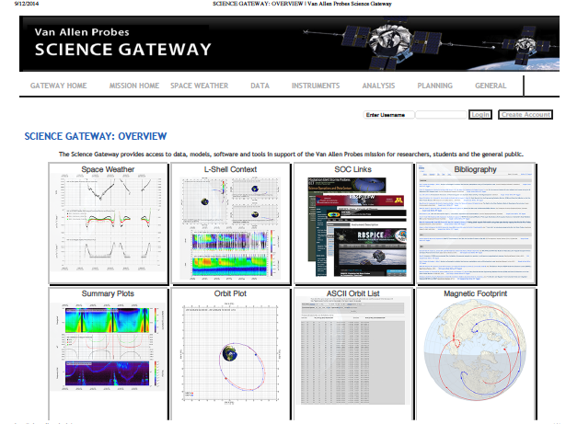
Entry Page (Upper)

Slide 5
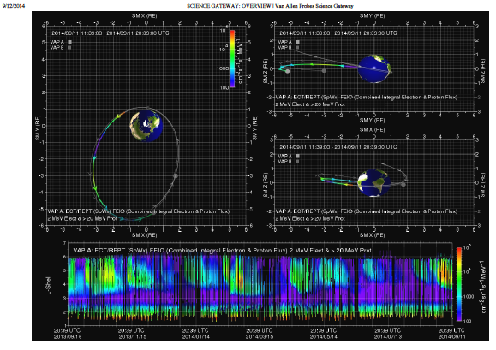
Entry Page (Lower)

Slide 6
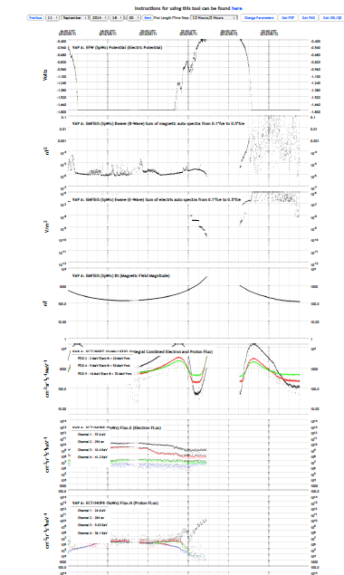
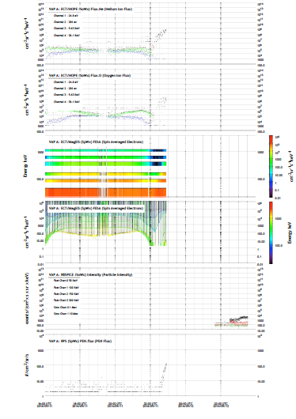
Space Weather Plots
Physical Units
Lots of Data in
Mix and Match
format
→ Meaningful

Slide 7
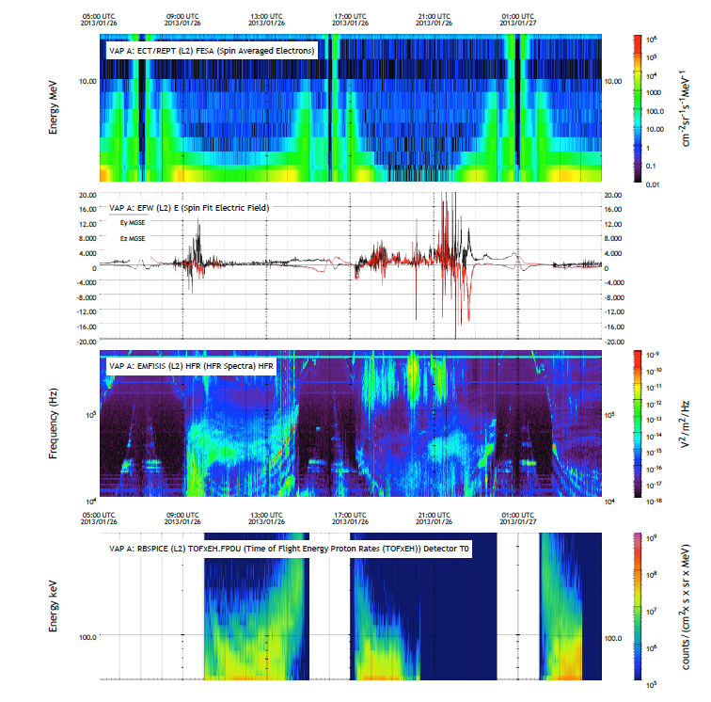
Science Data Plots
Physical Units
Lots of Data in
Mix and Match
format
→ Meaningful

Slide 8
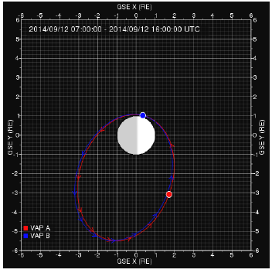
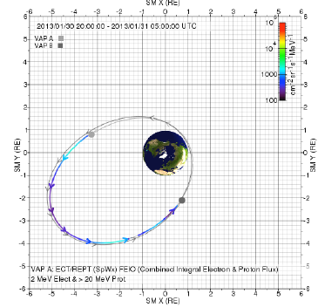
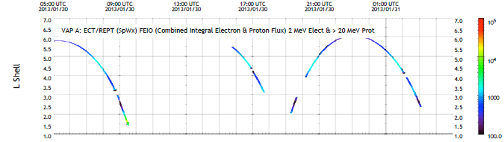
Ephemeris

Slide 9
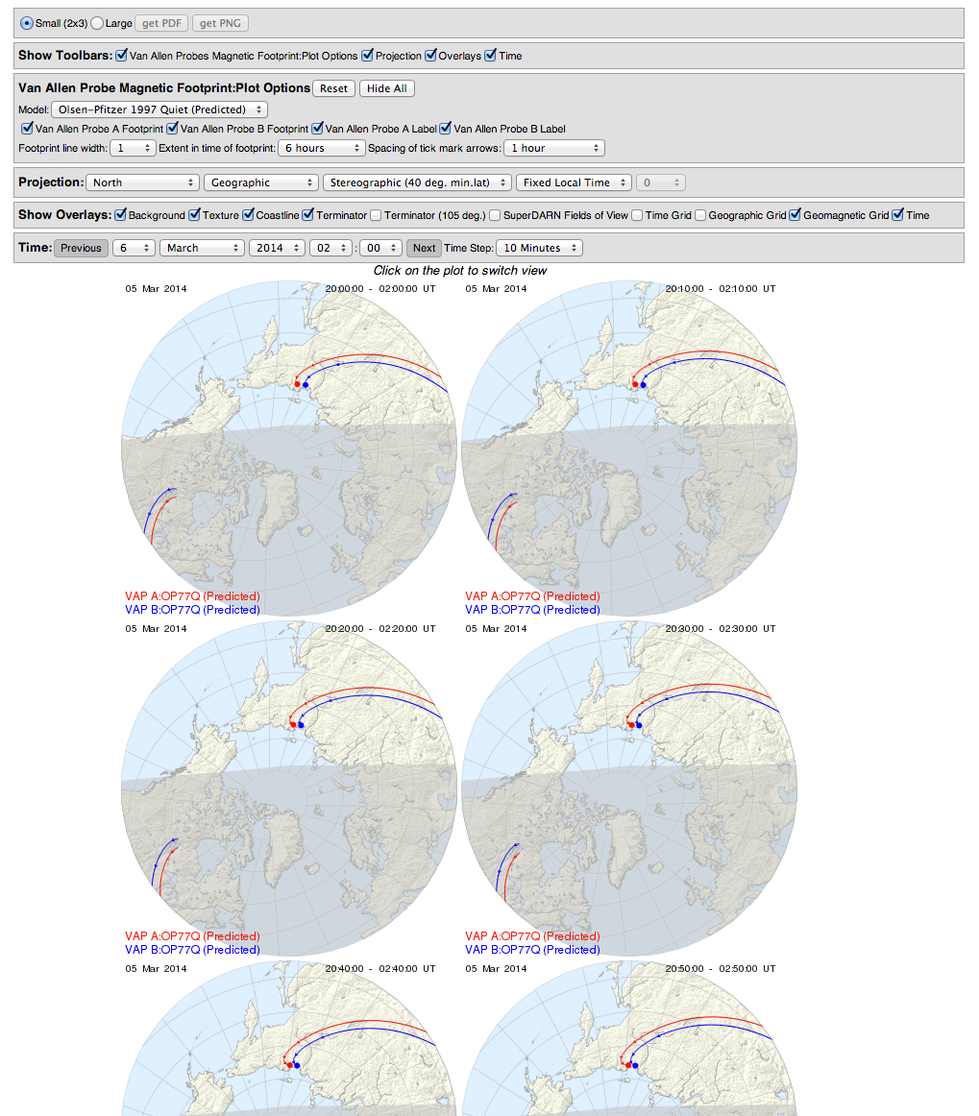
Ephemeris
Magnetic Footprint Plotter

Slide 10
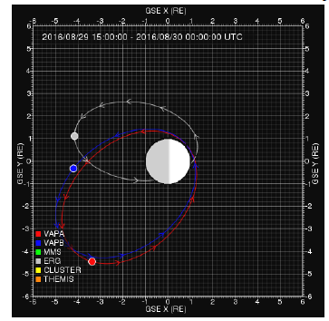
Ephemeris:
Extended Mission Planning

Slide 11
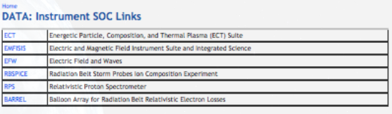
Links to Team Sites
Team pages look about the same…anything new I should know about?
RPS pages were lagging, but we impose no requirements on them…

Slide 12
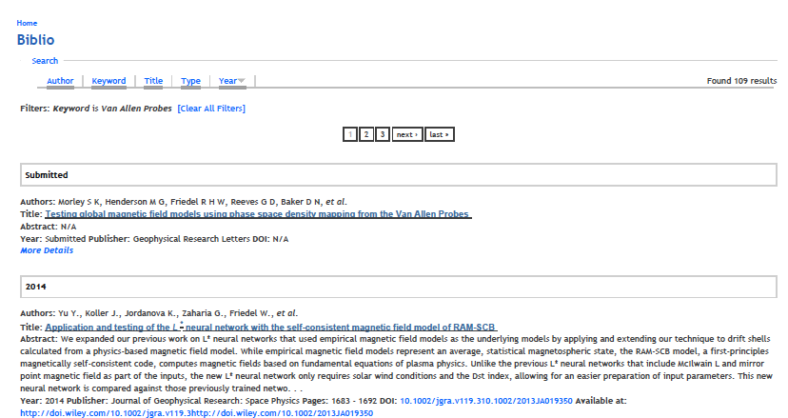
Bibliography
Essential for senior review proposal- please check that your papers are here and encourage
registration

Slide 13
Gateway
Entry Page
  Nice
Mix and Match Space Weather Plots
  In good shape
Mix and Match Summary Plots
  In good shape
Ephemeris
  Nice new appearance
Links to Team WWW sites/Bibliography
  Functioning

Slide 14
Data Pathways
Gateway
  Good shape
ViRBO
SPDF
What next

Slide 15
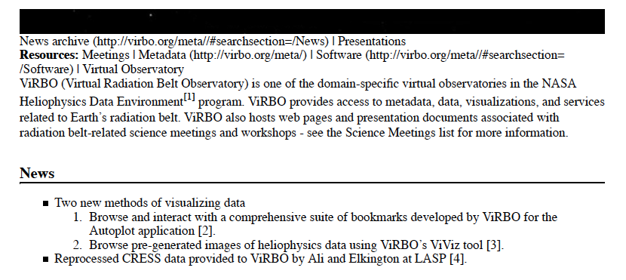
ViRBO

Slide 16
Data Pathways
Gateway
  Good shape
ViRBO
  Directs users to other WWW sites…
SPDF
What next

Slide 17
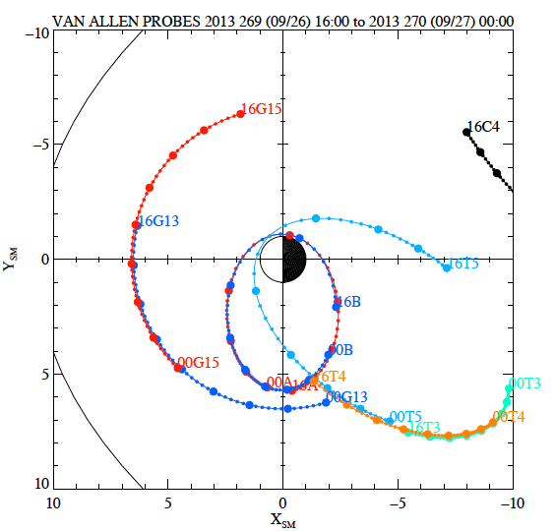
GIFWalk:
Survey Plots of Orbits/Data

Slide 18
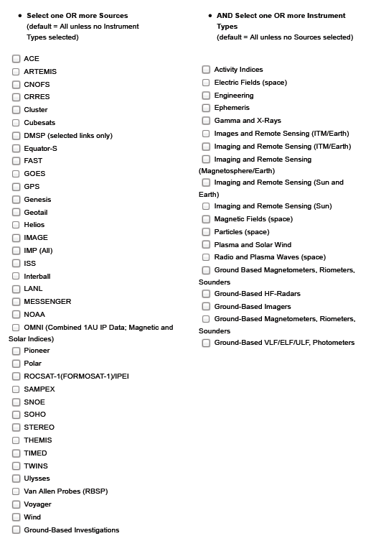
CDAWeb
Van Allen Probes,
Now available

Slide 19
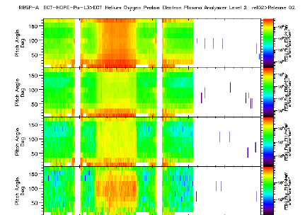
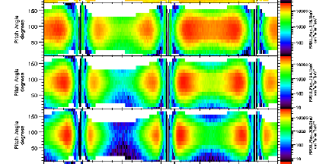
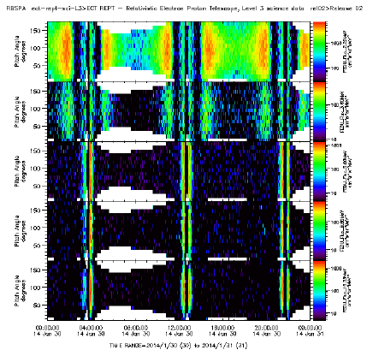
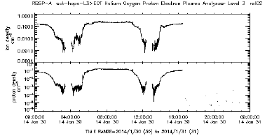
ECT Pitch Angle and HOPE Densities
HOPE
MagEIS
Some problems
With CDF
structuring
HOPE
REPT

Slide 20
ECT Pitch Angle and HOPE Densities
HOPE
MagEIS
HOPE
REPT
Second (tilted) medium energy MagEIS box
not needed/used to produce PADs

Slide 21
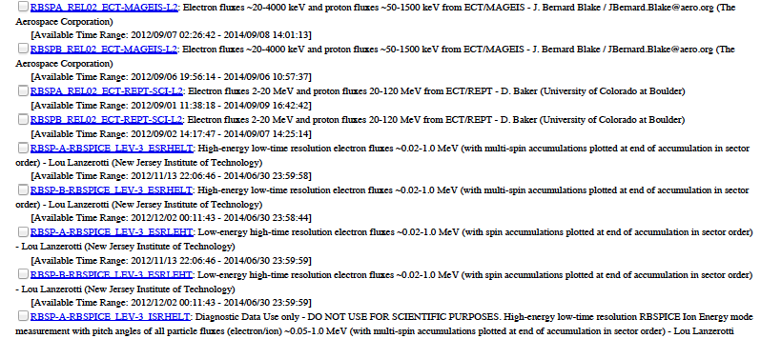
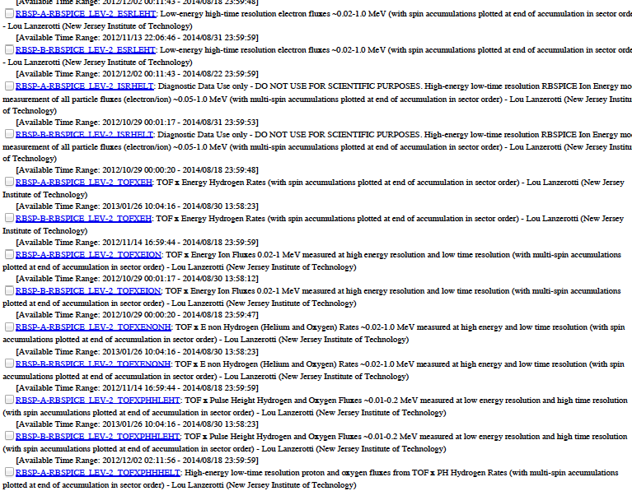
RBSPICE
Everything is there…

Slide 22
RBSPICE
Everything is there…whew…

Slide 23
Data Pathways
Gateway
  Good shape
ViRBO
  Autoplot and survey (?) plots
SPDF
  Good shape
What next

Slide 24
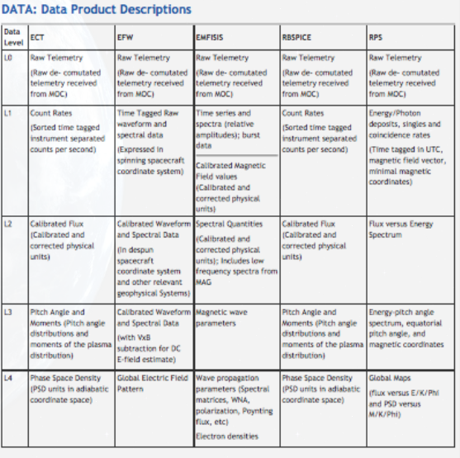
Data Files

Slide 25
Data Files
✔
✔
✔
✔
✔
✔
NEW
✔
✔
In progress?
✔
No

Slide 26
Data Files
✔
✔
✔
✔
✔
✔
Done
✔
✔
In progress?
✔
No
L1 requires field teams to produce plasma
densities at 10s cadence.

Slide 27
Possible/Forthcoming Enhancements
1. Status of EMFISIS DC magnetometer data set clean up?
2. EMFISIS Wave Normal Analysis products under production, but not ready for public release.
3. EMFISIS and EFW working together to produce densities, answering reasonable requests for the time being. Values up to around 2500 cm⁻³ possible.
4. RBSPICE to generate pressures/pitch angles in a more science oriented configuration.
6. ECT MagEIS and REPT spectra intercalibrated.
7. ECT to remove background from pitch angle distributions.
8. Characteristic wave frequencies placed on plasma wave survey plots?
9. Data quality flags on CDAWeb data sets?
10. Descriptions of data provided on real time space weather plots?

Slide 28
Data Pathways
Gateway
  Big progress
ViRBO
  Directs to other WWW sites
SPDF
  Good shape, significant progress
What next?
  A few more data products expected
  Another joint workshop/demo for GEM? Publicize in SPA newsletter?

Slide 29
EMFISIS CAVEATS
Current production codes and kernels include a
1.5 Hz signal that is Spice related and largely
removed at this time, an 11-sec signal that is the
spin tone due to less than ideal calibration that we
hope will be removed very soon, and a 5-min nutation
signal that is largely the result of removing the star
tracker from the spacecraft.
There is a 14.5 Hz signal on spacecraft A that
arises from an aliased heater line.

Slide 30
CAVEATS
Current production codes and kernels include a
1.5 Hz signal that is Spice related and largely
removed at this time, an 11-sec signal that is the
spin tone due to less than ideal calibration that we
hope will be removed very soon, and a 5-min nutation
signal that is largely the result of removing the star
tracker from the spacecraft.
There is a 14.5 Hz signal on spacecraft A that
arises from an aliased heater line.

Slide 31
CAVEATS
Current production codes and kernels include a
1.5 Hz signal that is Spice related and largely
removed at this time, an 11-sec signal that is the
spin tone due to less than ideal calibration that we
hope will be removed very soon, and a 5-min nutation
signal that is largely the result of removing the star
tracker from the spacecraft.
There is a 14.5 Hz signal on spacecraft A that
arises from an aliased heater line.

Slide 32
CAVEATS
Current production codes and kernels include a
1.5 Hz signal that is Spice related and largely
removed at this time, an 11-sec signal that is the
spin tone due to less than ideal calibration that we
hope will be removed very soon, and a 5-min nutation
signal that is largely the result of removing the star
tracker from the spacecraft.
There is a 14.5 Hz signal on spacecraft A that
arises from an aliased heater line.
Team is working diligently on removing
these signals.

