Slide 1
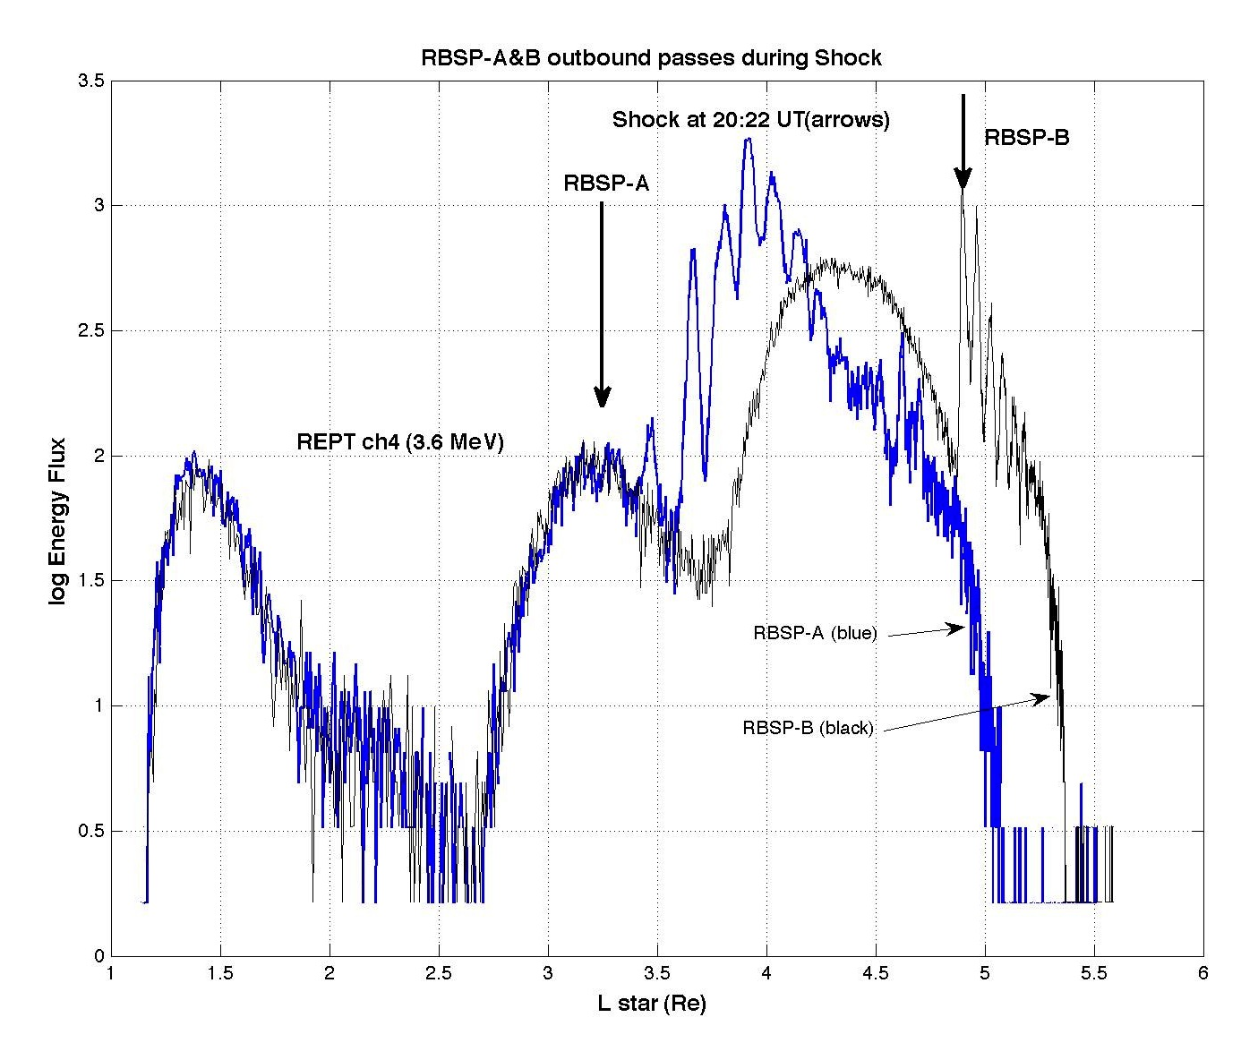
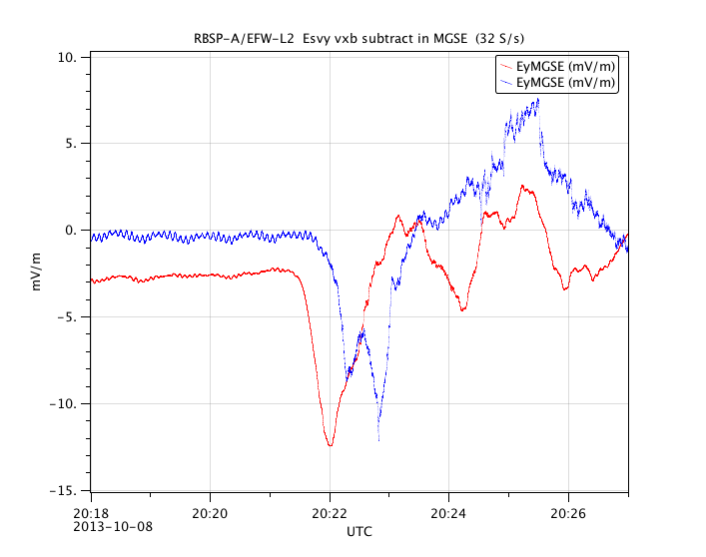
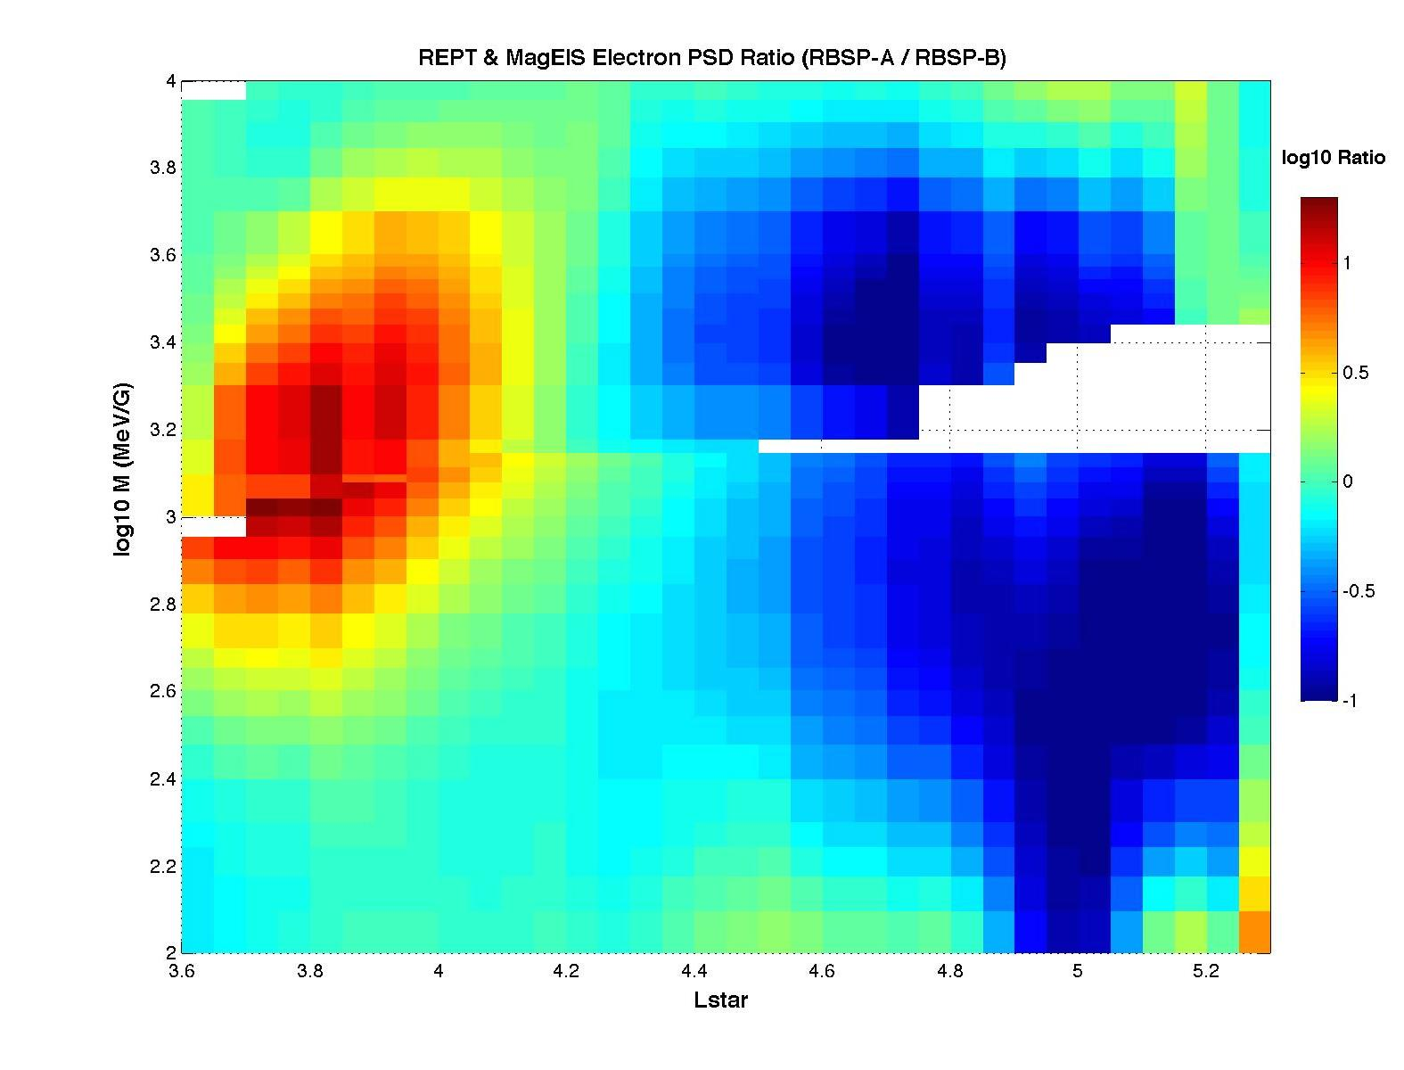
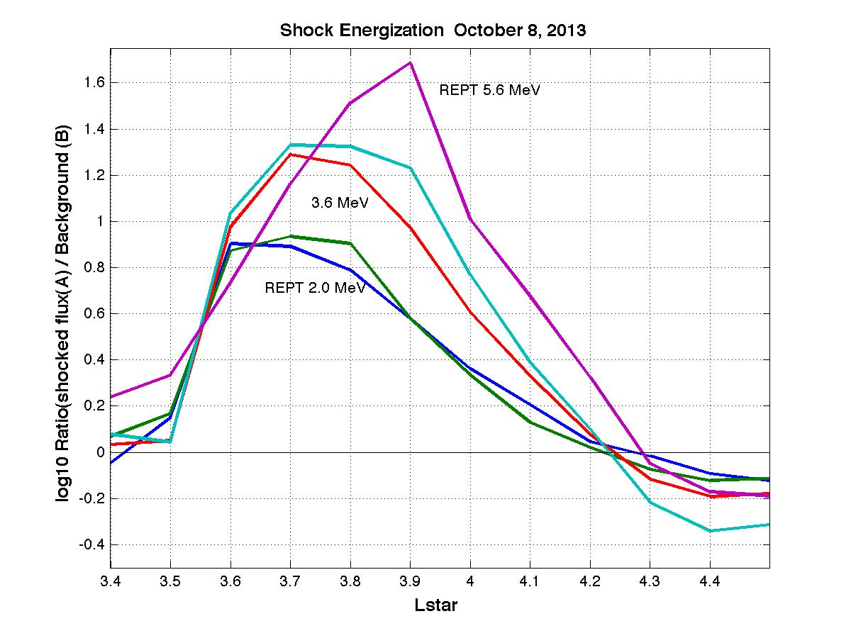
Dual S/C observations of shock-driven electron acceleration
A
B
Y_{GSM} (R_{E})
X_{GSM} (R_{E})
Lstar

Slide 2
New Opportunities
Spatial/temporal structures of injections and other transient phenomena - Enhanced orbit evolutions of the 2 Van Allen Probes to achieve different kinds of radial and local time separations, to better sample the evolving structures.
The need for good timing of the evolution of transient phenomena and the utility of having near-simultaneous background and perturbation observations along a similar path speak strongly for maintaining the configuration with Probes A and B in closely similar orbits with a temporal separation commensurate with the time scale of the phenomena of interest (e.g. ~1 hr for impulsive events).
Raising apogee of both Probes to (e.g.) 6.5 R_{E} would extend coverage into the region where injection physics is taking place in the midnight sector and would make crossings out of the plasmasphere and into the ring current more probable on the dayside. Coverage at higher L would address the physical processes in these active regions which are important for the evolution of the radiation belts.

Slide 3
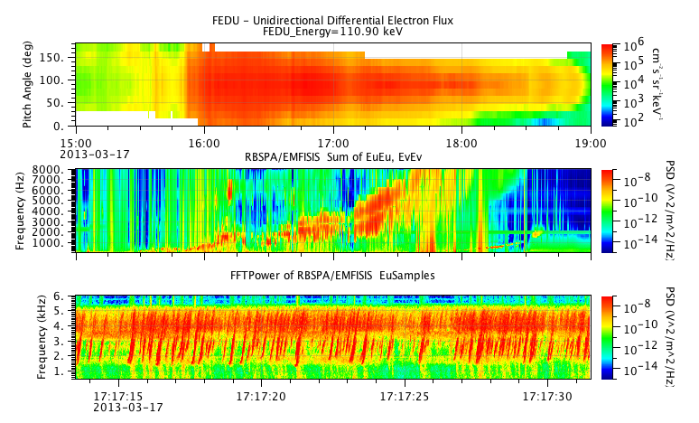
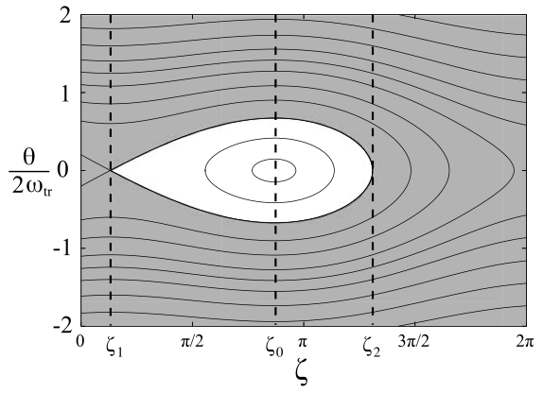
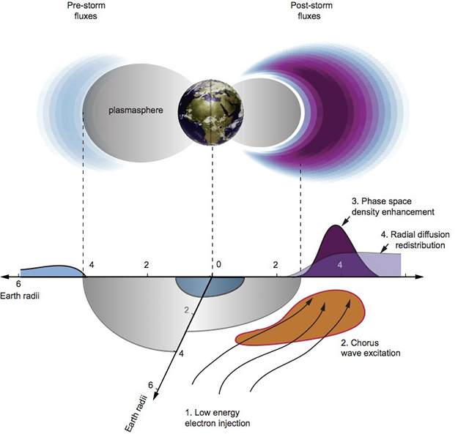
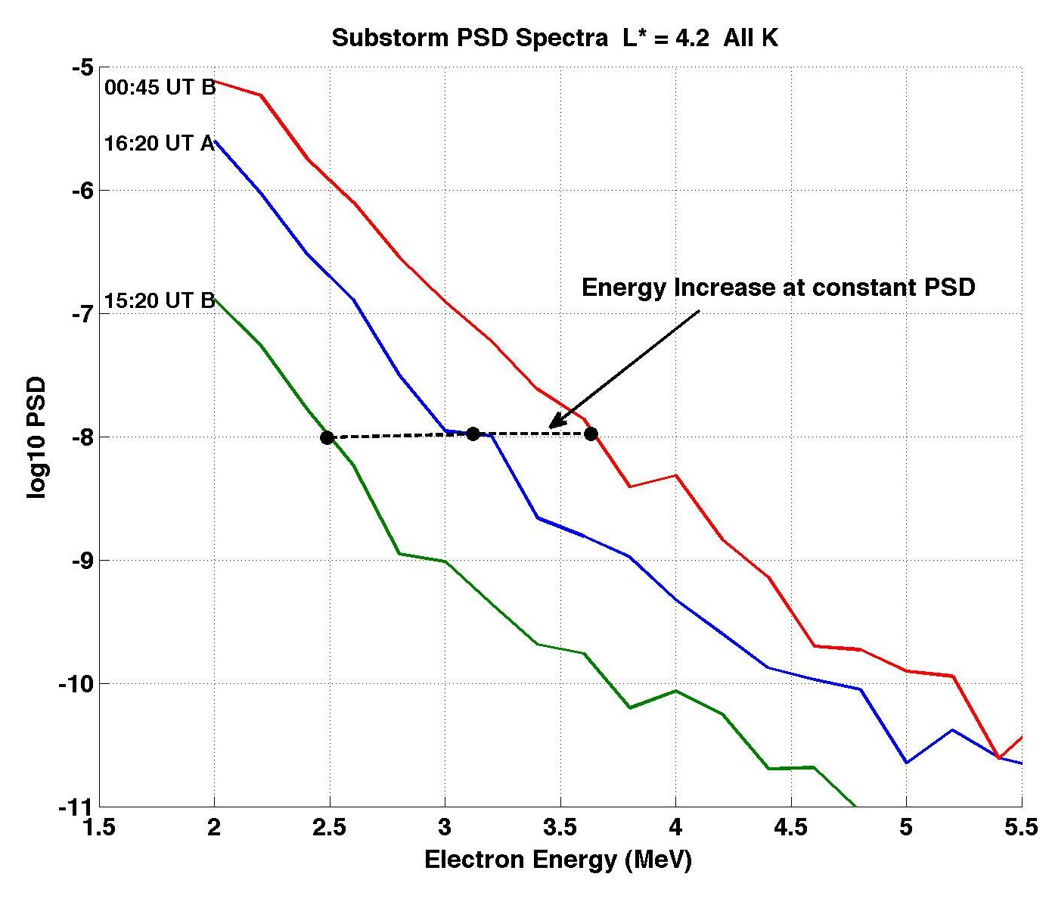
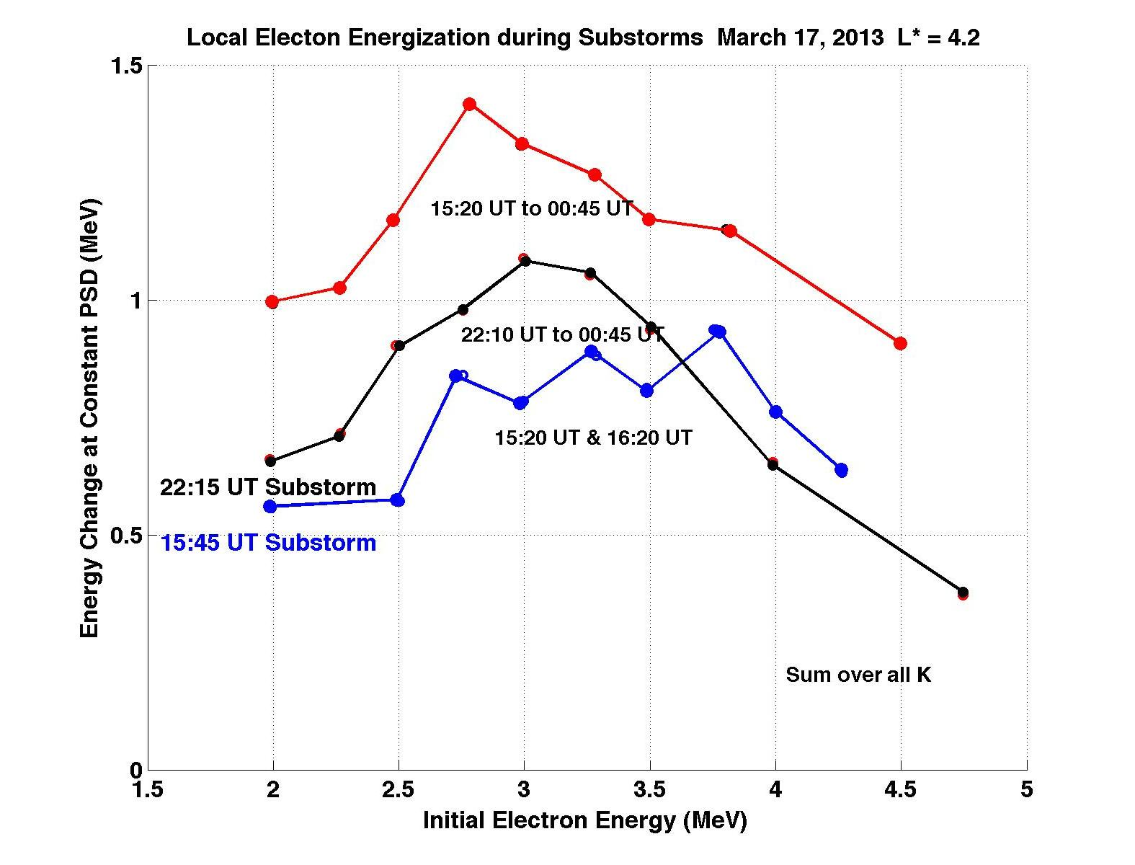
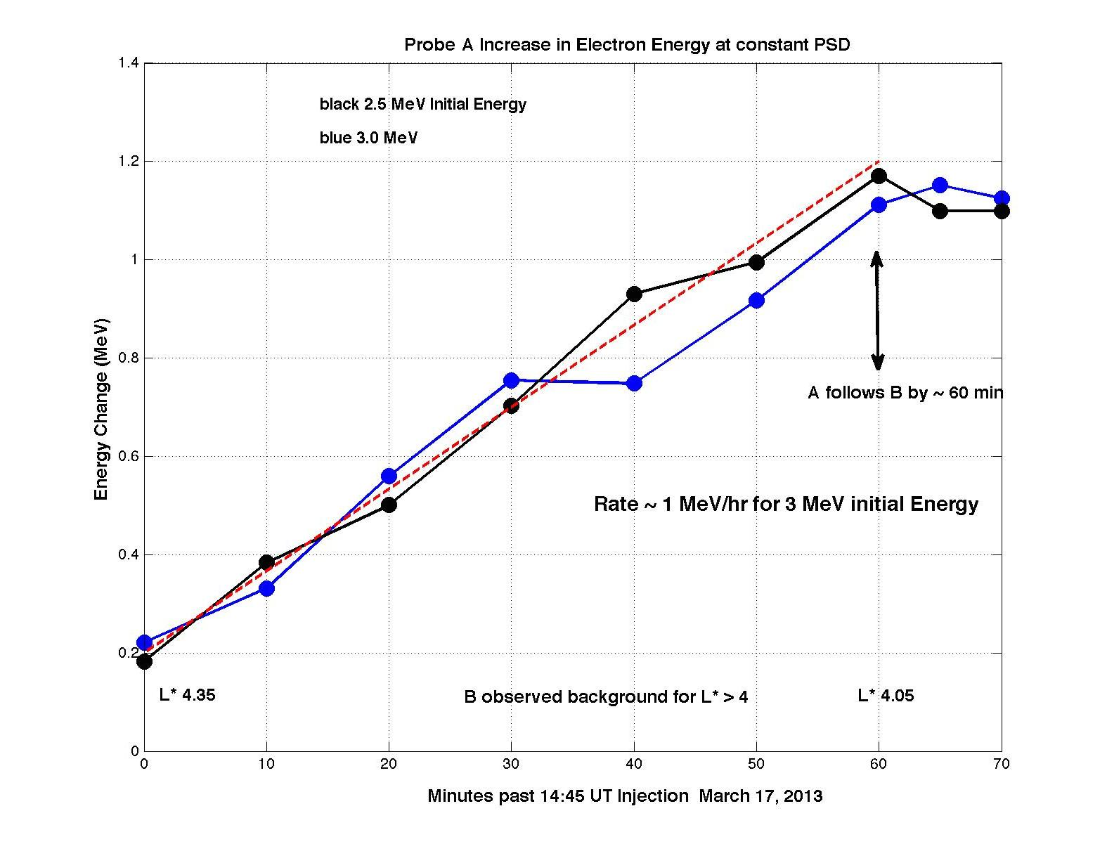
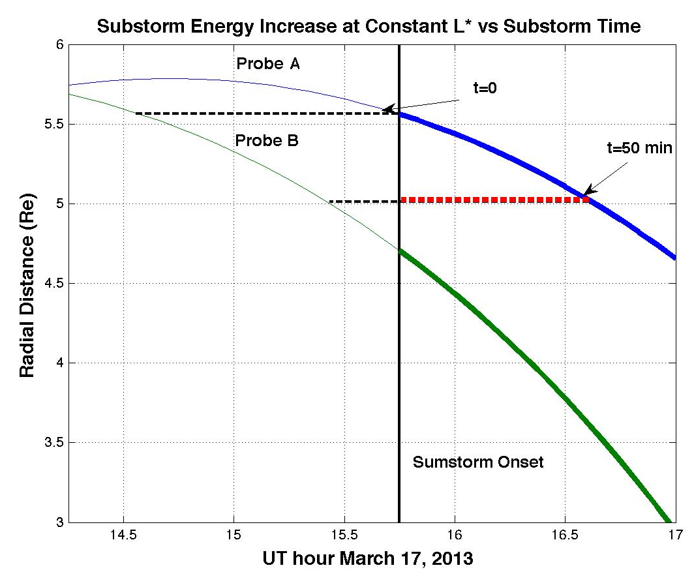
B
A
Prompt Local Acceleration of MeV Electrons during Substorm Injections
Non-linear Trapping & VLF Rising Tones (Omura et al, 2008)
Injection, Chorus & Local Acceleration (Thorne et al, 2013)
A follows B by 1 hr

Slide 4
New Opportunities
Spatial/temporal structures of injections and other transient phenomena - Enhanced orbit evolutions of the 2 Van Allen Probes to achieve different kinds of radial and local time separations, to better sample the evolving structures.
The need for good timing of the evolution of transient phenomena and the utility of having near-simultaneous background and perturbation observations along a similar path speak strongly for maintaining the configuration with Probes A and B in closely similar orbits with a temporal separation commensurate with the time scale of the phenomena of interest (e.g. ~1 hr for substorms).
Raising apogee of both Probes to (e.g.) 6.5 R_{E} would extend coverage into the region where injection physics is taking place in the midnight sector and would make crossings out of the plasmasphere and into the ring current more probable on the dayside. Coverage at higher L would address the physical processes in these active regions which are important for the evolution of the radiation belts.

