Slide 1
Nonlinear electric field structures
in the inner magnetosphere
D. M. Malaspina¹, L. Andersson¹, R. E. Ergun¹, J. R. Wygant², J. W. Bonnell³,
C. Kletzing⁴, G. D. Reeves⁵, R. M. Skoug⁵, and B. A. Larsen⁵
[1] U. Colorado / LASP
[2] U. Minnesota
[3] U.C. Berkeley
[4] U. Iowa
[5] Los Alamos
Van Allen Probes SWG
23-25 Sept. 2014
Mozer et al., 2013, PRL
Mozer et al., 2014, PRL
Chaston et al., 2014, GRL
Malaspina et al. 2014, GRL

Slide 2
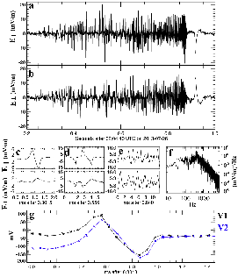
Nonlinear Electric Field Structures
in the Inner Magnetosphere
Diverse structures found < 6.6 RE:
Electron double-layers (Mozer et al. 2013)
Kinetic Alfven waves (Chaston et al. 2014)
Strong double layers (Malaspina et al. 2014)
Phase space holes (Malaspina et al. 2014)
Steepened chorus waves (Mozer et al. 2014)
Enable prompt, local acceleration:
Often high amplitude (> 20 mV/m)
E-fields parallel to B
Indicative of strong field-aligned currents
Related to ‘seed population’ creation ?
(Mozer et al. 2014)
Frequently Observed:
With dispersionless injection fronts
Inner edge of plasma sheet
Trapped / un-trapped boundary crossings
With sharp plasmapause crossings
Throughout m’sphere during shock impact

Slide 3
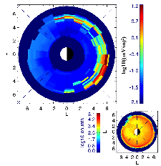
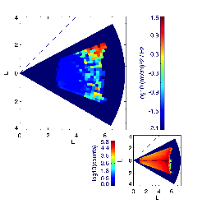
Nonlinear Structures in Extended Mission
Directly addresses:
Theme 1: injection temporal structure, evolution, effects on radiation belt and ring current
Theme 5: Detailed character of microphysical processes that energize radiation belt particles
Theme 6: Coupling between the magnetopause and the inner magnetosphere
Sample new regions:
New range of MLaT in night sector accessible in extended mission
Tune instruments:
Adjust EFW and/or EMFISIS spectral data coverage to full duty cycle
Coordinate MagEIS bursts w/ EFW or EMFISIS bursts
Trigger wave bursts on broad-band E-fields (or AE when in dusk sector)

