Slide 1
Observation of Prompt Energization to ultra relativistic energies by interplanetary shock
Shri Kanekal, Dan Baker, Bern Blake, Sam Califf, Seth Claudepierre, Scot Elkington, Joe Fennell, Allison Jaynes, Ashley Jones, Craig Kletzing, Xinlin Li, Geoff Reeves, Harlan Spence, and Lynn Wilson

Slide 2
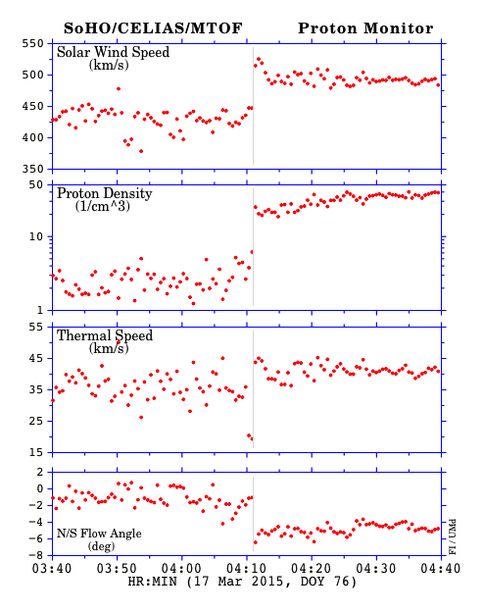
WIND, SOHO IP Shock observations

Slide 3
Prompt electron response: REPT A ultra relativistic electrons
Post injection
velocity dispersion

Slide 4
REPT A observations continued
Electrons energized to ultra-relativistic energies (>6 MeV)
Clear velocity dispersion suggesting local injection

Slide 5
MagEIS A observations
Weak enhancement in low energy channels
- likely bremsstrahlung
background
Implies energization confined to 1.0 to 6.0 MeV
Joe Fennell, Seth ClaudePierre

Slide 6
REPT and MagEIS post shock pitch angle distributions
Probe B
Seth ClaudePierre

Slide 7
Shock Injection and velocity dispersion
Xinlin Li

Slide 8
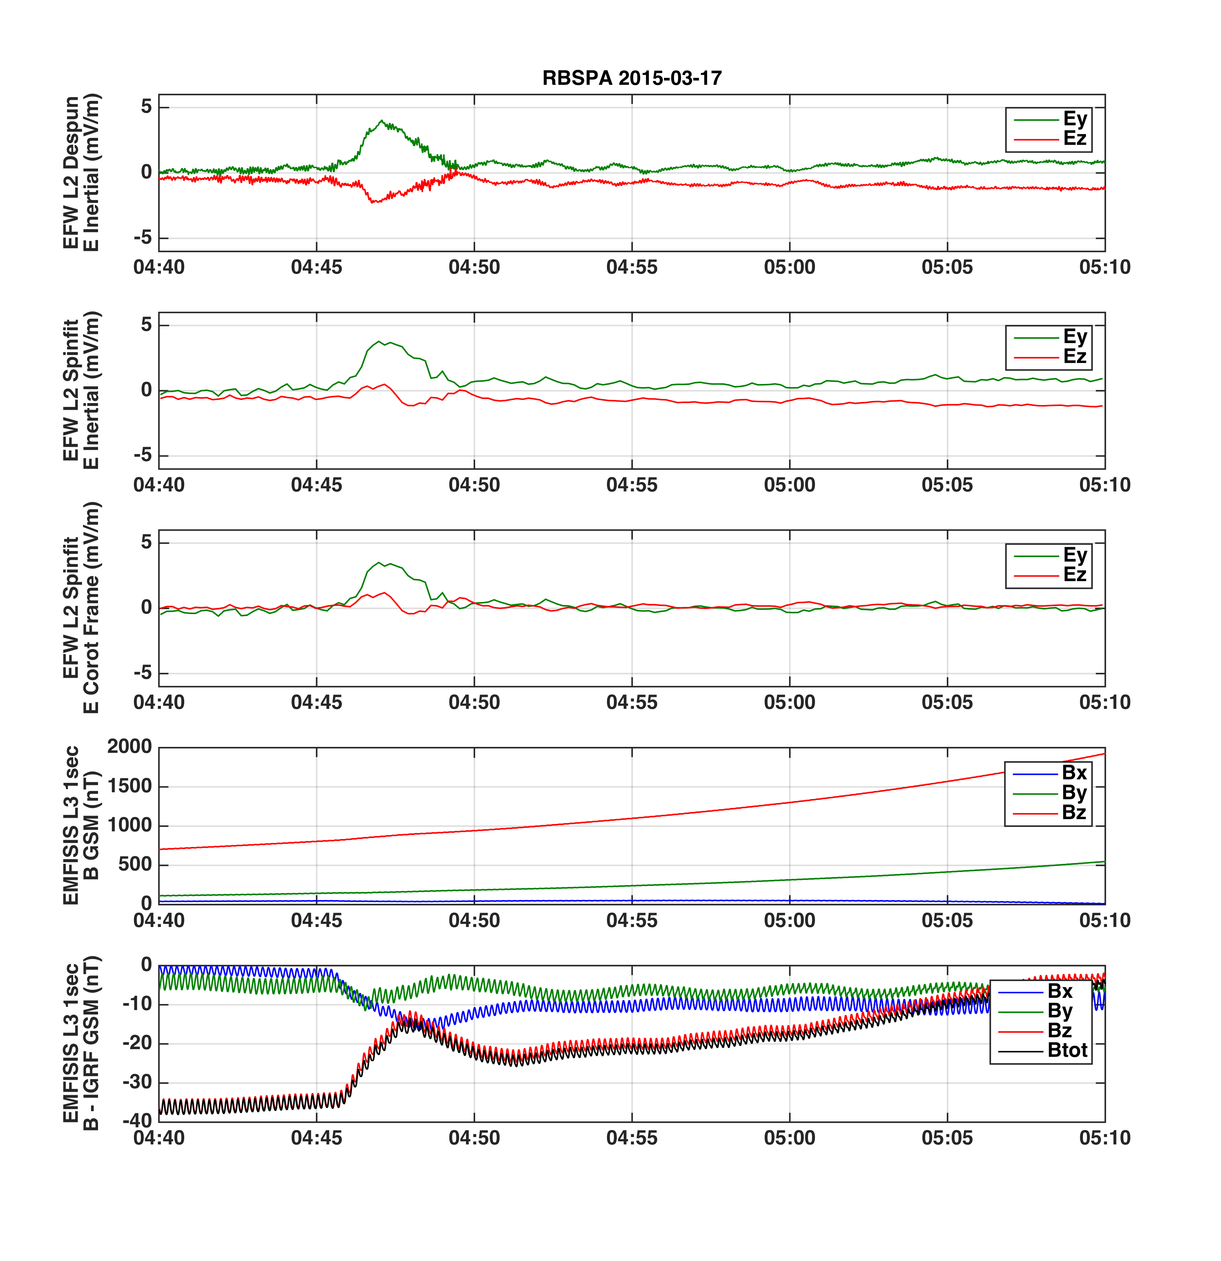
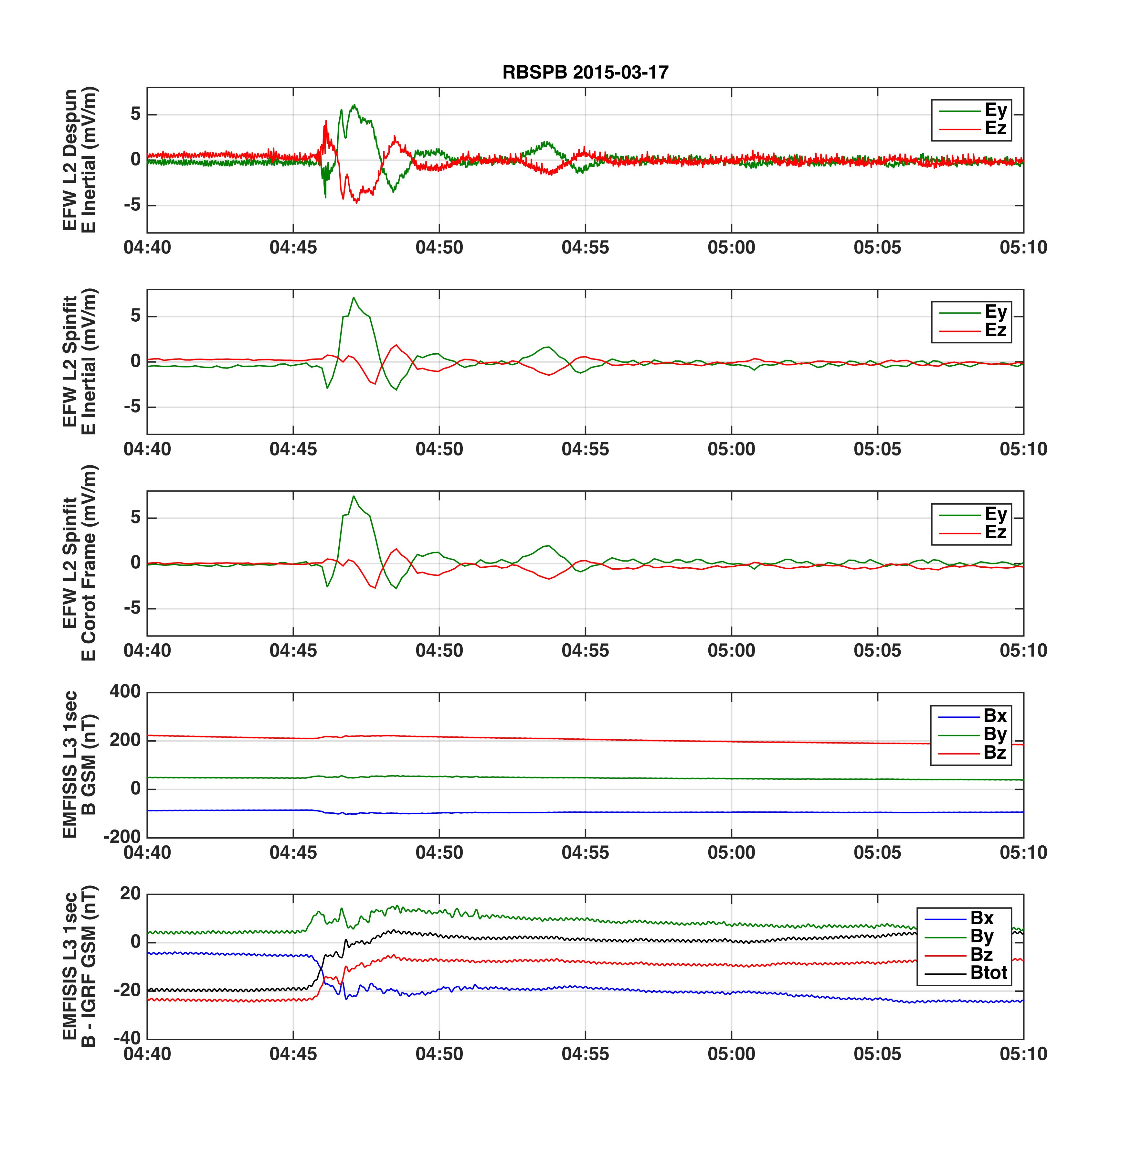
E and B Fields data from EFW and EMFISIS
Sam Califf

Slide 9
Drift velocity for electrons in a dipole field

Slide 10
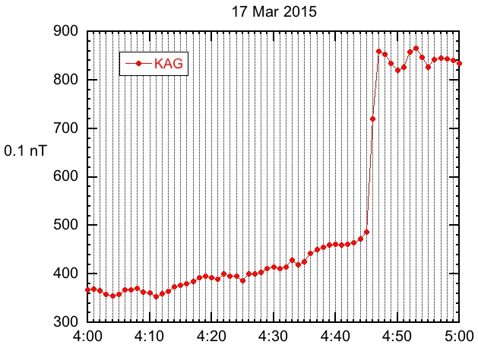
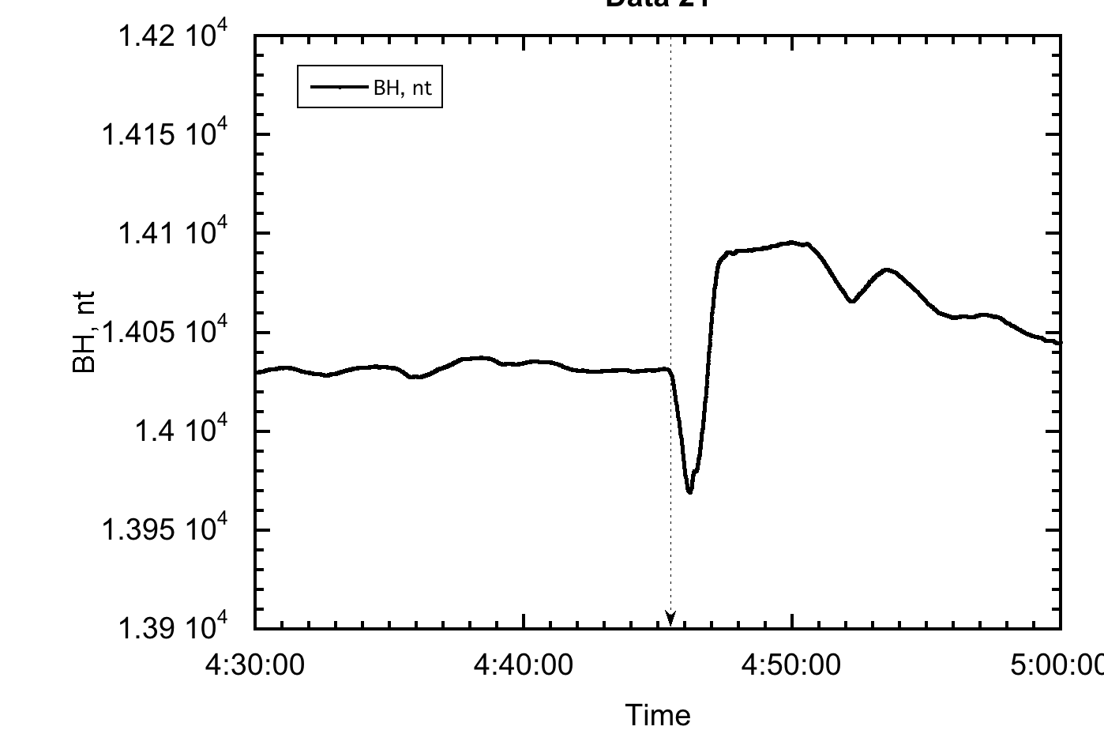
Ground magnetometer observations
210 Chain KAG
Time of shock passage 04:45 UT
Joe Fennell, Bern Blake

Slide 11
Shock Analysis based upon WIND measurements
Shock normal angle [degrees]: 56.1 ± 6.5
Sound speed Mach number: 6.74 ± 0.51
Alfven Mach number: 4.24 ± 0.42
Fast mode Mach number: 3.69 ± 0.21
Shock density compression ratio: 2.16 ± 0.39
Shock normal vector [GSE]: (-0.714814, -0.385614, 0.552736)
Upstream shock normal speed [spacecraft frame]: 510.79 km/s
Wind was located at the shock arrival time (~04:00 UT at Wind)
at roughly: (1612674.625, 346568.312, 80152.977) [km, GSE]
Lynn Wilson

Slide 12
Peak flux times and drift speed
E (MeV) | Vd (Rads/sec) | Time (hr:min:sec) | T Mins. Of day | ϕ₀
6.3 | 0.860 | 4:47:28 | 287.47 | 0.461
5.2 | 0.725 | 4:47:43 | 287.65 | 0.464
4.2 | 0.600 | 4:48:00 | 287.83 | 0.467
3.4 | 0.500 | 4:48:27 | 288.38 | 0.471
2.6 | 0.400 | 4:48:47 | 288.73 | 0.475

Slide 13
REPT A flux profiles 90⁰ pitch angle
2.6 MeV
4:48:44
3.4 MeV
4:48:23
4.2 MeV
4:47:50
5.2 MeV
4:47:39
Ashley Jones

Slide 14
Drift Period Analysis from REPT A
Time_{injection} = 286.3 ± 0.3
ϕ_{injection} = -0.47±0.15 = 333.1⁰ ±9⁰
ϕ_{s/c} = 0.47 rad. = 27⁰

Slide 15
Shock arrival calculated from WIND compared to
injection time from REPT observations
Assume Nominal Magnetopause at 11Re, i.e. 70125 km
Distance in X (GSE) travelled by shock
ΔX = X_{Wind}-X_{MP}
= 1612674 - 70125 = 1542549 km
Time of traversal = 1542549*0.88/510
where 0.88 is cosine of shock normal angle θ
Time of traversal = 2661 sec = 44min
Time of shock at WIND = 4:00UT
propagated time to MP nose = 4:44UT
from REPT measurements = 4.46UT

Slide 16
Summary and Conclusions
Shock response of electrons show several interesting features
- prompt injection of ~1 to 6 MeV electrons
- no discernible response of ~200 keV to ~1 MeV
Ground level discontinuity 04:45 UT (shock passage)
- Estimated time of injection 04:46:18 UT
- Electrons energized to 6 MeV in < 2 minutes
Drift echo times consistent with expectation [O’Brien et al.,2015]
Detailed analyses underway
- multiple publications planned
- encourage participation from SWG

Slide 17
Shock Arrival calculated from WIND position
and shock measurements
Shock front
-y GSE
θ
Vdt
Shock normal
dx
Shock front
-x GSE
Vdt/dx = cosθ
=> dt = dx*cosθ/V

