Slide 1


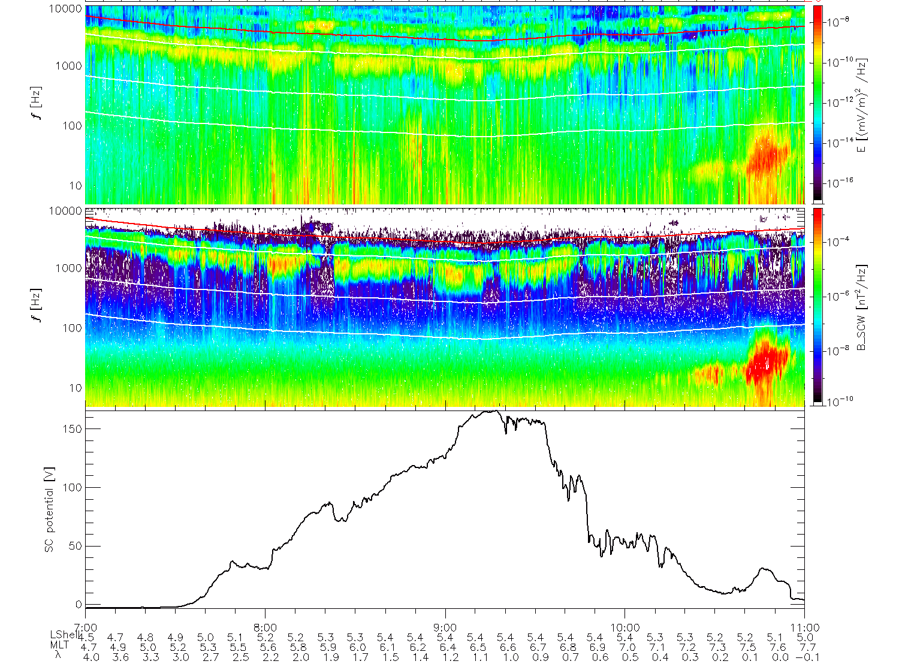
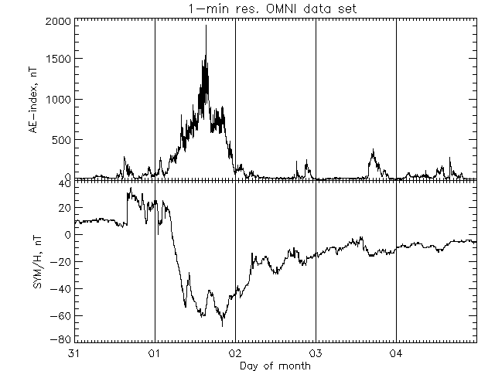
Nonlinear bursts of electric field – Time Domain Structures
GEM 2015, Aspen
Electric and magnetic field dynamic spectrograms from EMFISIS aboard Van Allen Probe B (2012-11-01), and spacecraft potential in the bottom. Right panels shows AE and Dst index. Red arrow indicates the observations time

Slide 2
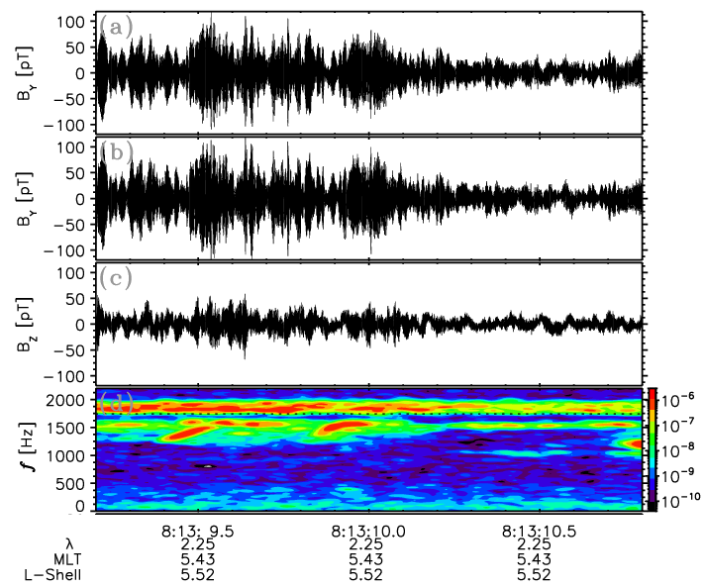
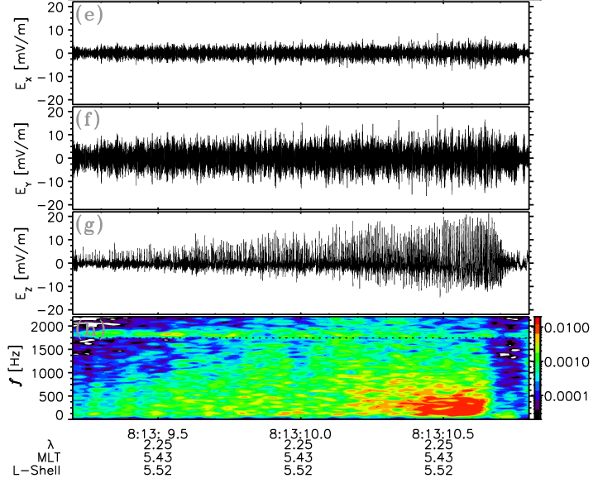
Waveforms of magnetic and electric field
GEM 2015, Aspen
Electric and magnetic field waveforms and dynamic spectrograms from EFW aboard Van Allen Probe B (2012-11-01), and spacecraft potential in the bottom.

Slide 3
Parametric decay
f₁=1.8-1.9 kHz, f₂=1.5-1.6 kHz, f₃=0.3 kHz
λ₁=23.5-25 km, λ₂=21-22 km, λ₃=10 km
V_{TDS}=3000 km/s and
(ω₁- ω₂)/(k₁+k₂) =2200-4500 km/s
λ_{eH}=50-100 m,
n_{cold}=5-6 cm⁻³, n_{hot}=0.1-0.5 cm⁻³
(n_{hot in TDS}=1-3 cm⁻³)

Slide 4
Parametric decay
Dynamics of the (a) perpendicular X component of the magnetic field and the (b) parallel Z component of the electric field. (c) Spectra of the magnetic (black curve) and electric (red curve with the scale in the right) field perturbations. The Poynting flux direction is indicated in the bottom of Figure (c) with red being along the background magnetic field and blue in the opposite direction. The expression 0.5fce is indicated by the dotted line
The bicoherence spectrum of the two transverse magnetic field components and the parallel component of the electric field. Dashed lines indicate frequencies of observed whistler waves (f₀ and f₁) and the frequency of EAW (f₀ − f₁). Crosses indicate the supposed positions of peaks on cross-frequencies ([f₀, f₁] and [f₁, f₂] ) in a case of their phase connection.

Slide 5
Electron distribution function
Distribution of electron fluxes on pitch angles (a). α = 0◦ corresponds to the magnetic field aligned direction. The distribution functions restored from the electron fluxes distribution with respect to the background magnetic field. The fit by the sum of five Maxwellians (60, 150, 240, 2100, and 9500 KeV) is shown by red curve.

Slide 6
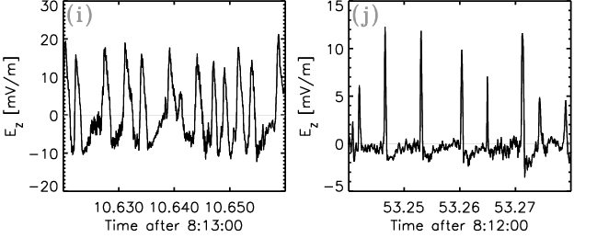
Electron acoustic waves
Nonlinear development of electron acoustic waves

Slide 7
Conclusions
We present the observation of parametric interaction of two VLF whistler waves (with frequencies 𝜔₀ and 𝜔₁) propagating in opposite directions and low-frequency electron acoustic wave (frequency𝜔₂ roughly being the difference between the whistler wave frequencies) which transforms to the nonlinear localized bursts of electric field with the main component parallel to the background magnetic field.
The Van Allen Probes spacecraft often observes clusters of such spatially localized bursts in the Earth’s outer radiation belts, and often they are associated with large-amplitude chorus waves. These observed structures propagate to the geomagnetic equator and share properties of soliton-like nonlinear electron acoustic waves:
  a velocity of propagation∼2000–4000 km/s
  a spatial scale of electric field burst periodicities∼20–40 km.
Observed properties of the three waves are in a good agreement with an assumption of their parametric interaction.

