Slide 1
Long-term VERB code simulations of ultra-relativistic elections and comparison with Van Allen Probes measurements
Drozdov A. Y.^{1,2}, Shprits Y. Y.^{1,3}, Orlova K.G.^{1,2}, Kellerman A. C.¹, Subbotin D. A.¹, Baker D. N.⁴, Spence H.E.⁵ and Reeves G.D.⁶
University of California, Los Angeles, CA, USA
Lomonosov Moscow State University Skobeltsyn, Institute of Nuclear Physics, Moscow, Russia
Massachusetts Institute of Technology, Cambridge MA, USA
Laboratory for Atmospheric and Space Physics, University of Colorado, Boulder, CO, USA
Institute for the Study of Earth Oceans and Space, University of New Hampshire, Durham, NH, USA
Space Science and Applications Group, Los Alamos National Laboratory, Los Alamos, NM, USA

Slide 2
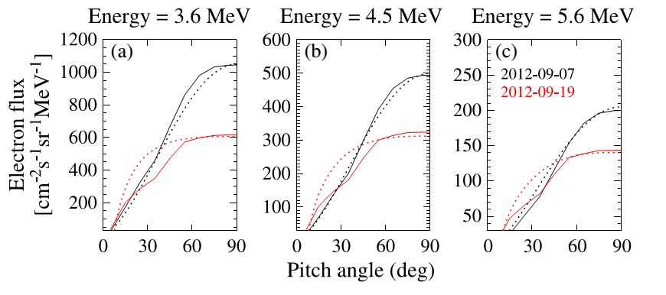
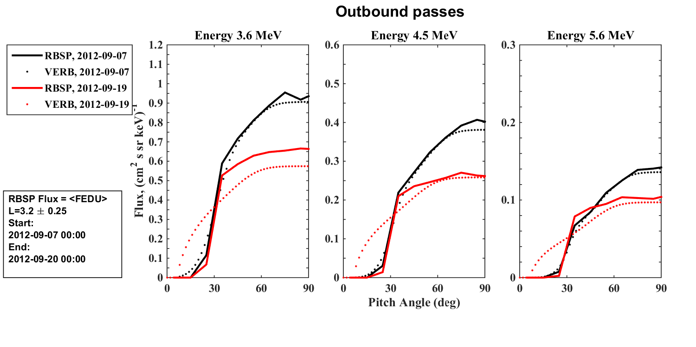
Comparison of 1D simulations Sep, 07 – 19, 2012
Reproduce 1D simulation performed by Thorne et al. [2013]
Results of simulation from Thorne et al. [2013]
Comparison of the diffusion coefficients
“We demonstrate that the slow temporal decay of the electron ring for energies above 3 MeV is caused by pitch angle scattering due to the global distribution of plasmaspheric hiss”
Results of simulation by the VERB code

Slide 3
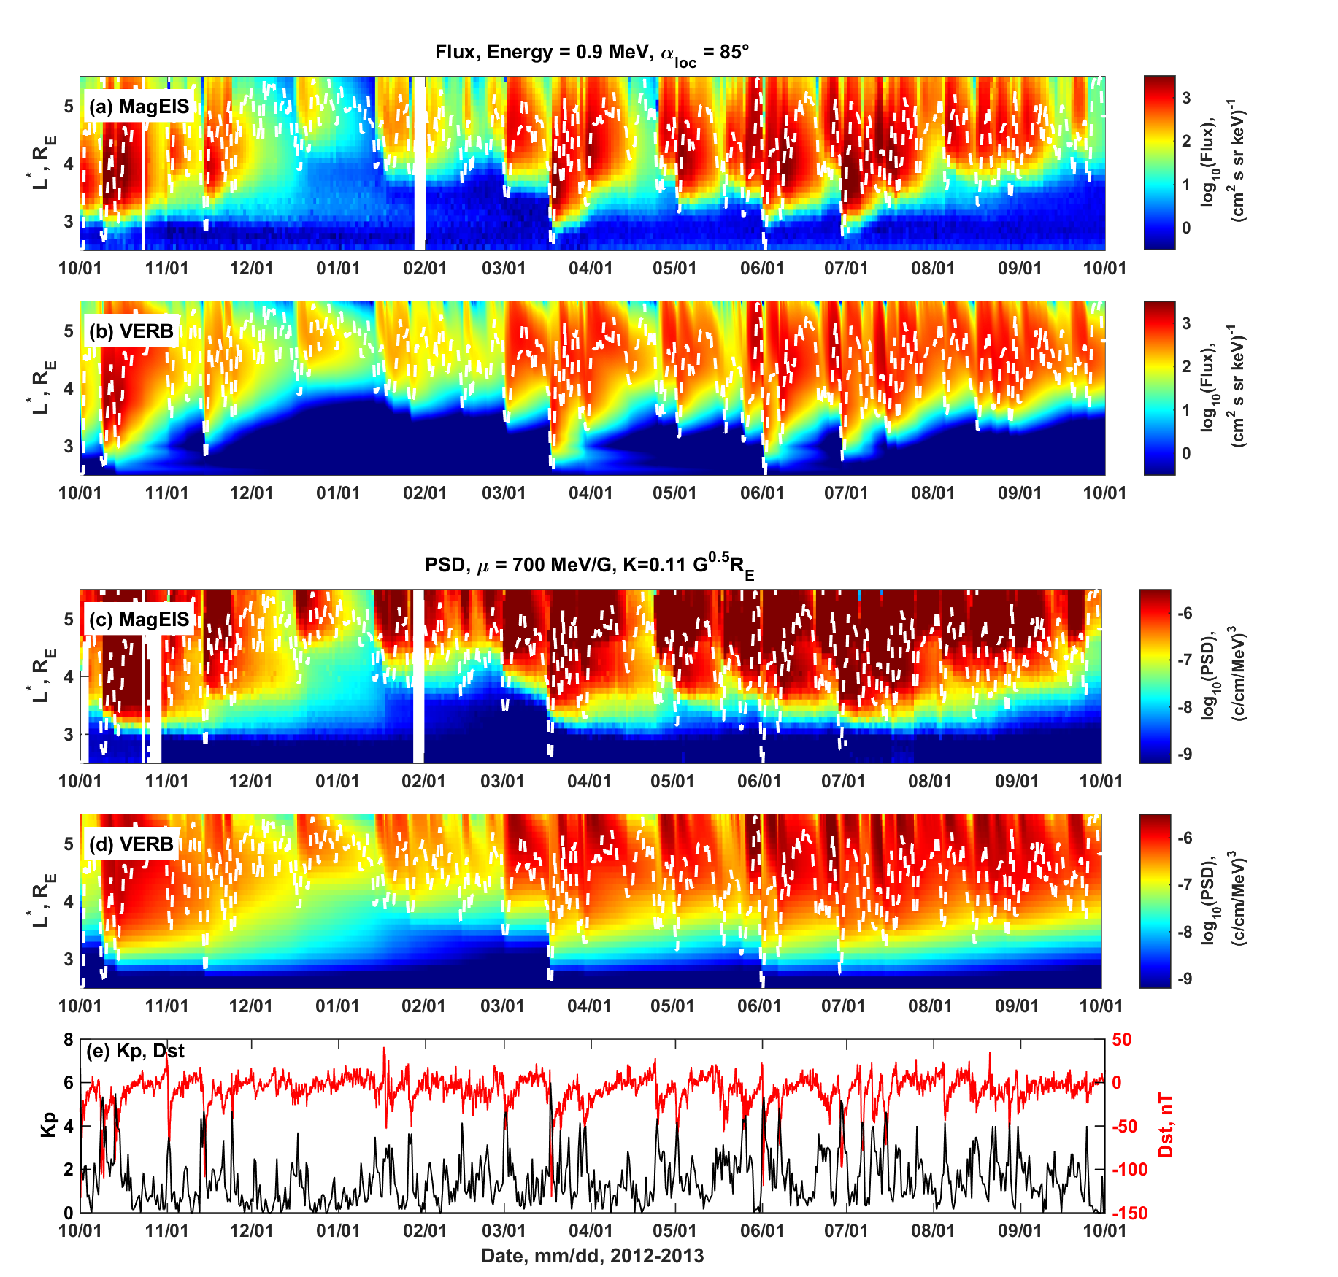
Long period simulation Oct 2012 – Oct 2013
Reproduce the dynamics of relativistic electrons, but not for the ultra-relativistic energies
Flux. Energy 0.9 MeV. L* vs time plot.
Observations
Simulation
PSD. μ = 700 MeV/G. L* vs time plot.
Flux. Energy 3.6 MeV. L* vs time plot.
Observations
Simulation
Kp DST

Slide 4
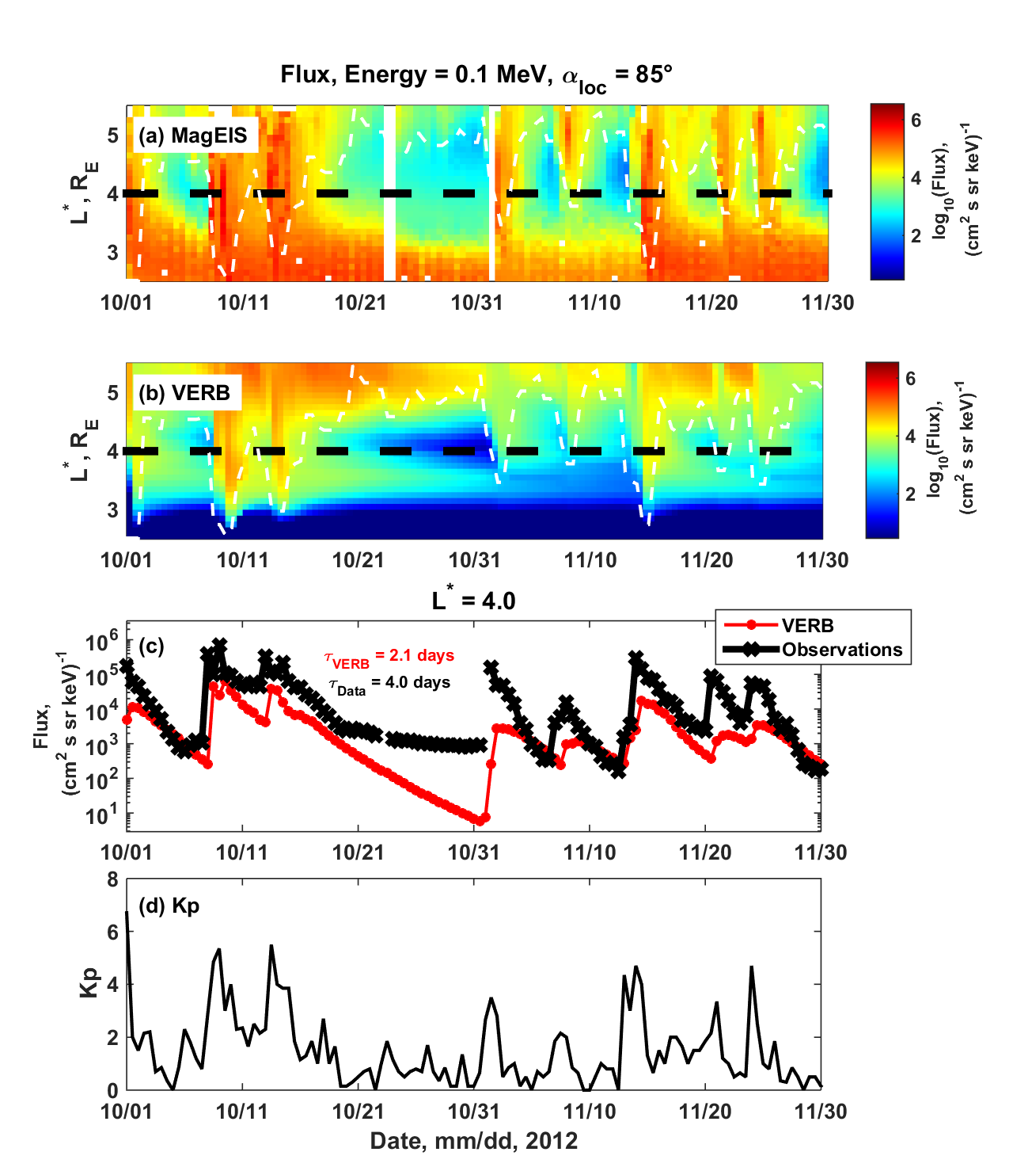
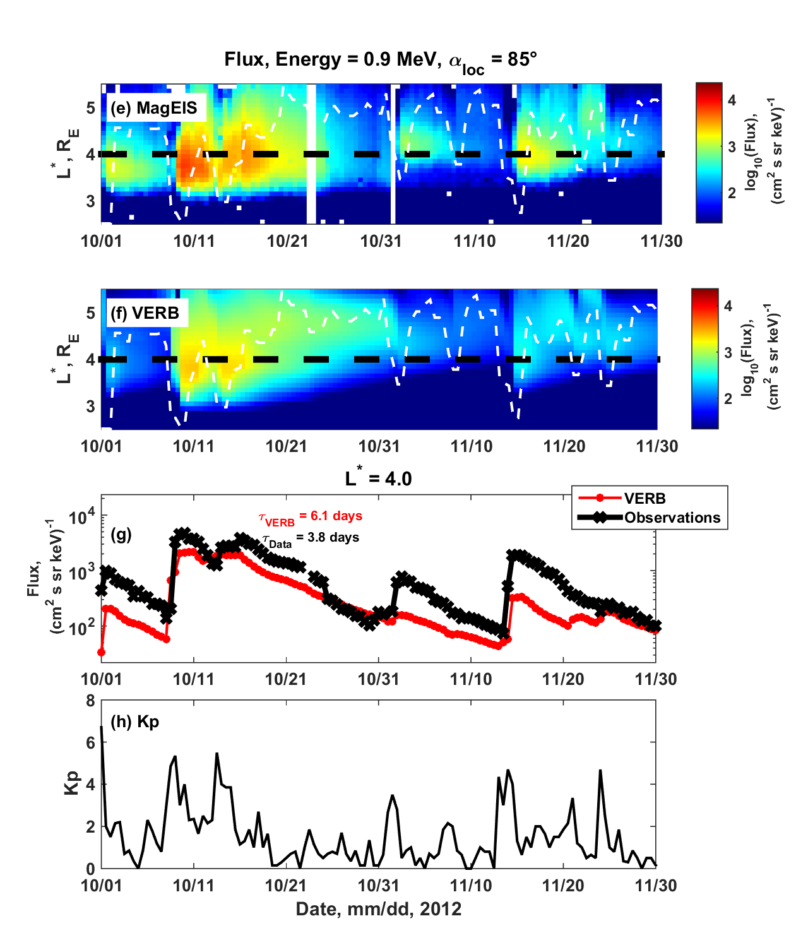
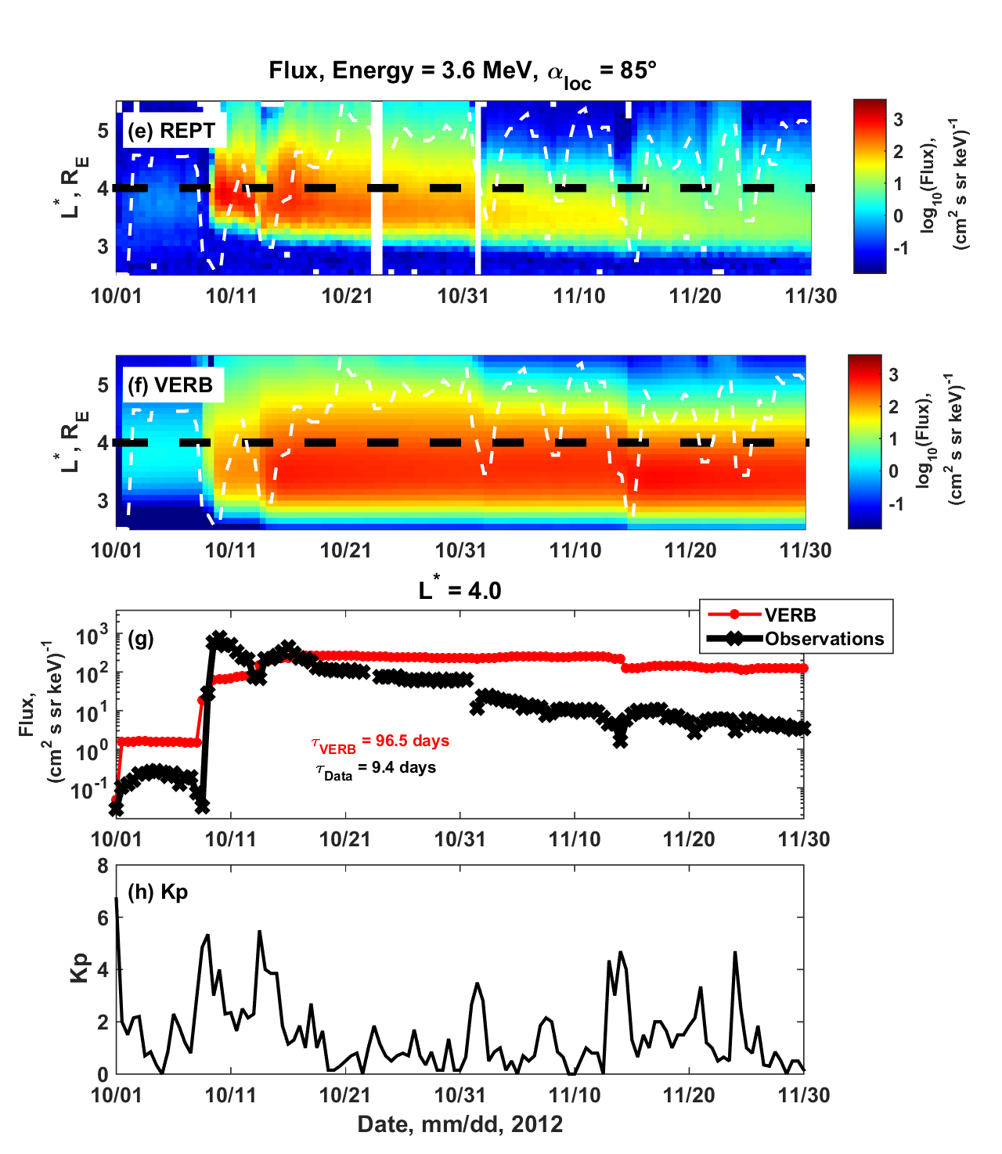
Decay rates comparison at L*=4 Oct, 01 – Nov, 30, 2012
Observed and modeled decay rates are significantly different for ultra-relativistic electrons
Energetic electrons. 300 keV
Relativistic electrons. 900 keV
Ultra-Relativistic electrons. 3.6 MeV
Observations
Simulation
L*=4
$$τ_{VERB}=2.1 days, τ_{Data}=4.0 days$$
$$τ_{VERB}=6.1 days, τ_{Data}=3.8 days$$
$$τ_{VERB}=95.5 days, τ_{Data}=9.4 days$$
Drozdov, A., Y. Y. Shprits, K. G. Orlova, A. C. Kellerman, D. A. Subbotin, D. N. Baker, H. E. Spence, G. D. Reeves (2015), Energetic, relativistic, and ultrarelativistic electrons: Comparison of long-term VERB code simulations with Van Allen Probes measurements, J. Geophys. Res. Space Physics, 120, doi:10.1002/2014JA020637.

Slide 5
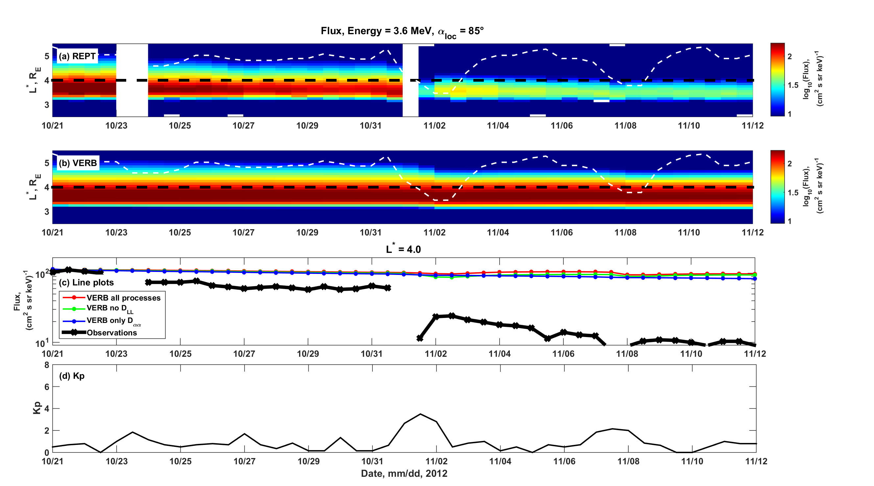
1D, 2D and 3D simulations Oct, 21 – Nov, 12, 2012
Neither of 1D, 2D, 3D simulations can reproduce the dynamics of ultra-relativistic electrons
Observations
3D Simulation
Full simulation
L* = 4
Hiss, EMIC waves?
No radial diffusion
Only pitch-angle scattering (no sources)
Observations

Slide 6
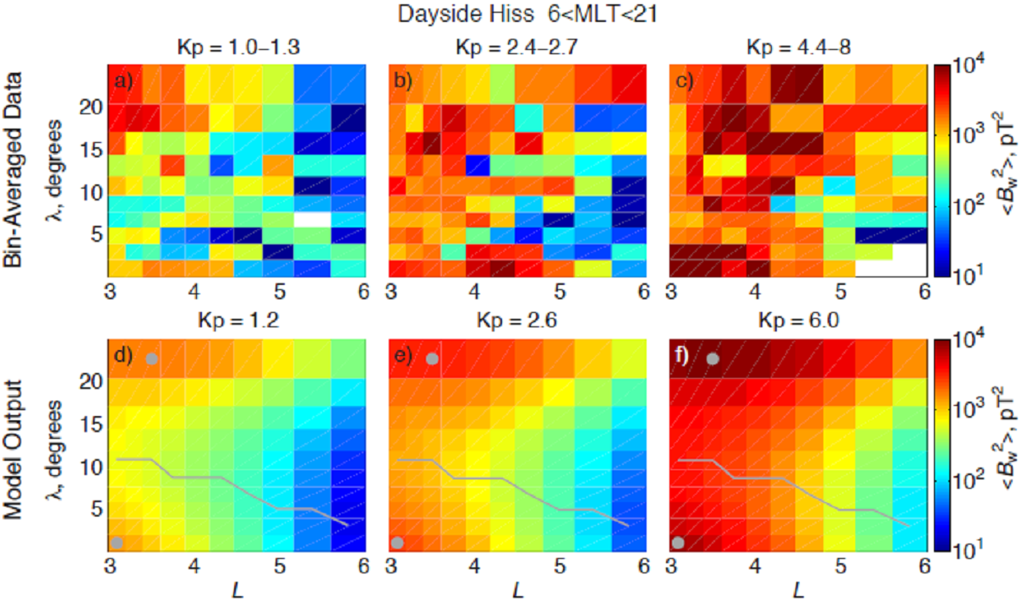
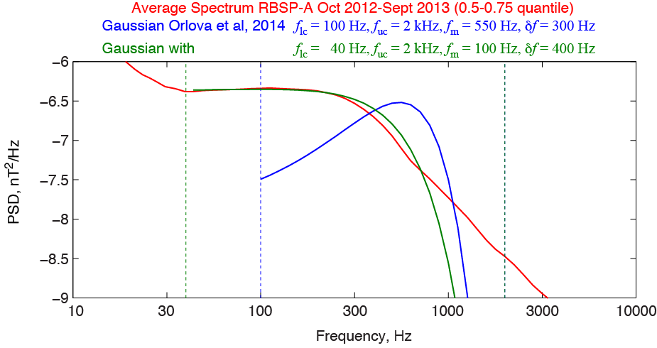
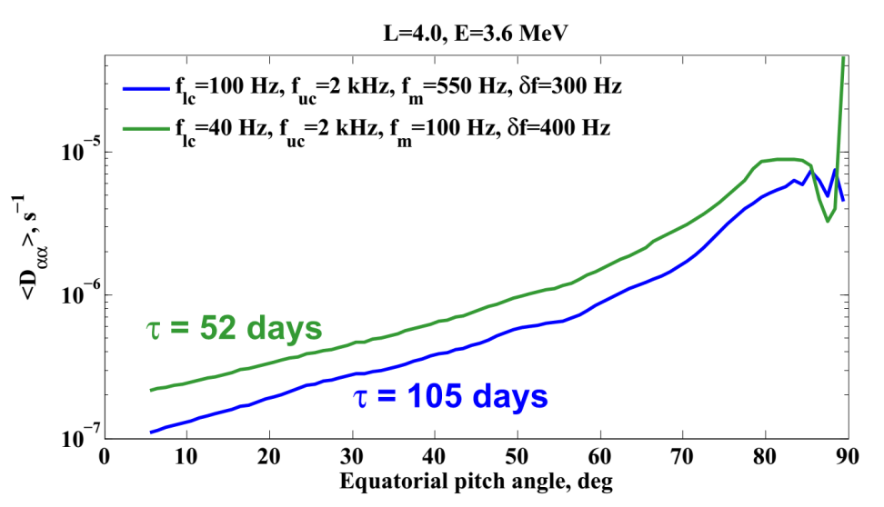
Discussion of possible loss mechanisms
Average spectrum for the Hiss waves
Observed and used in the D_{αα} calculations
B_{w}² observed and used in D_{αα} calculations
Latitude and L* dependence.
Calculated D_{αα} with various lower frequency cutoff
Decay rates.
Orlova at al., 2014
Data
Model
Courtesy of Maria Spasojevic
Accurate determination of such parameters as wave amplitude, power spectral density, wave normal angle, plasma pause location, plasma density are important for computing the diffusion coefficients.

Slide 7
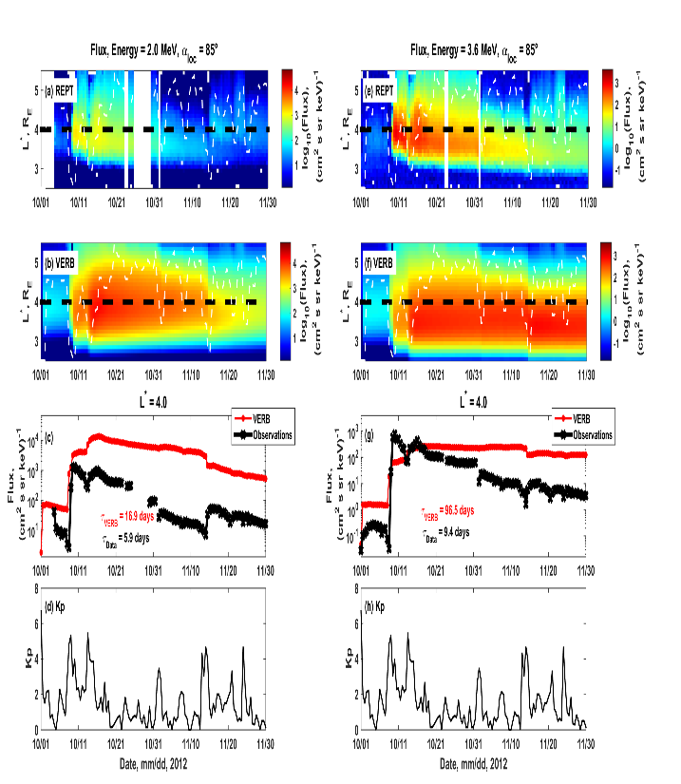
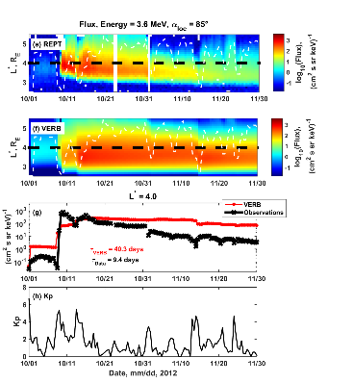
Decay rates comparison at L*=4 Oct, 01 – Nov, 30, 2012
Decay rates for different hiss diffusion coefficients.
Ultra-Relativistic electrons. 3.6 MeV
Lower cutoff ~100 Hz
Lower cutoff ~40 Hz
Observations
Simulation
L*=4
$$τ_{VERB}=95.5 days, τ_{Data}=9.4 days$$
$$τ_{VERB}=40.3 days, τ_{Data}=9.4 days$$

Slide 8
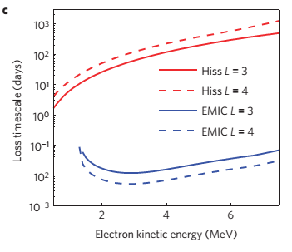
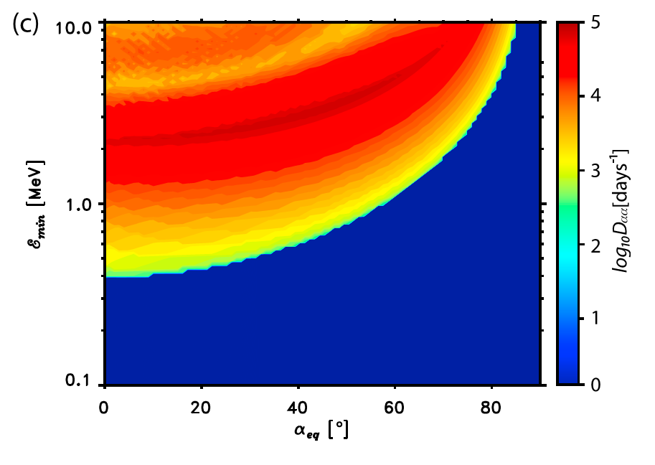
EMIC waves are important!
Thorne and Kennel [1971]; Summers and Thorne [2003]; Li et al. [2007] Ukhorskiy et al., [2010] suggested that EMIC waves may provide efficient scattering mechanism for relativistic electrons.
The loss time scale for EMIC and hiss waves
Bounce-averaged pitch-angle diffusion coefficient for the EMIC waves
Shprits et al., 2014
Ukhorskiy et al. 2010

Slide 9
Conclusions
Comparison of VERB code simulations with Van Allen Probes observations shows relatively good agreement for relativistic and energetic electrons.
At higher energies, modeled fluxes of ultra-relativistic electrons show much slower decay rates than seen in observations.
Comparison of simulations with observations show that the EMIC waves is likely a major additional mechanism of the ultra-relativistic electrons scattering that needs to be included into simulations.

Slide 10
BACKUP

Slide 11
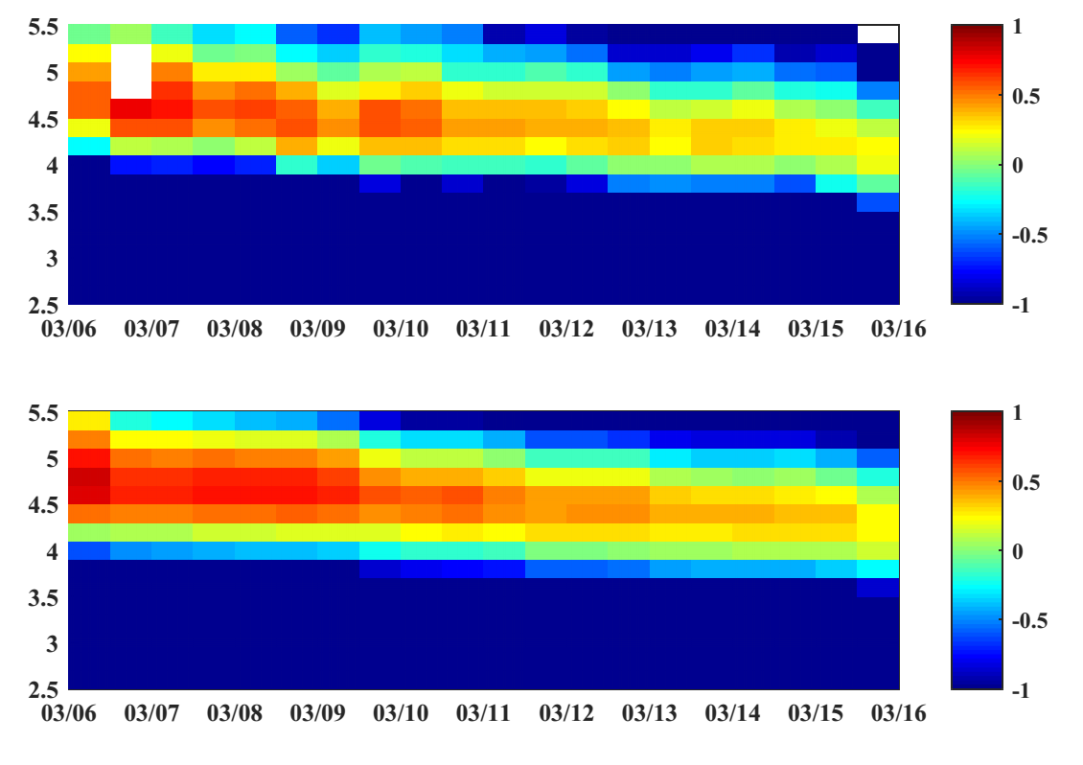
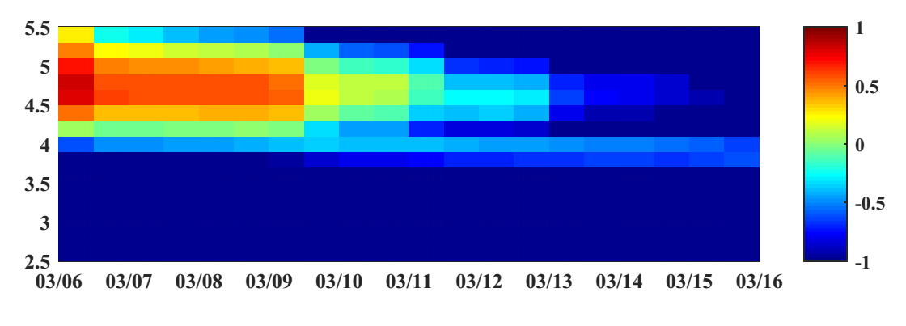
Simulations with EMIC waves Mar, 06 – 16, 2013
EMIC waves are tricky
Ma et al. [2015]
Reproduce the results
When Kp ≥ 2 EMIC, B_{w}² = 0.1 nT² (B_{w} = 0.32 nT)
Observations
3.60 MeV
Observations
Simulation
Simulation
3.60 MeV
Preliminary
B_{w} = 1 nT
[e.g. Ukhorski et al, 2010; Min et al. 2012]
Simulation
3.60 MeV
Preliminary

Slide 12
EMIC Daa

Slide 13
Long period simulation Oct 2012 – Oct 2013
Reproduce the dynamics of relativistic electrons
Flux. Energy 0.9 MeV. L* vs time plot.
Observations
Simulation
PSD. μ = 700 MeV/G. L* vs time plot.
Observations
Simulation
Kp DST

Slide 14
Long period simulation Oct 2012 – Oct 2013
There is a discrepancy at ultra-relativistic energies
Flux. Energy 3.6 MeV. L* vs time plot.
Observations
Simulation
PSD. μ = 3500 MeV/G. L* vs time plot.
Observations
Simulation
Kp DST

