Slide 1
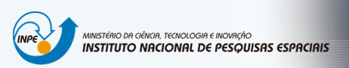

Van Allen Probes SWG meeting 2015
Global Recovery of the Outer Radiation Belt after a Corotating Solar Wind Stream
Ligia Alves da Silva
National Institute for Space Research - INPE, Brazil

Slide 2
Goals
Understand the stability of the outer radiation belt after a corotating solar wind stream.
Observe the solar wind pattern during interaction of complex interplanetary structures.
Observe the pitch angle evolution during the recovery.
Identify the presence of the ULF waves and VLF waves during dropout and reformation.

Slide 3
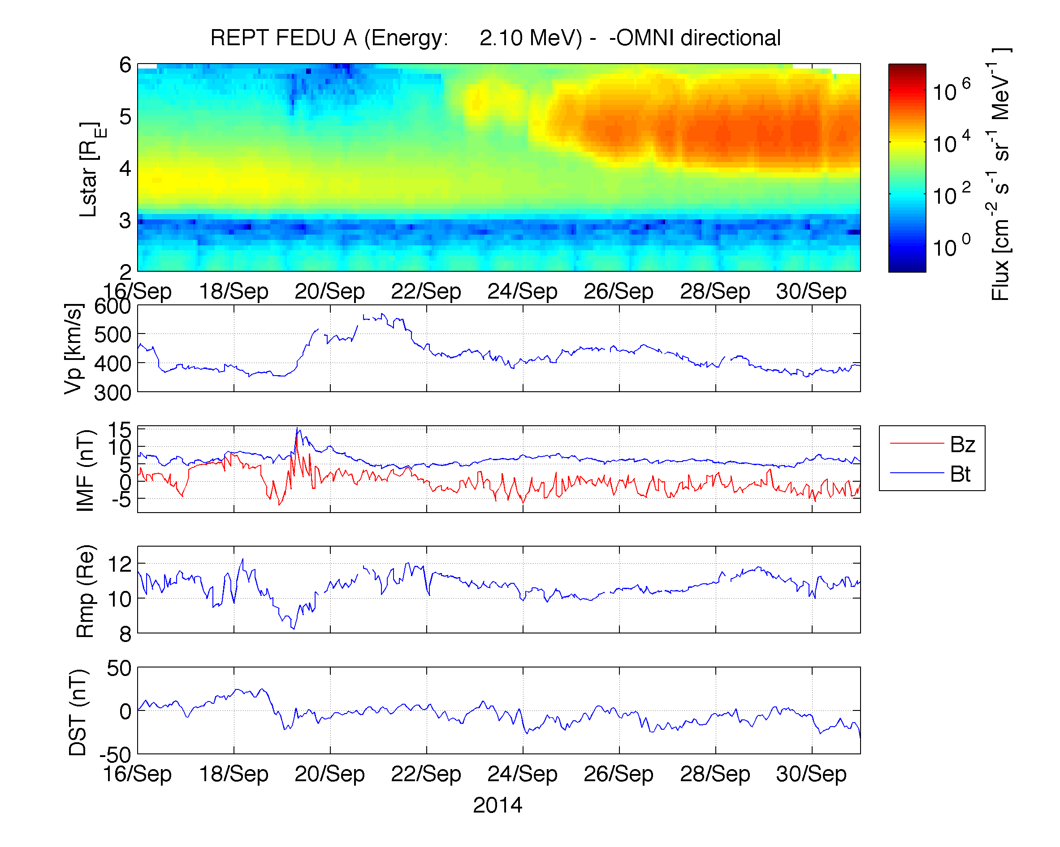

Slide 4
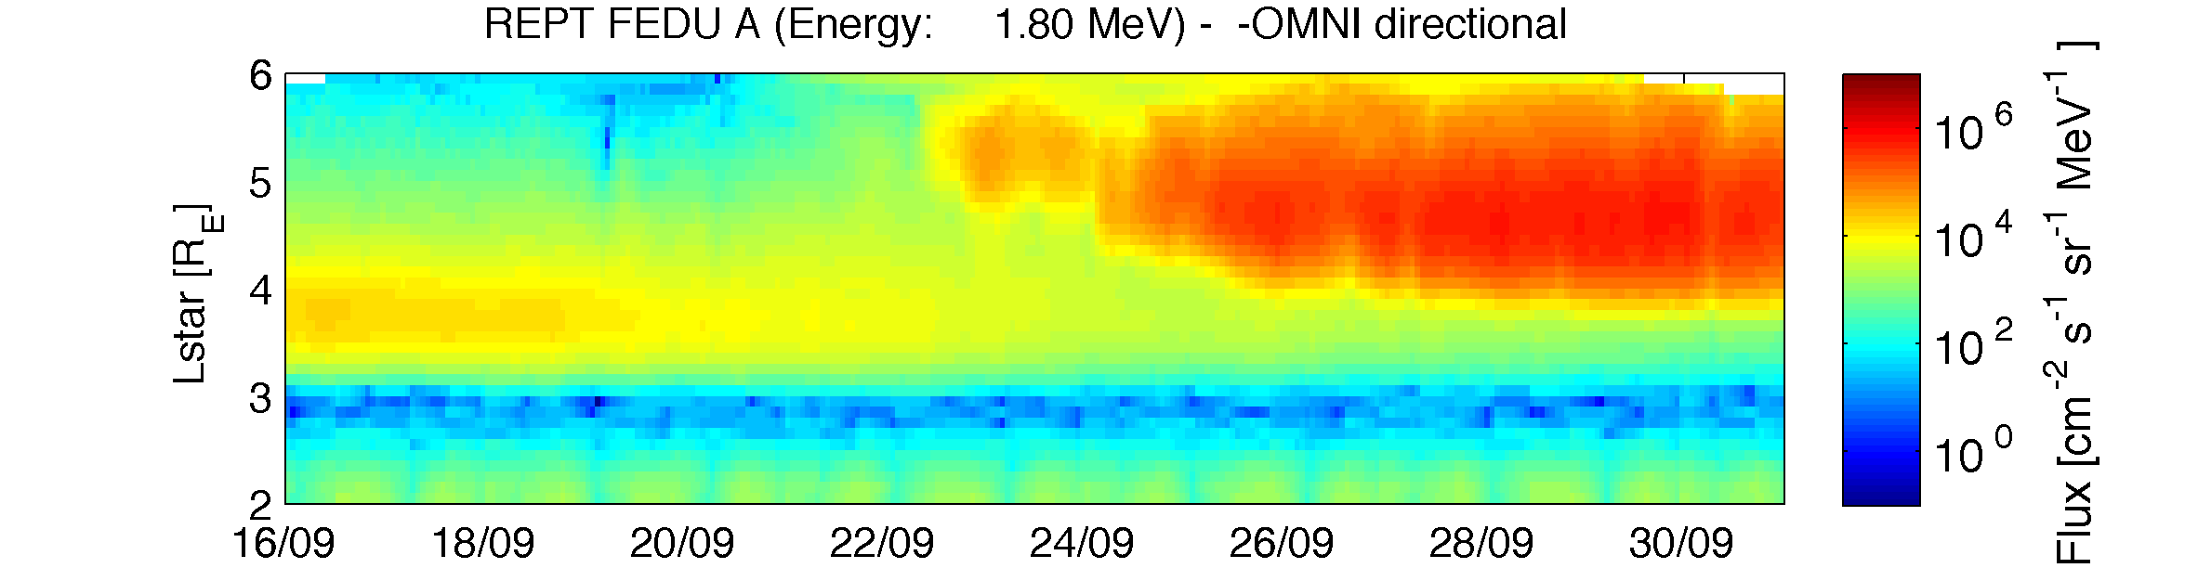
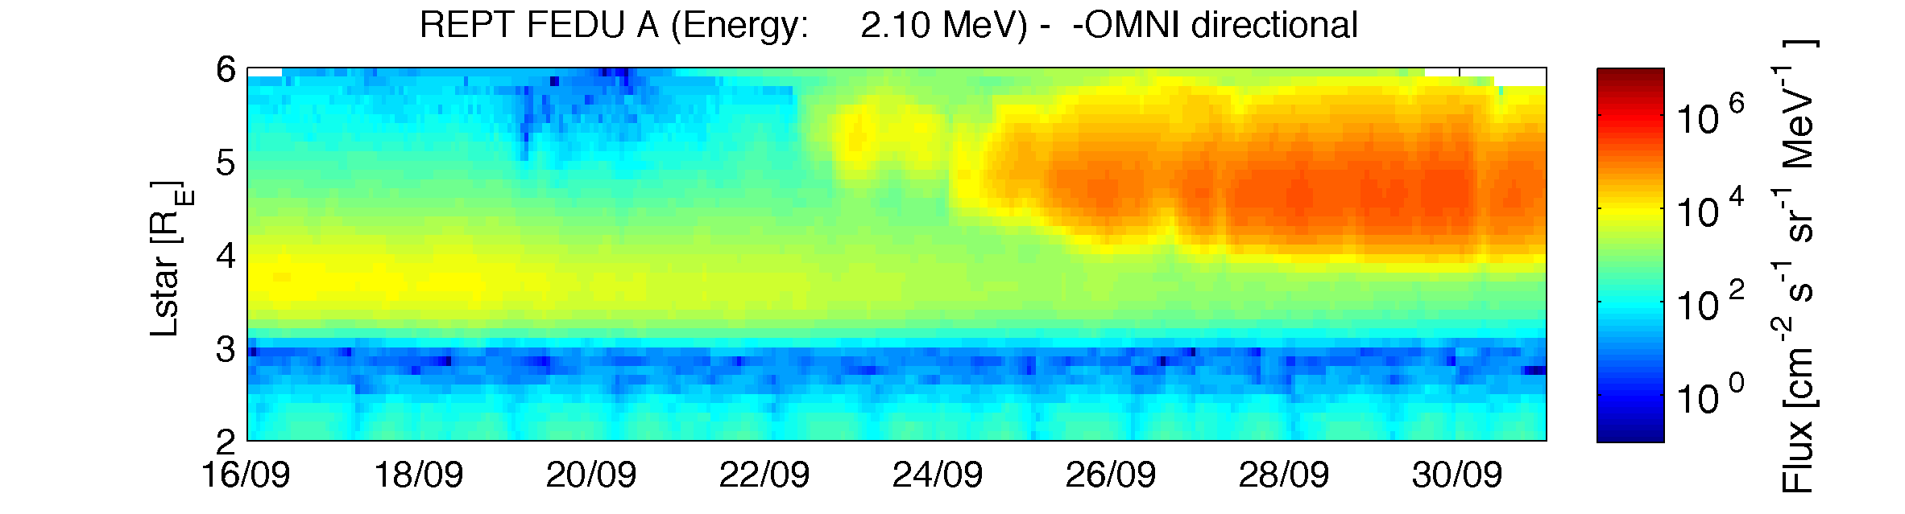
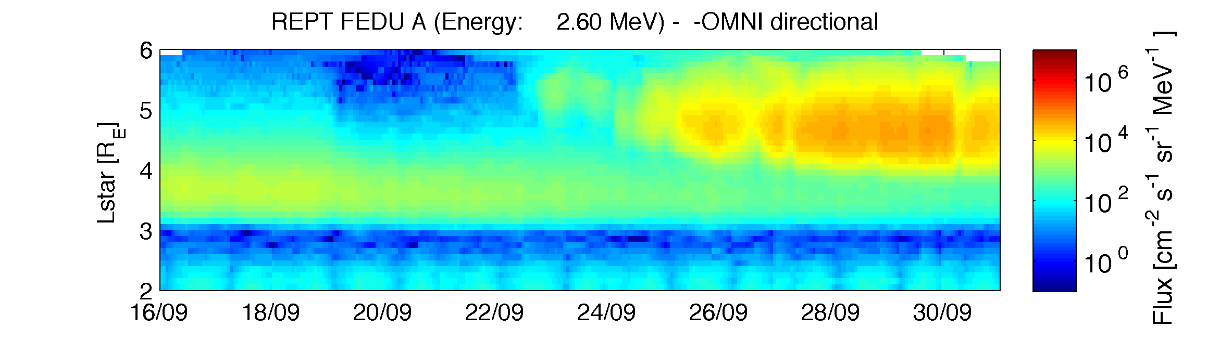
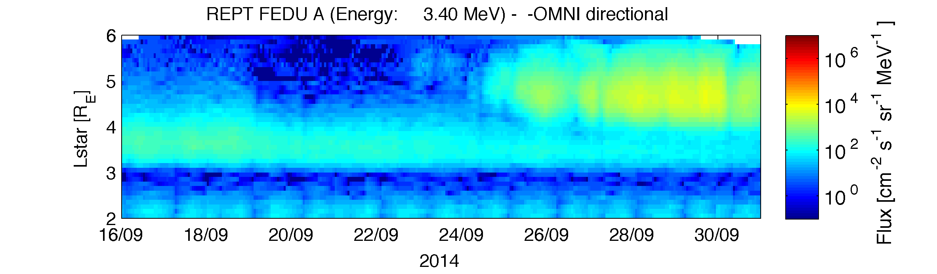

Slide 5
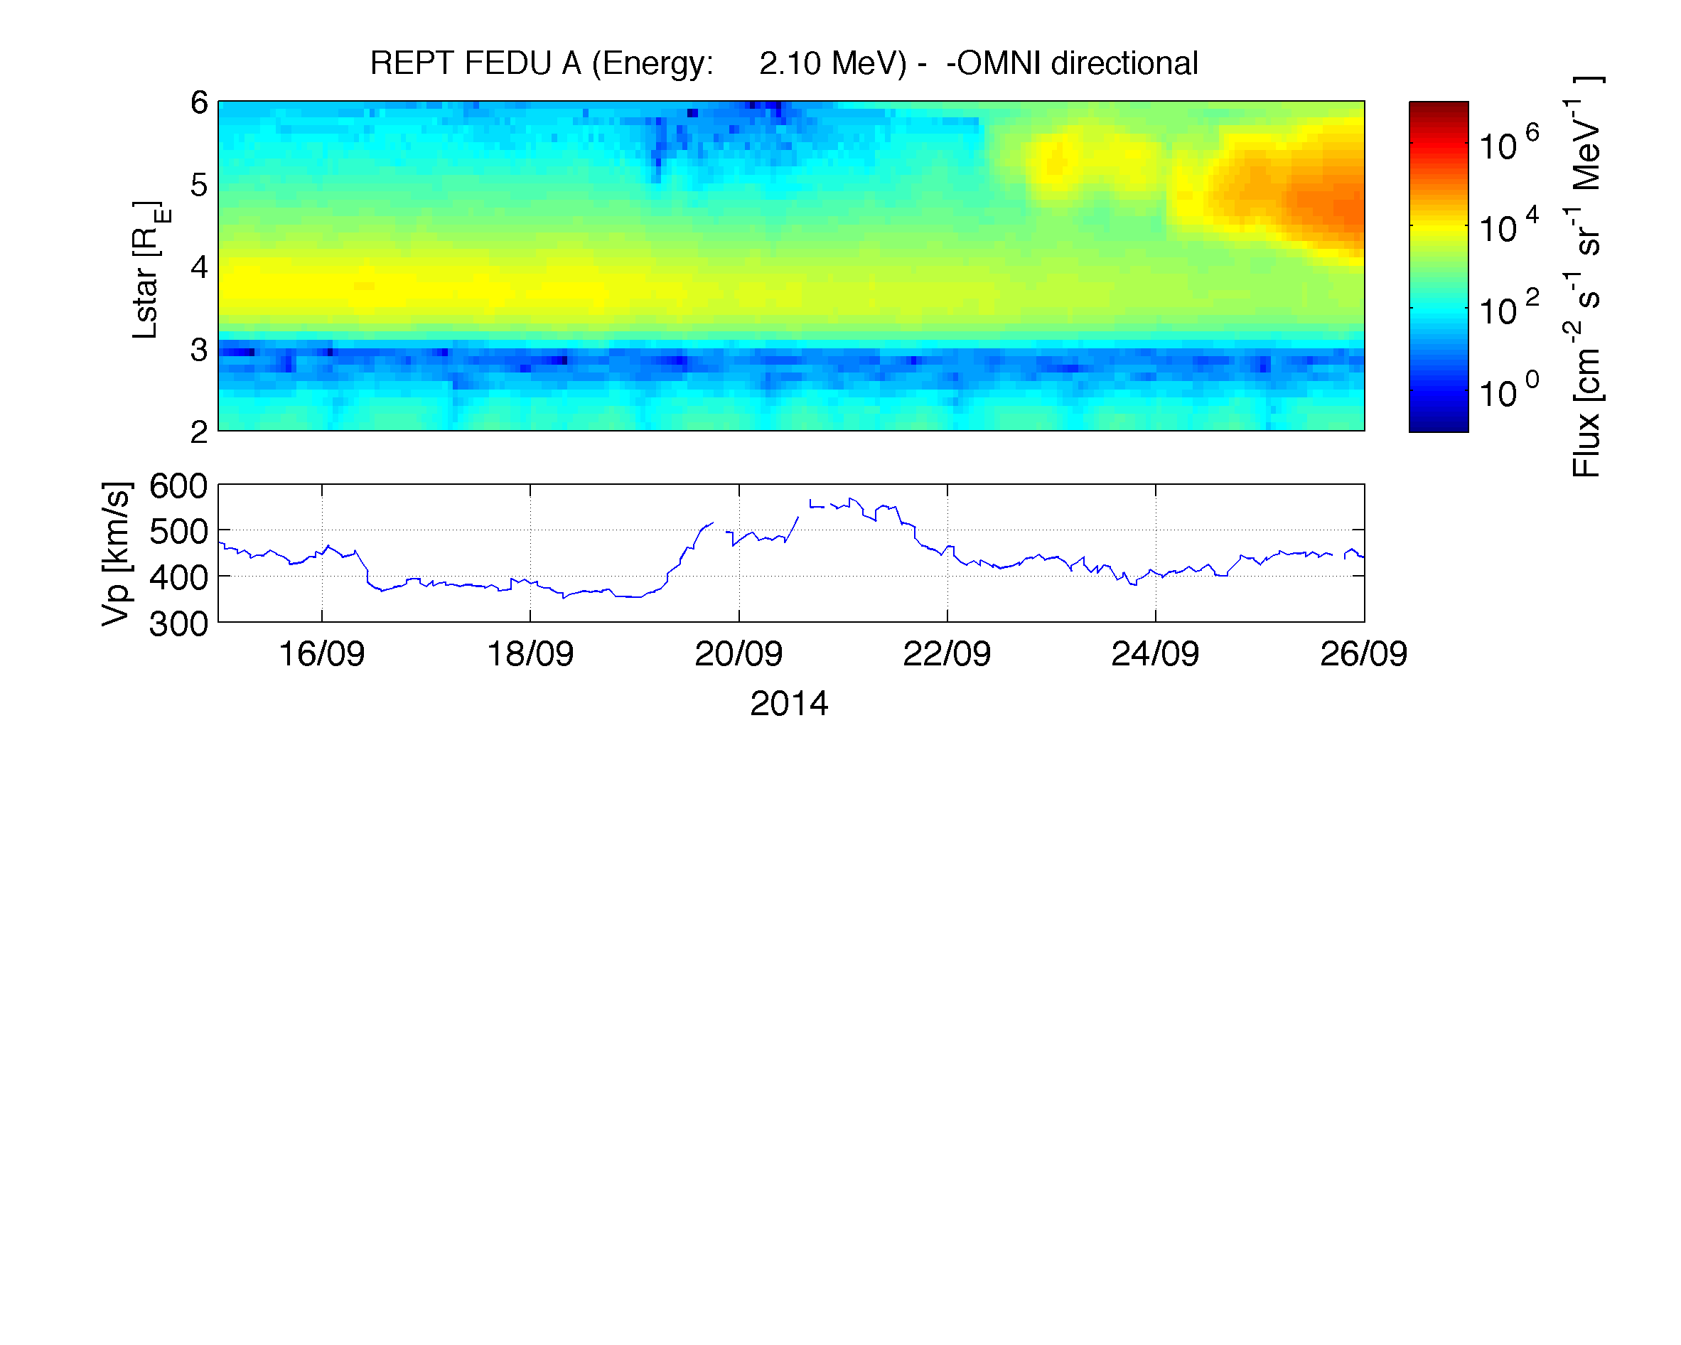
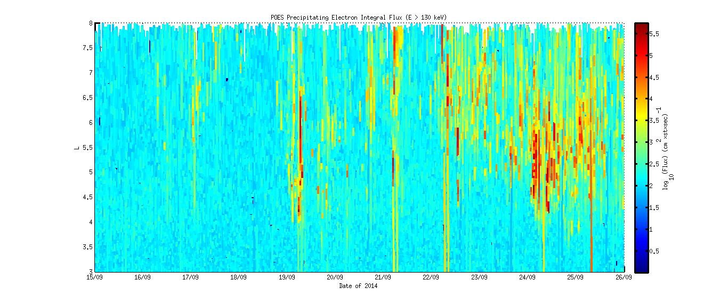
POES Precipitating Electron Integral Flux (E>130keV)
8
5
7
4
6
3
L
Log₁₀ (Flux)(cm² x sr x sec)⁻¹
5
2
4
1
3

Slide 6
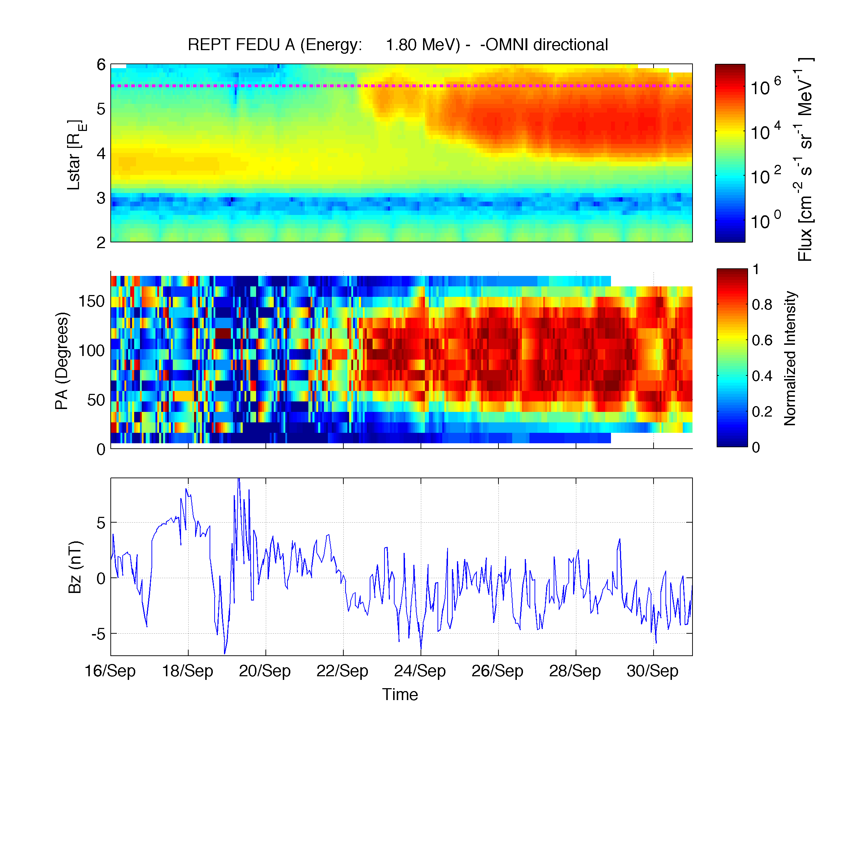
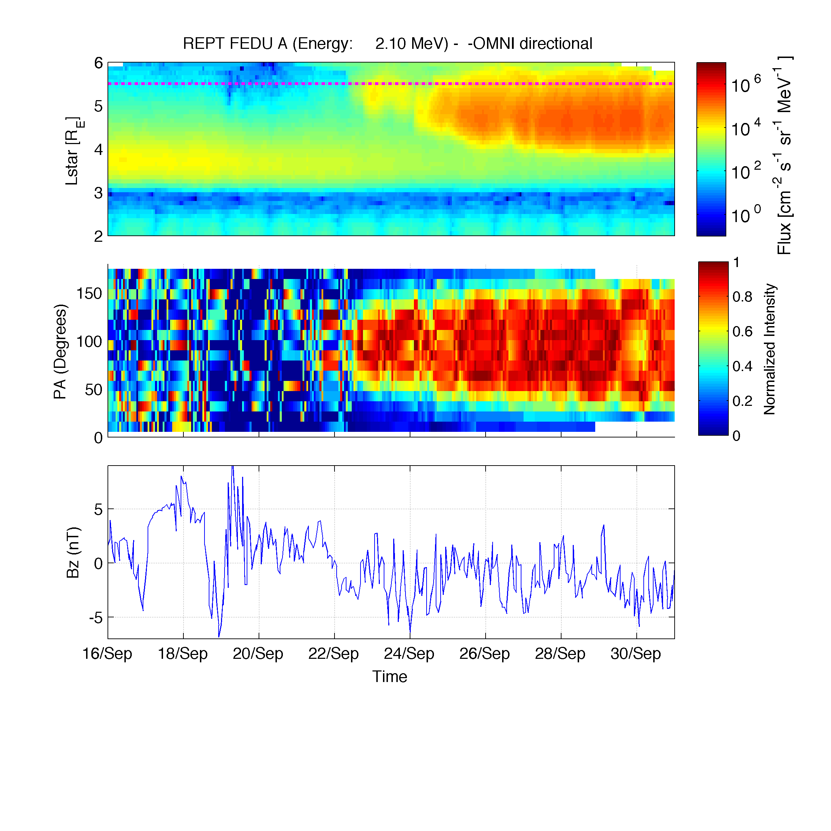

Slide 7
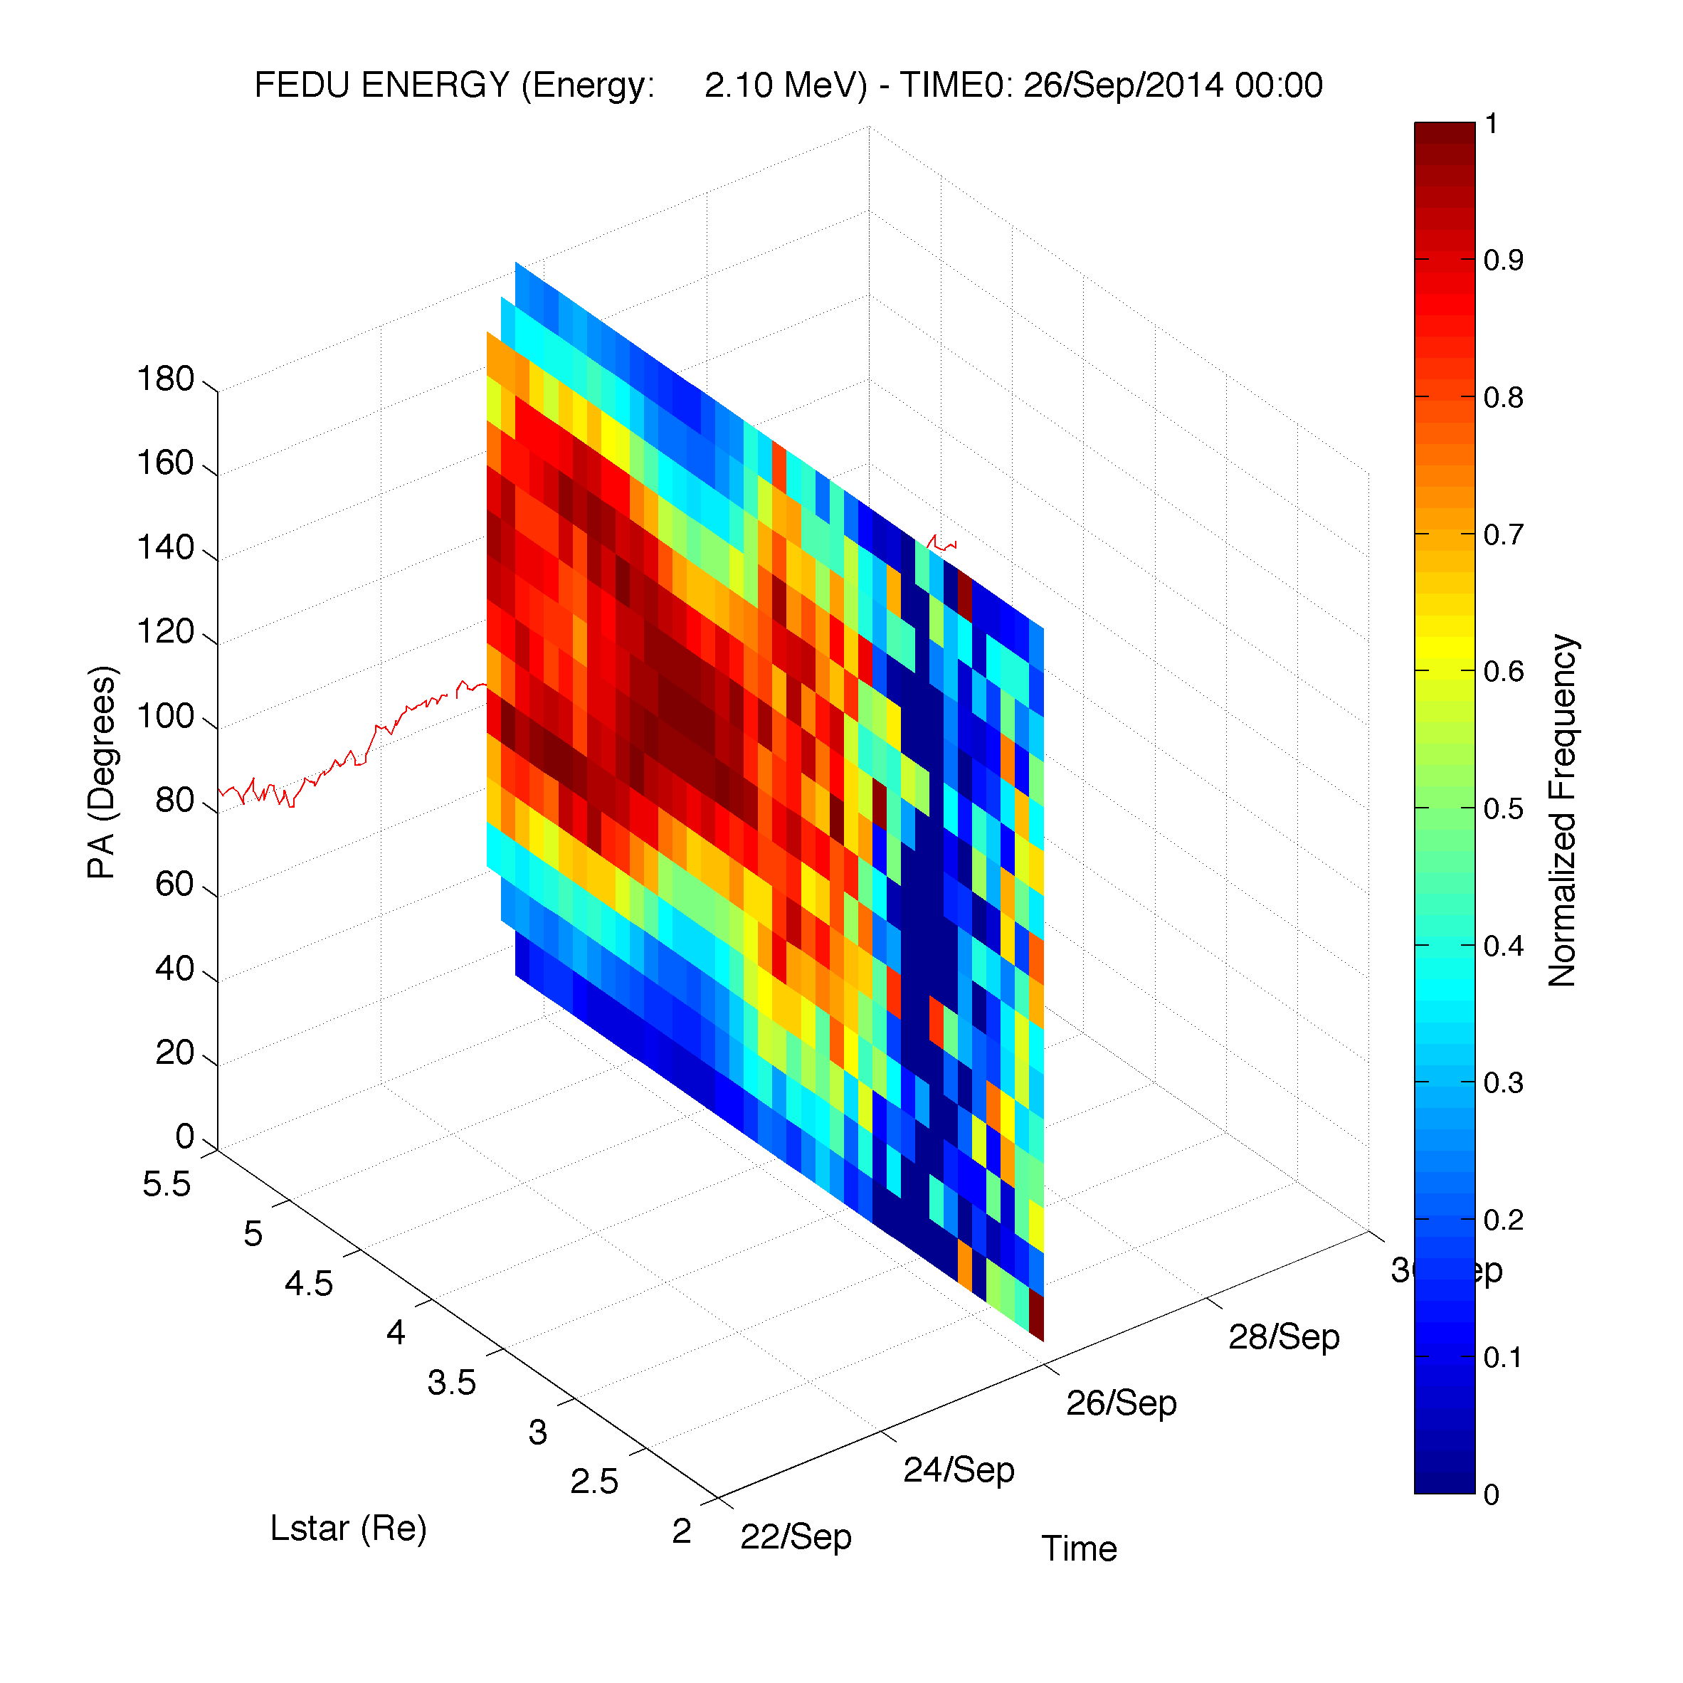
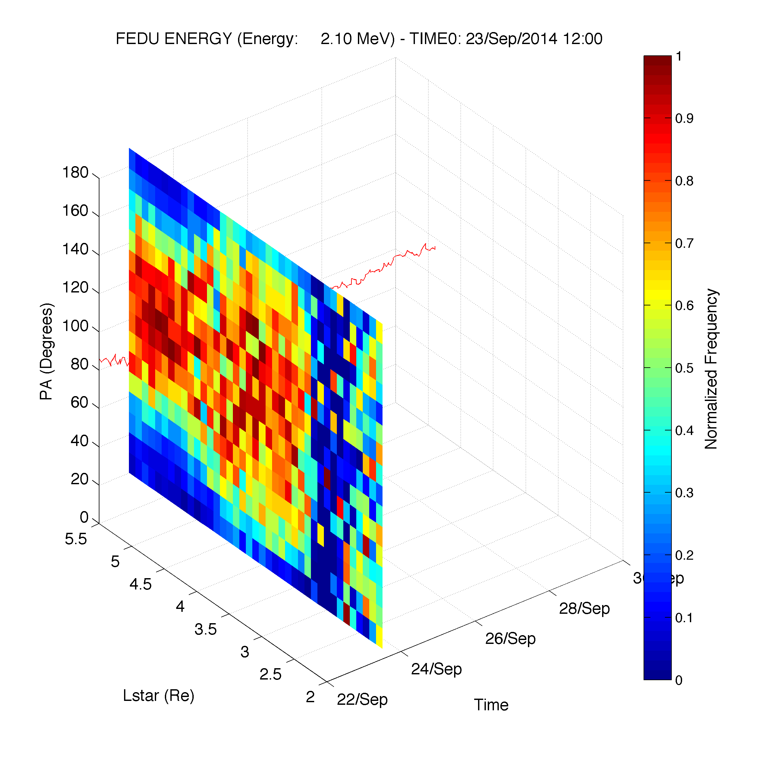
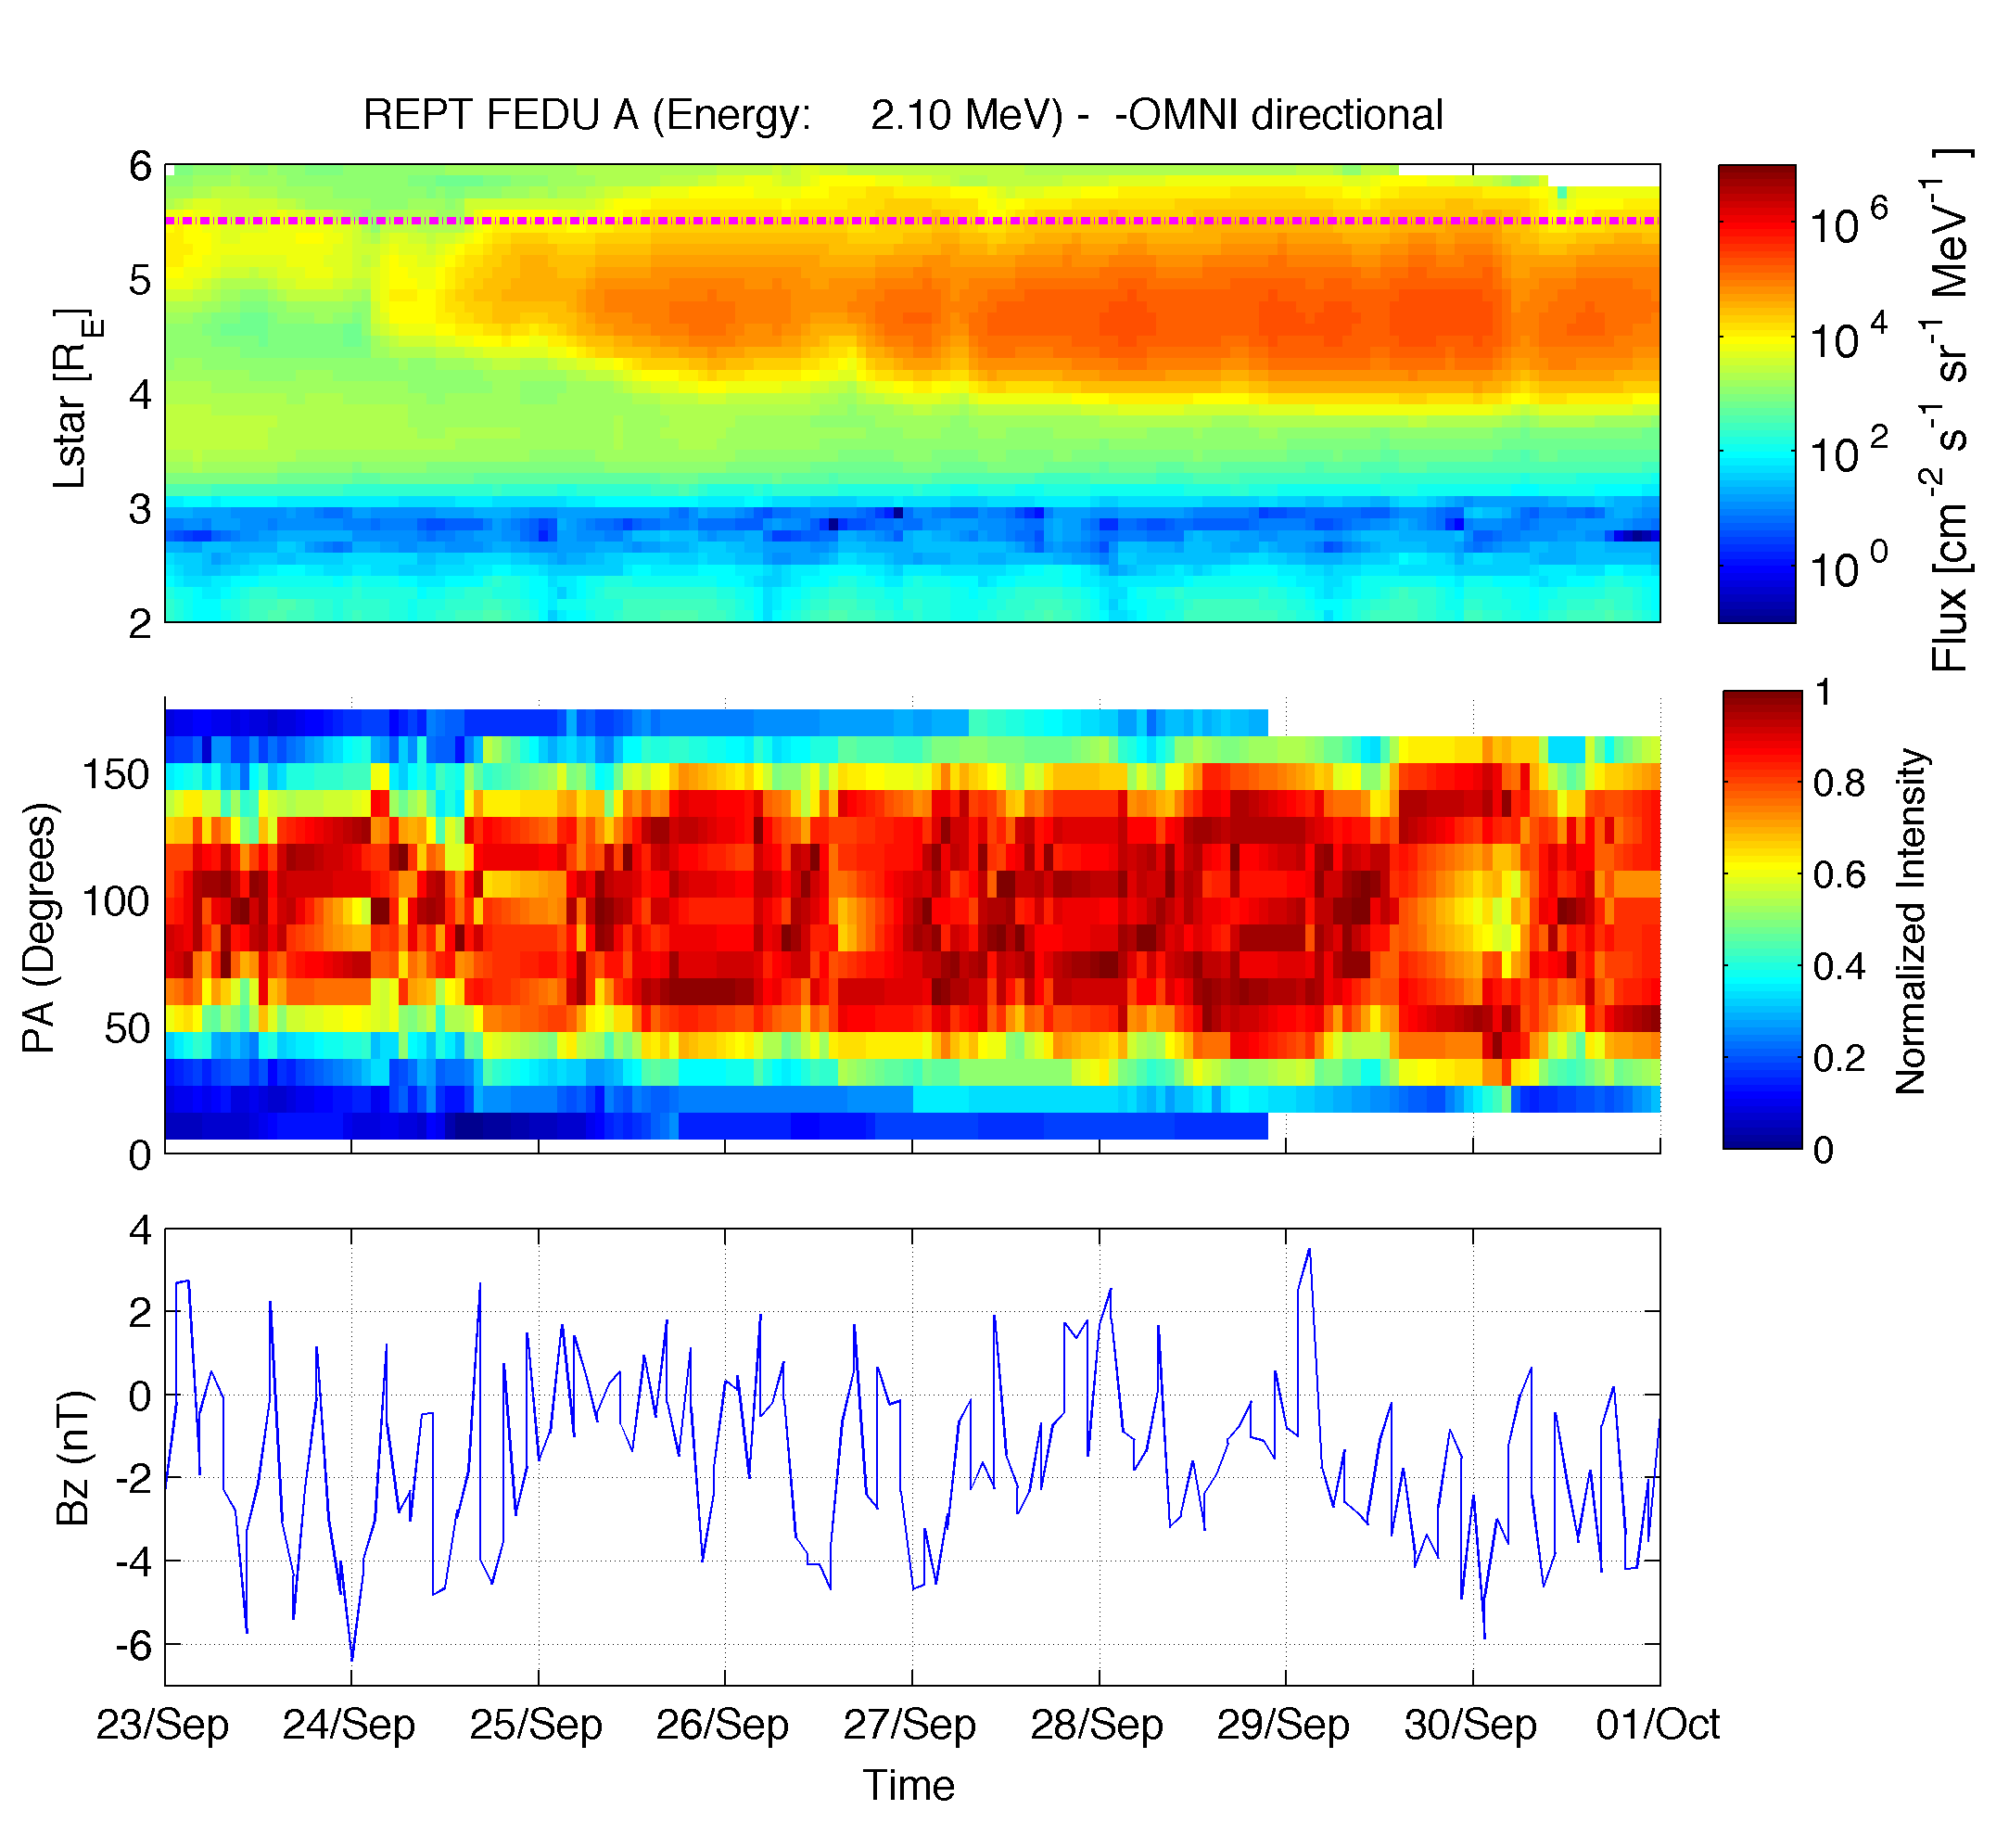
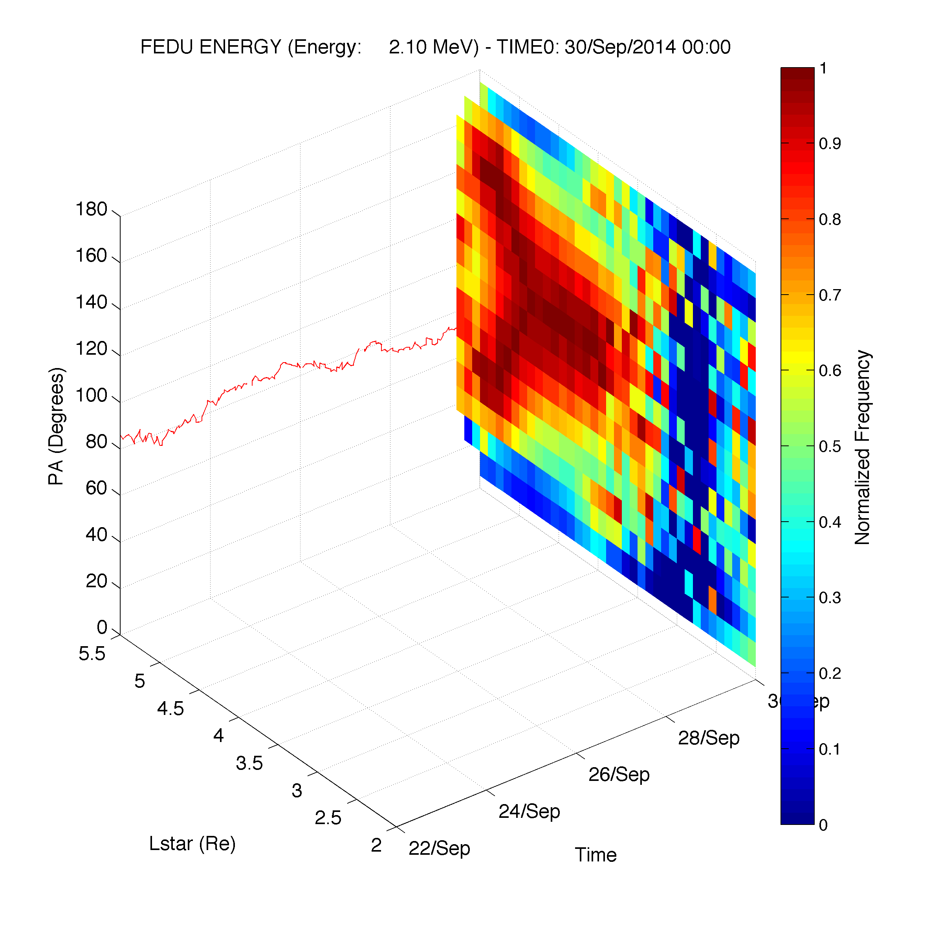
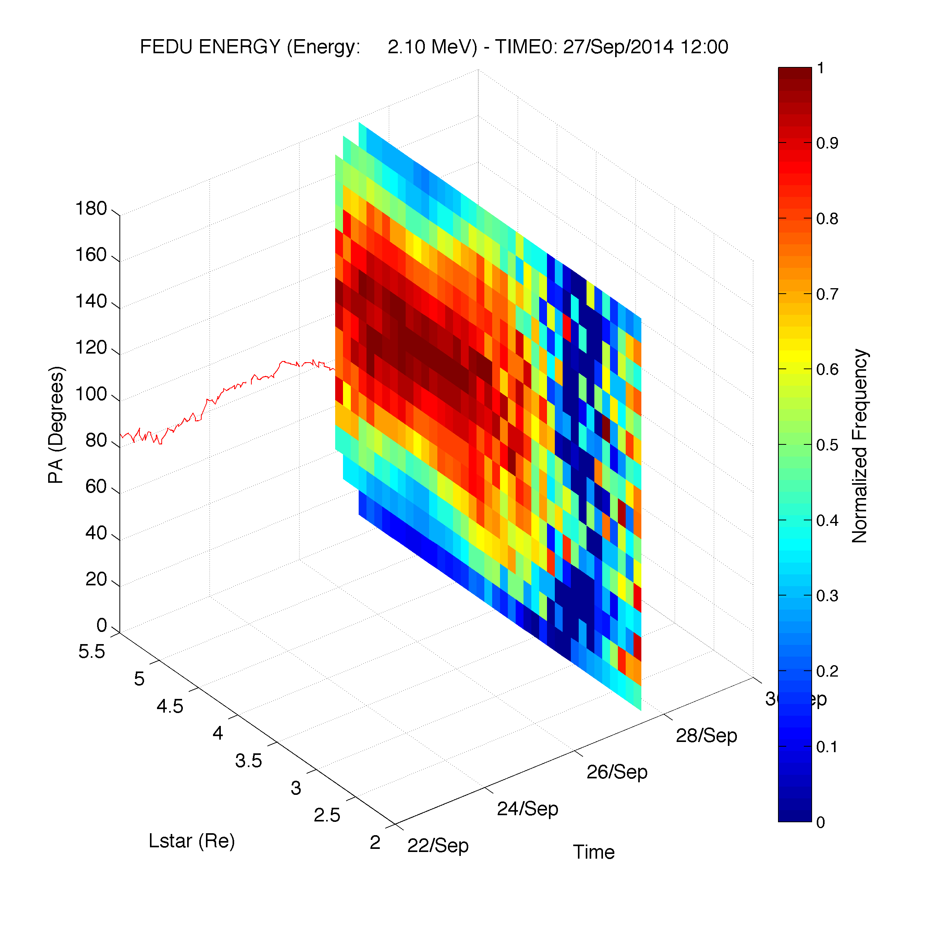
Butterfly Distribution
Pancake Distribution

Slide 8
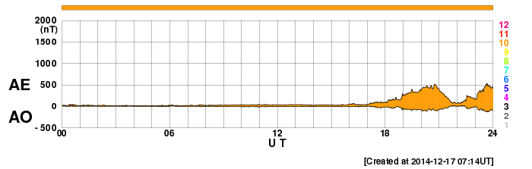
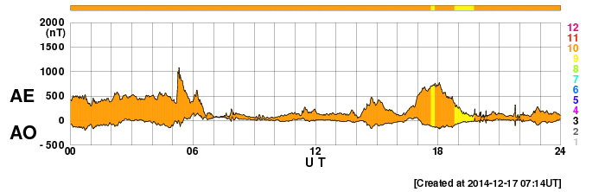

Slide 9
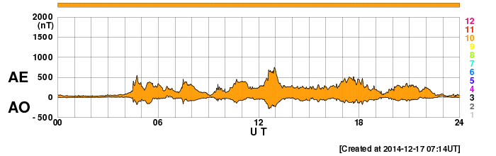
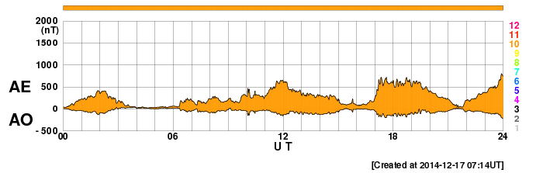

Slide 10
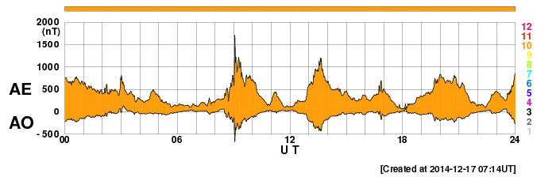
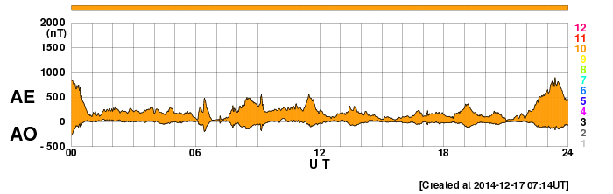

Slide 12
Conclusions
The preliminary results suggest that several dynamic processes may affect the re-formation of high-energy electrons of the outer radiation belt and consequently may affect the configuration of the pitch angle distribution of high-energy particles.
The population of high-energy electrons of the outer radiation belt seems to be affected differently by the interaction of distinct solar wind structures with the Earth’s magnetosphere.

