Slide 1
Van Allen Probes Science Gateway
July 29, 2015
R.J.Barnes, G. Romeo

Slide 2
Van Allen Probes – Senior Review
However, the panel noted that many of the individual instrument teams are using their own different preferred data analysis platforms and that the analysis of data from multi instruments would be aided by a more coordinated approach. Ideally, this would enable single point data access in formats easily integrated and analyzed with a common analysis package. The panel notes that the Van Allen team is aware of this need and is taking steps to rectify it. Nonetheless the panel believes that the Van Allen Probes team needs to undertake additional efforts in the extended mission phase to make all instrument data easily accessible from a single location. This should be in a form that can be easily ingested into a common data analysis platform for all of the instruments in the payload. More information and the availability of more extensive documentation about the content of data files and processing options at the mission web site would also be valuable.

Slide 3
Current State of Van Allen Probes Software
ECT
Autoplot, PNG Walk
EFW
SPEDAS (TEDAS)
EMFISIS
Autoplot, PNG Walk
RBSPICE
MIDL, Survey plot viewer
Gateway
rPlot
SPDF
CDAWEB

Slide 4
Van Allen Probes Software
Tools can be placed into a hierarchy of complexity
Level 1 tools provide basic data views, are simple to use but have limited use beyond surveying the data
PNG Walk, Survey plot viewer
Level 2 tools provide more sophisticated ways of plotting the data but still do not provide a programming interface for working with the data
Autoplot, MIDL, rPlot
Level 3 tools provide an full access to the raw data but require expert knowledge to use effectively
SPEDAS, CDAWEB Data Queries
We do not have the resources to come up with a new data analysis package, so we must provide support for these existing tools.

Slide 5
Van Allen Probes Software – Data Access
Van Allen Probes Data can be accessed through CDAWEB
http://cdaweb.gsfc.nasa.gov
Or through the individual SOC web sites:
http://www.rbsp-ect.lanl.gov/
http://www.space.umn.edu/missions/rbspefw-home-university-of-minnesota/
https://emfisis.physics.uiowa.edu/
http://rbspice.ftecs.com/
There is no “1-click” way of getting to the data:
You have to go through the CDAWEB interface
Alternatively navigate 4 different web sites

Slide 6
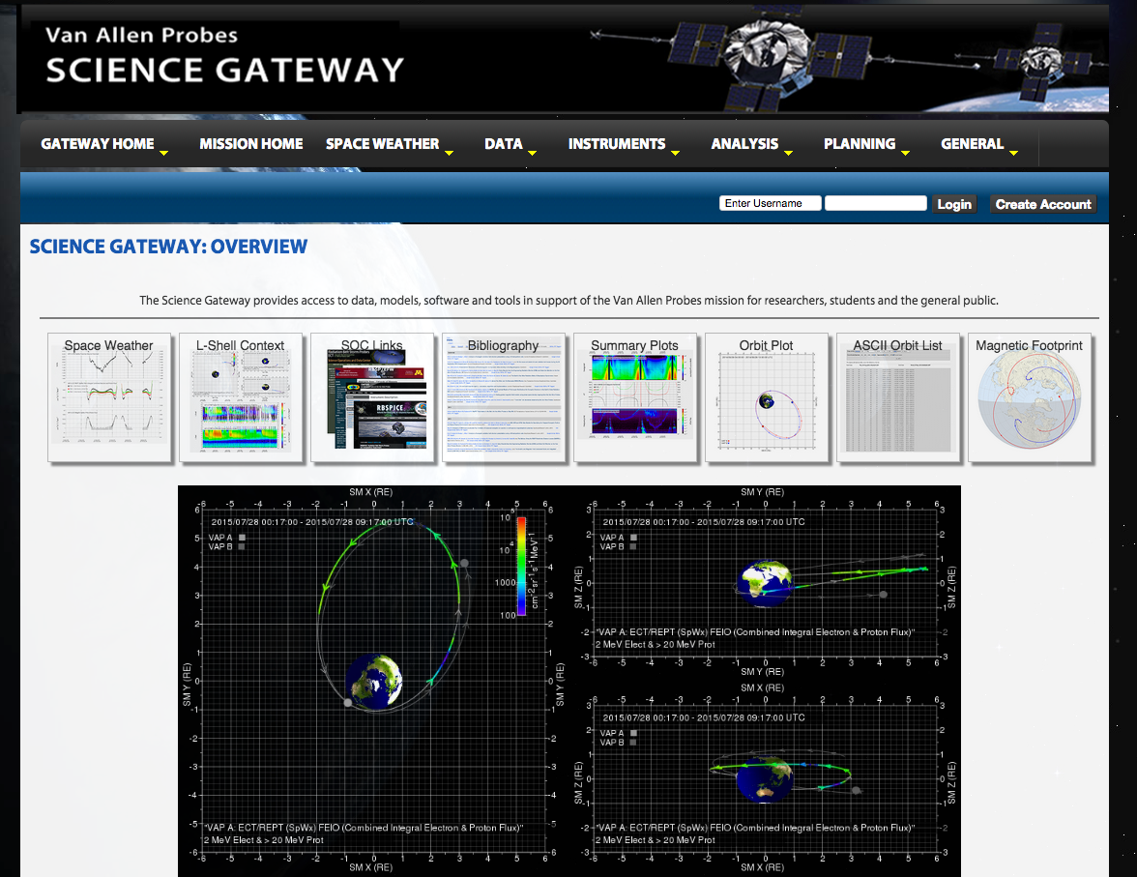
The Plan – Consolidation through the Gateway
http://rbspgway.jhuapl.edu

Slide 7
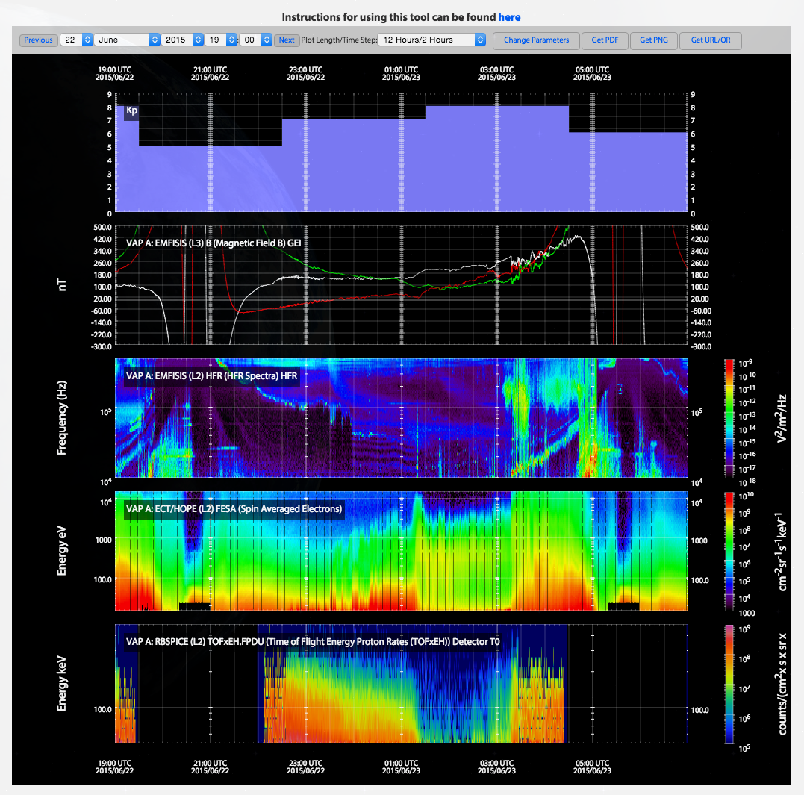
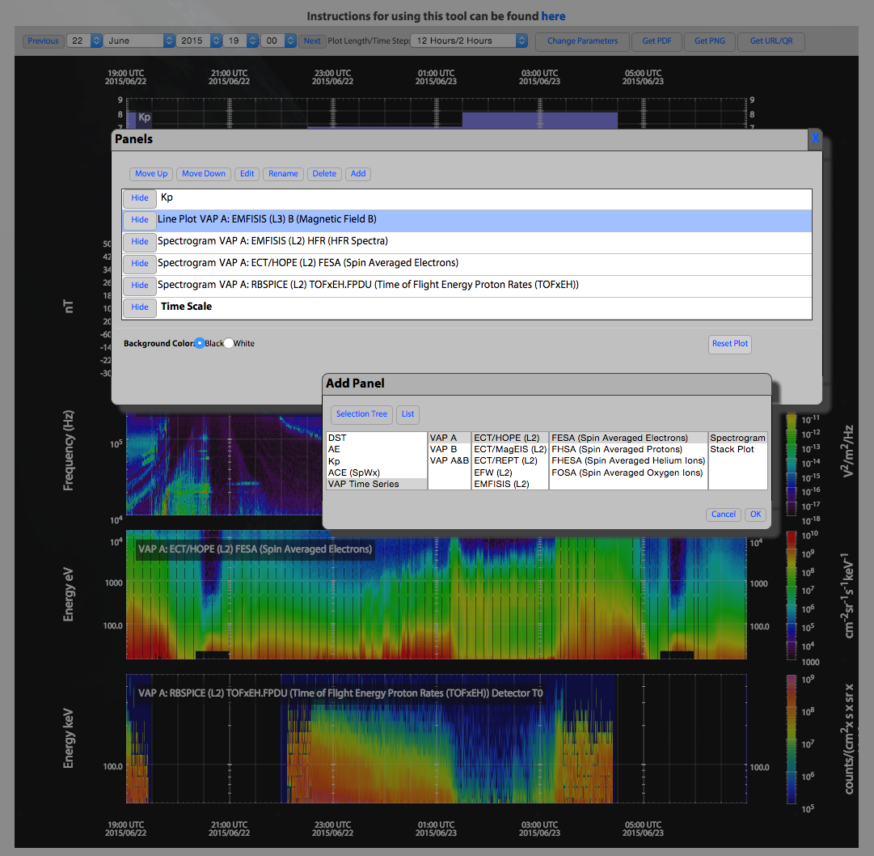
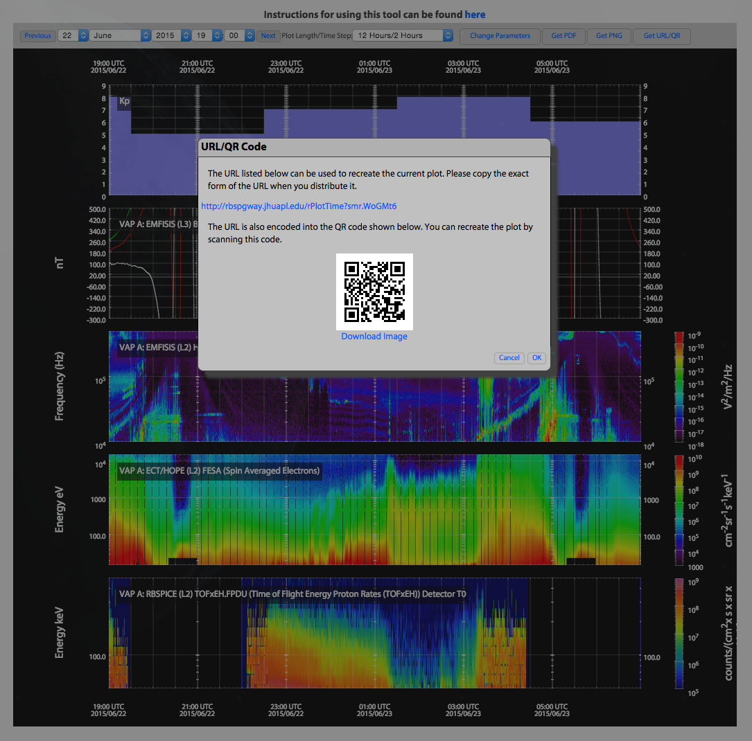

Slide 8
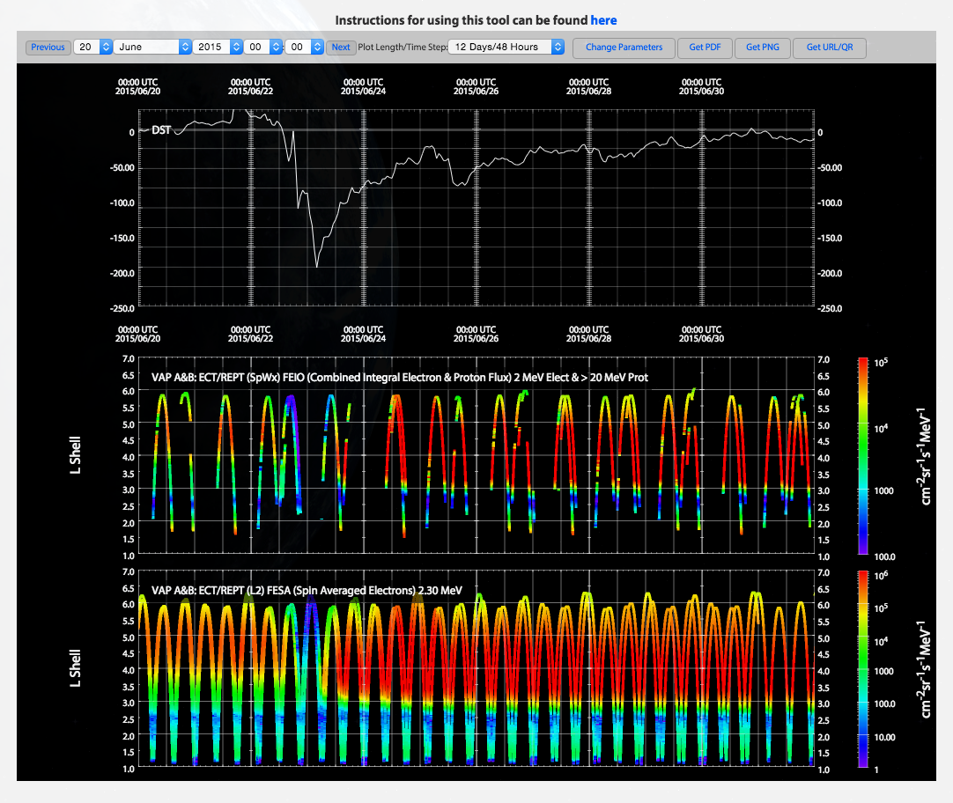
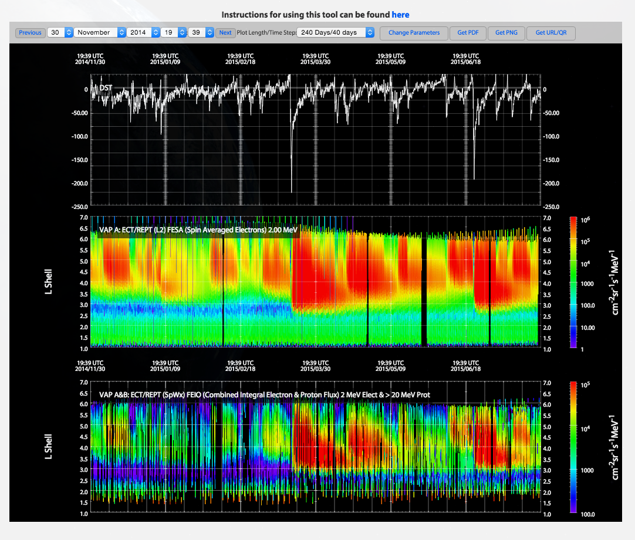

Slide 9
Gateway Tools
Allow data from multiple instruments to be co-plotted
Does not require a local copy of the data files
Web based – will even work on an iPad
Provides “goldilocks” level of sophistication
Already built

Slide 10
Gateway – Way forward
Provide better support for other tools
Pages for MIDL, AutoPlot, SPEDAS
Provide better access to the data files
Provide links to the CDF files that are currently being used in a plot
Provide links to AutoPlot and MIDL so that they will load the current data plotted when loaded
Provide a data catalog
Provides links to data products for a given date, with filters for data products
Work with instrument teams on adding more products to the gateway
L3+ data products (pitch angle distributions)
We just require instrument teams to assess the plots
Provide better feedback to the instrument teams
Provide better documentation

Slide 11
Discussion?

