Slide 1
Application of Advanced Spectral Techniques to EMFISIS Burst Mode Waveform Data
Chris Crabtree Erik Tejero CL Enloe Guru Ganguli
Naval Research Laboratory
George Hospodarsky Craig Kletzing
University of Iowa

Slide 2
Outline
Sub-packet Structure of Whistler Mode Chorus
  Understanding sub-packet structure could lead to understanding the saturation mechanism.
  Data reveals multiple waves are present.
  Data is complex, further laboratory experiments, and theory are necessary to clarify
VLF Whistler Waves driven by Plasma Boundary Layers
  Malaspina et al. 2015 found “Electric Field Structures” at plasma boundaries consistent with waves generated by velocity shear [Ganguli 1988, 2014] (EMEIH).
  Current laboratory experiments confirm generation of whistlers by electric field inhomogeneity and similar nonlinear frequency-time structures.

Slide 3
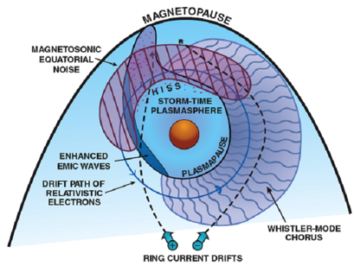
Whistler Mode Chorus
Van Allen Probe A in morning sector at L~5.5 in Equatorial Plane on Oct 14, 2012

Slide 4
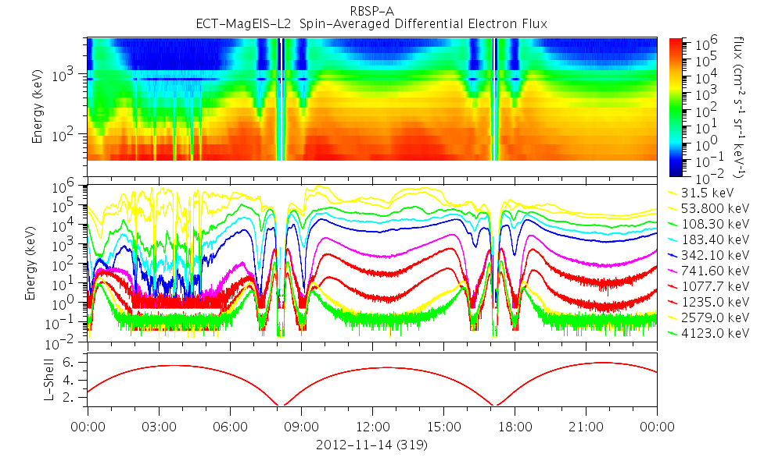
Particle Data

Slide 5
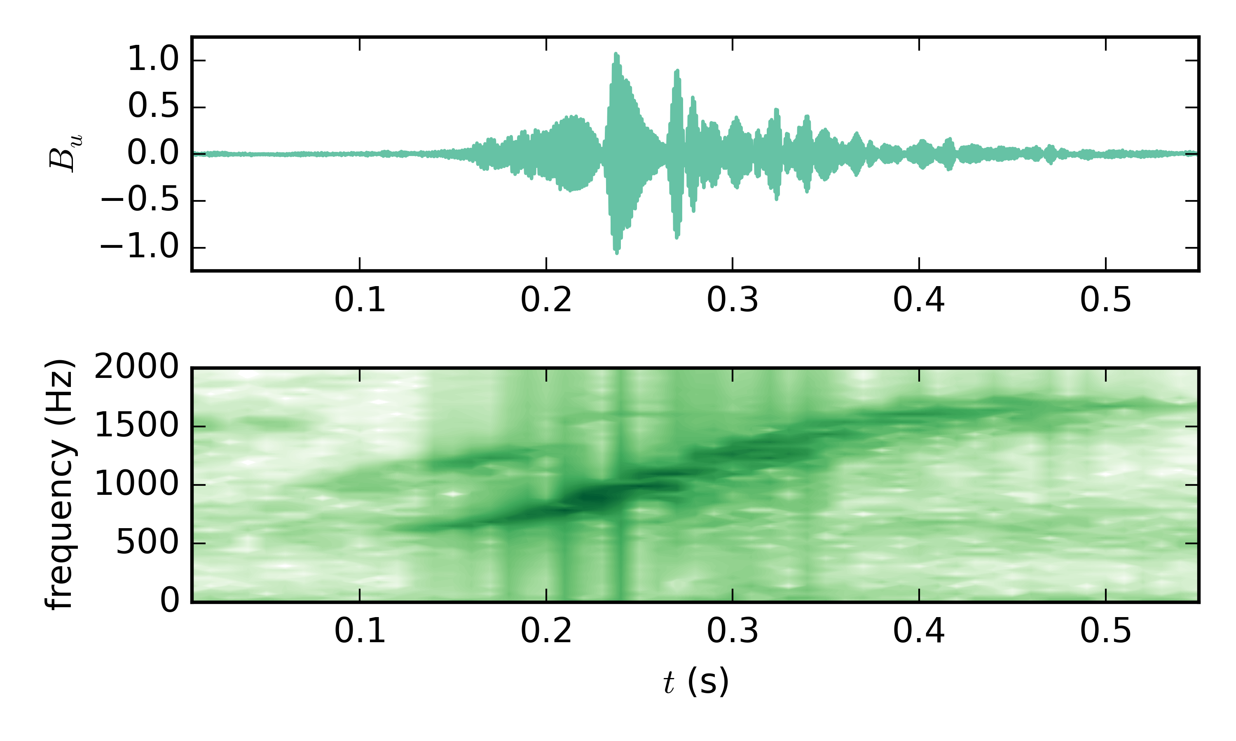
One Chorus Element Recorded in Burst Mode
Time after 2012-11-14 14:00:22.679318
1024 square window-70% overlap

Slide 6

Advanced Spectral Techniques
Assume a model for the time series, i.e.
Assume least informative model for noise, i.e. Gaussian
Thomas Bayes (1701-1761)
Assume least informative prior and integrate over Nuisance parameters.
Bayesian Analysis Techniques ushered in the era of precision cosmology and astrophysics: Benitez ApJ 2000; Hobson et al. MNRAS 2003; Scargle et al. ApJ 2006

Slide 7
Extension of Fourier Methods
If you assume a single stationary frequency,
and integrate over amplitudes
If you don’t know :
Most of plasma theory can be captured by:
You can still integrate over amplitude and phase analytically!
…in special numerically generated coordinates
[Bretthorst 1988, Jaynes 1996]

Slide 8
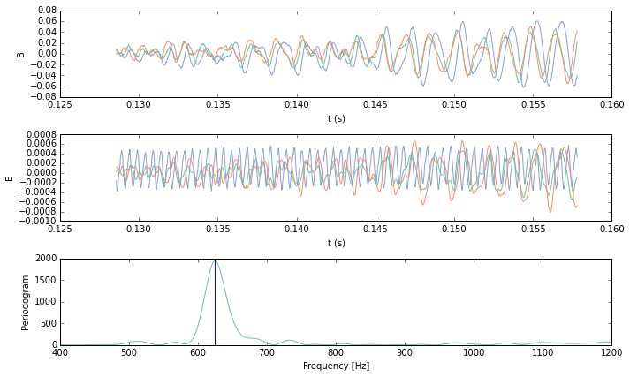
One Time Interval at beginning of Element
624.7 Hz
Time window = 0.029257 S, f~34 Hz

Slide 9
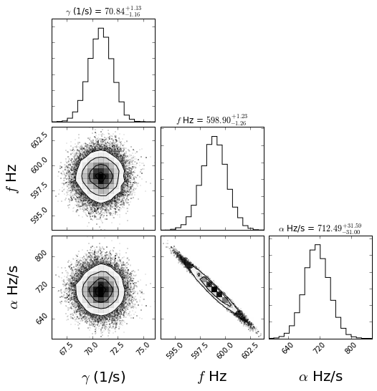
Find the Parameters that Maximize the Probability Function
We can then calculate, expected
amplitude and phases of waves.
and from that get:
Wave Normal angle: 155 degrees
Azimuthal Angle: 77 degrees
Wave Energy Density: 1.5E-14
Etc.

Slide 10
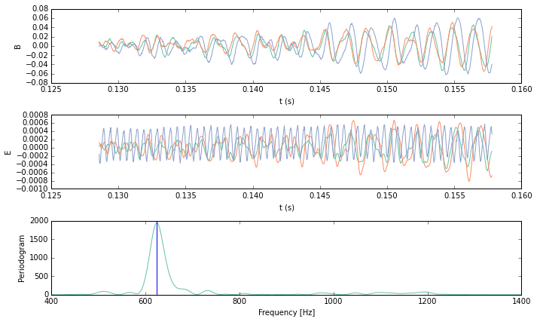
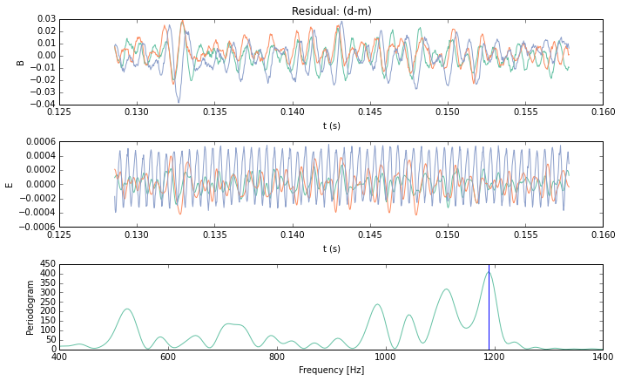
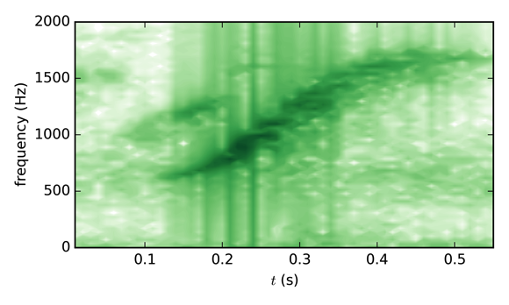
Take the one wave model and calculate the residual signal
Original Data
Data with first wave
subtracted
There is still Wave Power!

Slide 11
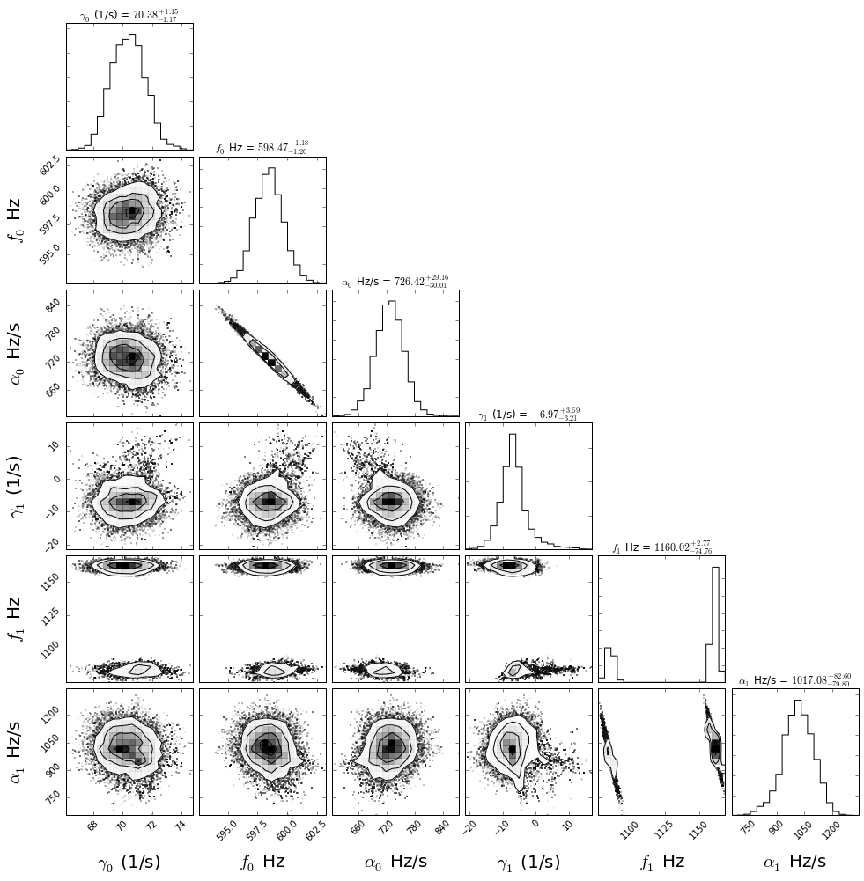
Add another Wave to the Model
First wave parameters remain the same. Second wave has,
Wave Normal angle:
144 degrees
Azimuthal Angle:
82 degrees
Wave Energy Density:
1.4E-14
Bimodal Distribution indicative of third wave

Slide 12
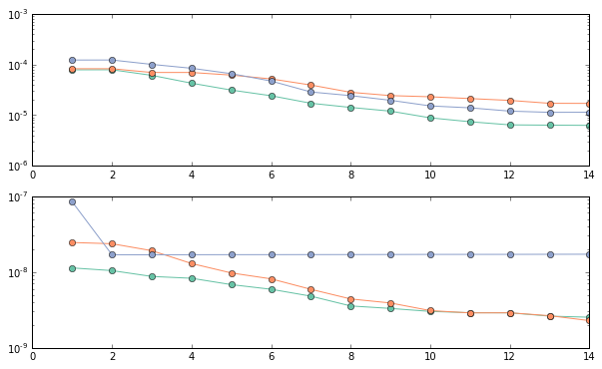
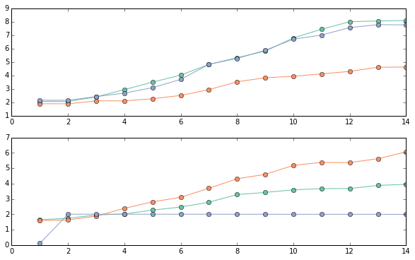
How many waves are present?
After about 8 waves have been included in the model the Signal to Noise and the estimate of the error in the detector have leveled off.

Slide 13
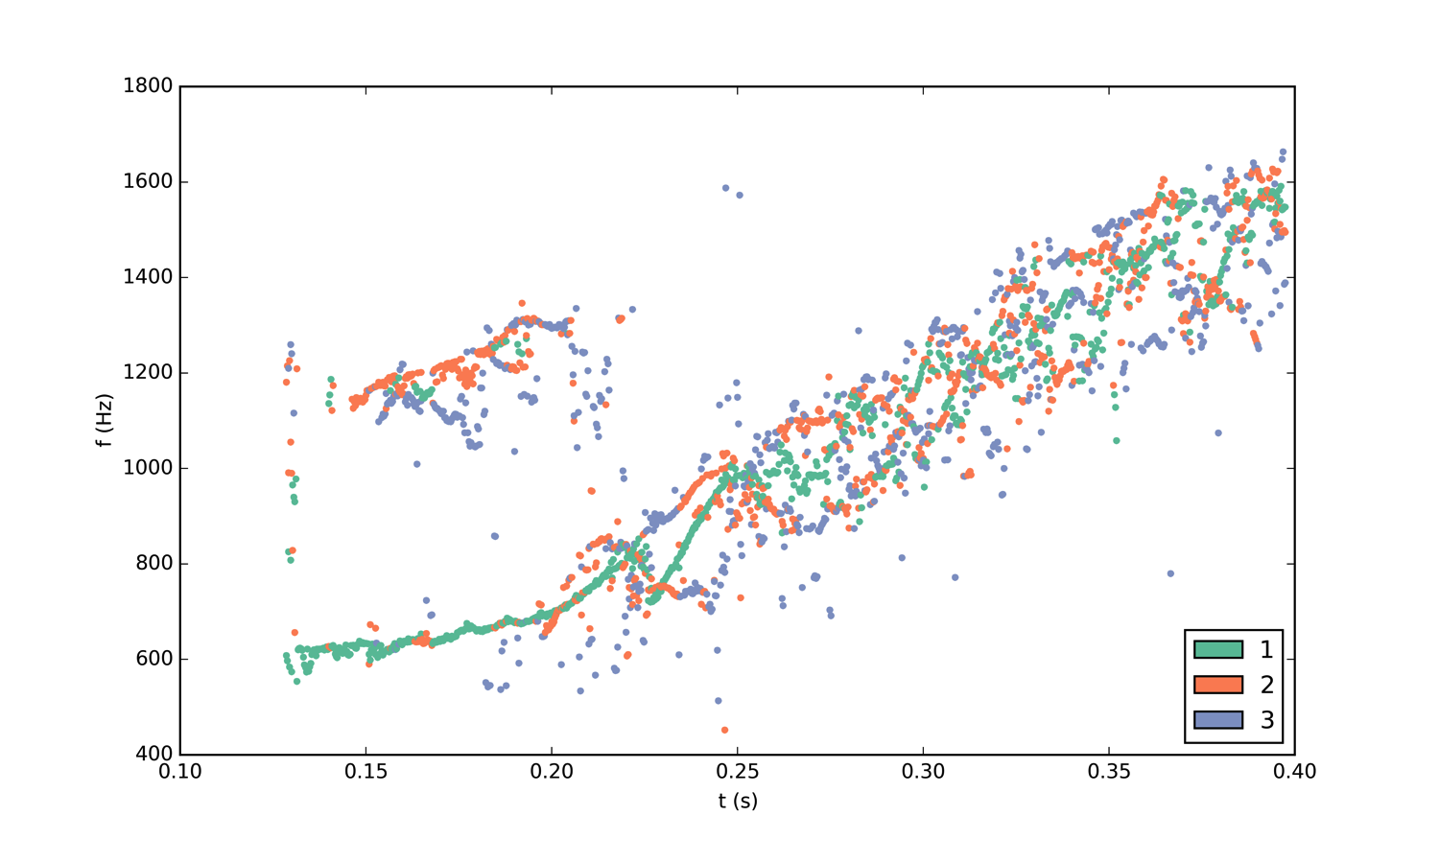
Apply this with a sliding window

Slide 14
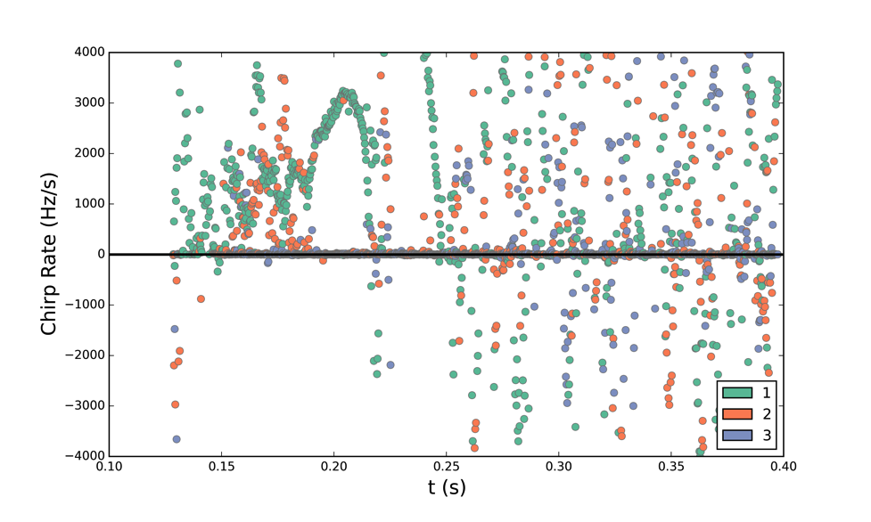
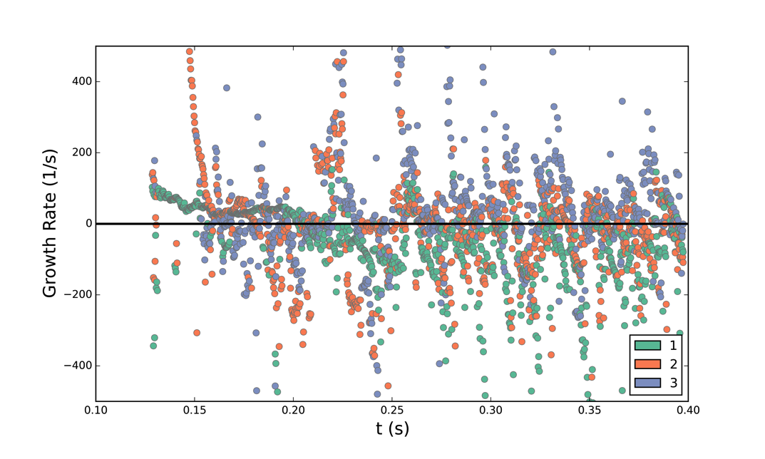

Slide 15
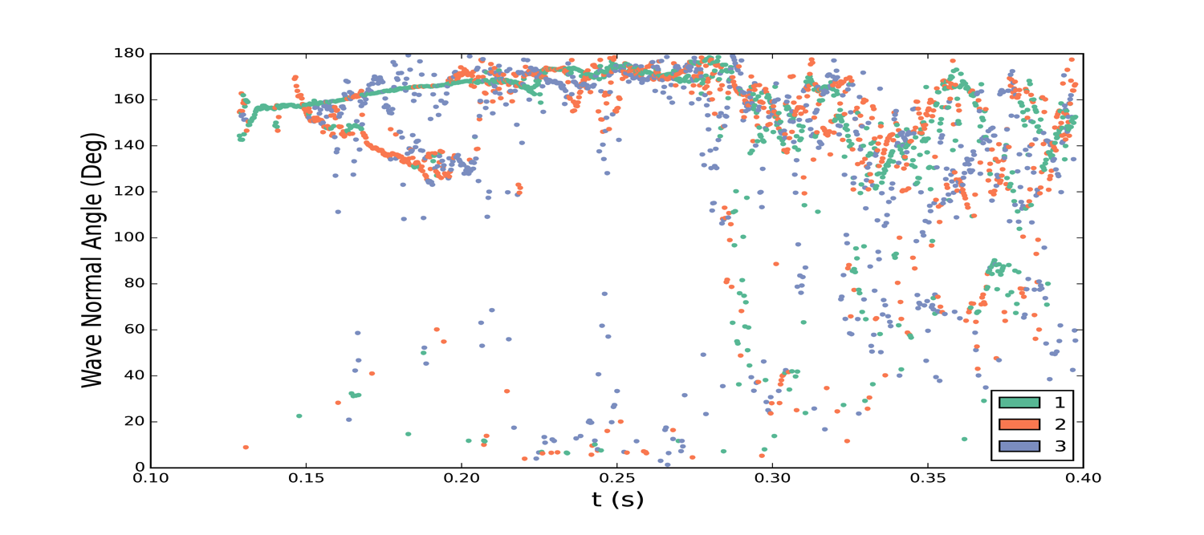
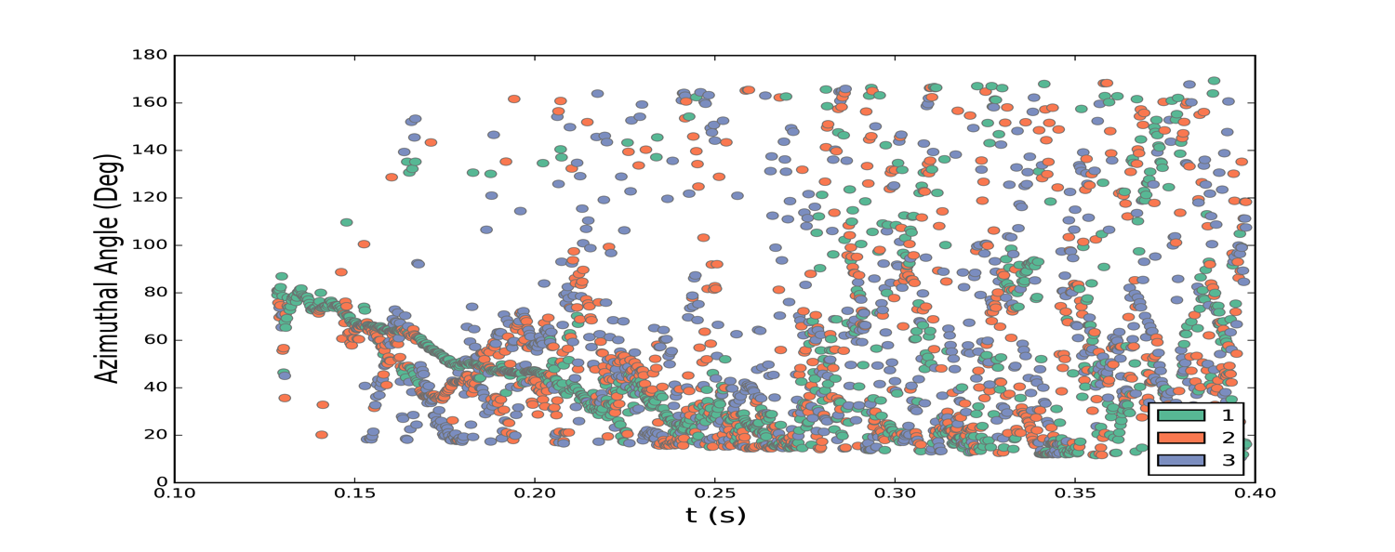

Slide 16
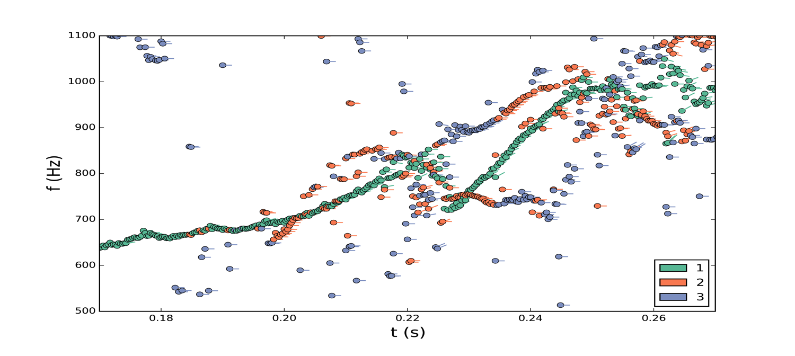
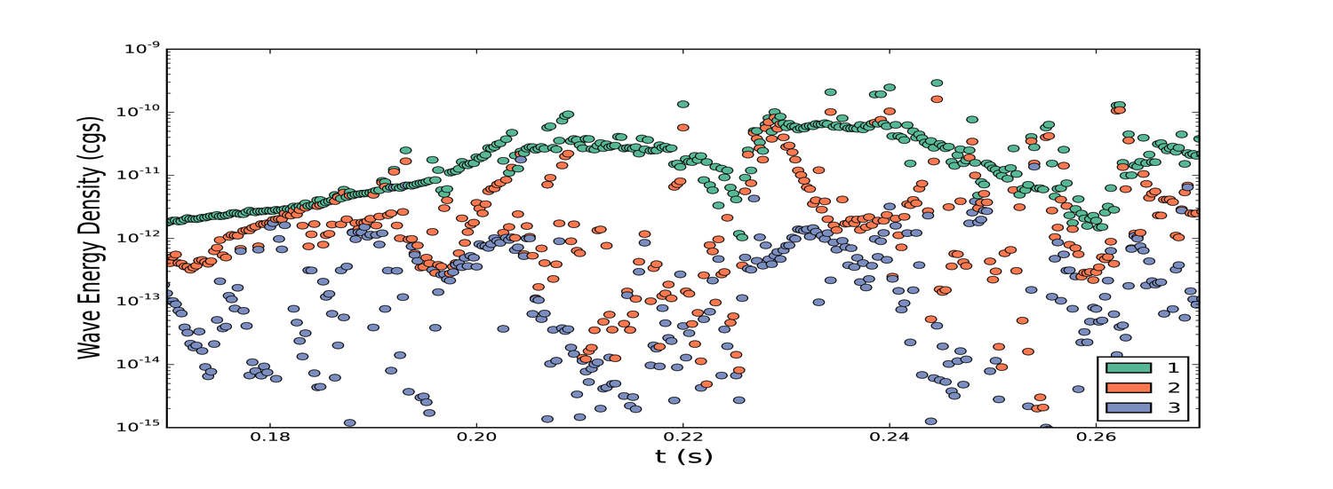

Slide 17
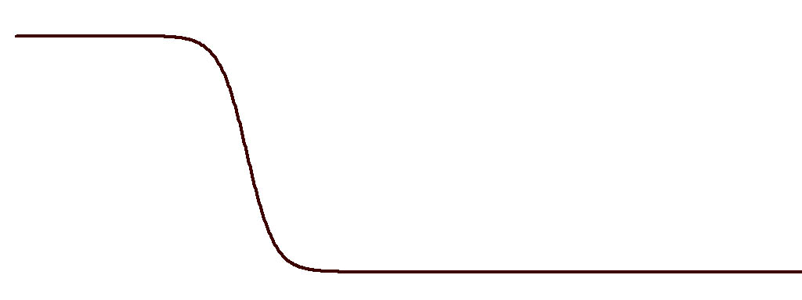
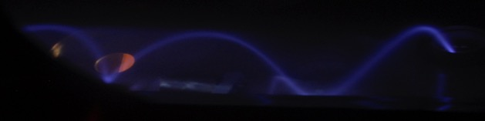
Triggered Emissions Experimental Setup
B_{z}
mirror point
420 G
20 G
SPSC Main Chamber
helical antenna
hollow cathode
Plasma
Source
SPSC Source Chamber

Slide 18
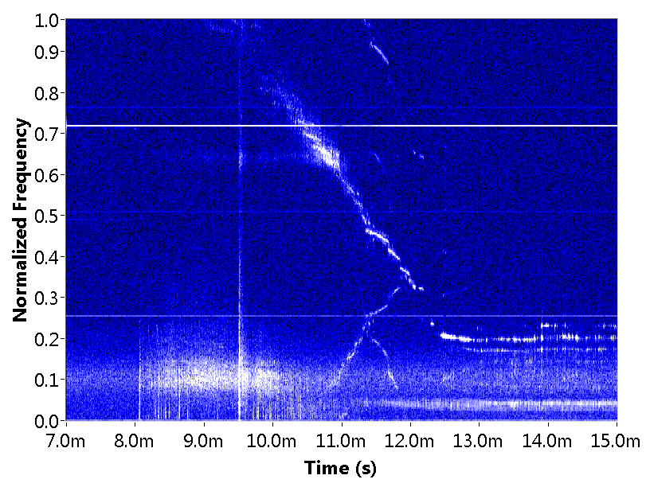
Triggered Emissions
Triggered Emission
Launched
Whistler
Triggered emissions observed in laboratory experiments.

Slide 19
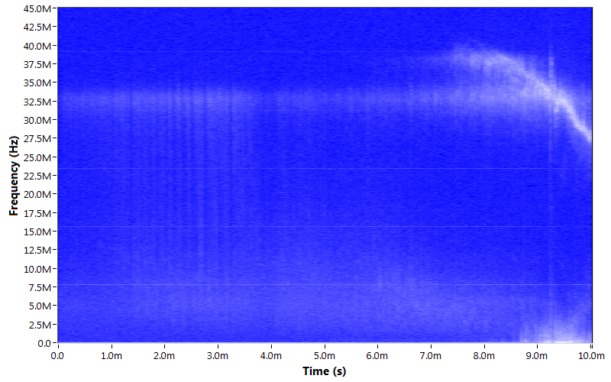
Whistler Chorus-like Emissions
Beam Generated Mode
Whistler Chorus-like Emission
Chorus-like emissions observed in laboratory experiments.

Slide 20
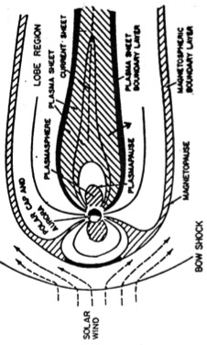
Boundary Layer Driven Whistlers
Whistler branch waves (Ω_{e} > ω > Ω_{i}) due to plasma compression
Lobe
Plasmasheet
Solar wind compression on plasma sheet generates boundary layer with transverse dc E fields [Romero et al. GRL, 1990]
- The scale size of the E field can be smaller than a local ion gyroradius
Spatial gradient in dc electric field triggers the electron-ion-hybrid (EIH) instability [Ganguli et al., Phys of Fluids, 1988; PoP, 2014]
  ES and EM emissions in the whistler branch
  Can be around lower hybrid frequency or different depending on parameters
  Eigenvalue condition for ES waves (δ=ω_{pe}/Ω_{ε}):
Boundary layers are being generated and analyzed in the SPSC
  Existence of ES and EM EIH emissions verified
  Signatures of triggered emissions observed
    Magnetron effect can nonlinearly lead to secondary emissions displaying frequency chirping [Palmadesso et al., Geophys Mgr, 1986]
NASA/ISEE-1 data
Boundary Layers due to Plasma Compression
E(r)
filament supply
V_{p} ~ V_{bias}
B
filament supply
V_{p} ~ 0 V
discharge
supply
grid bias
discharge
supply
Laboratory simulation of the stressed boundary layer with localized radial electric field and axial magnetic field

Slide 21
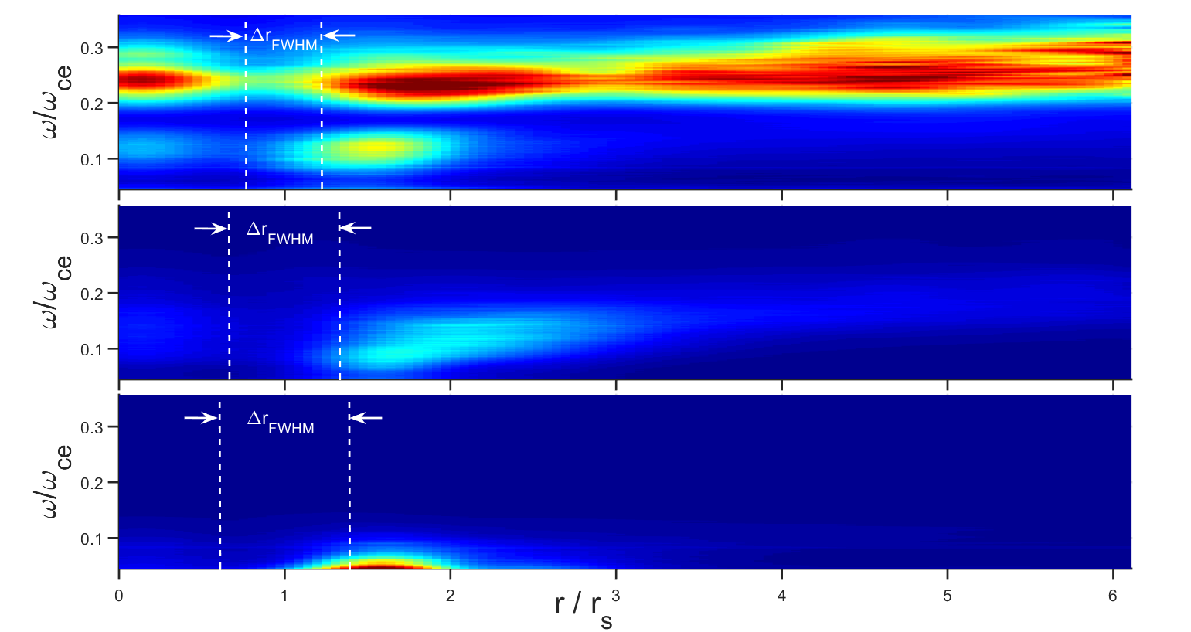
Transition to Electromagnetic Waves driven by Velocity Shear

Slide 22
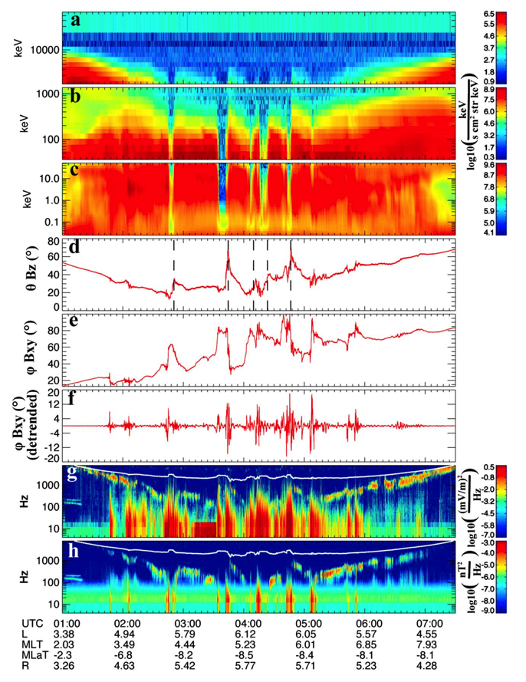
Van Allen Probe Evidence for Whistlers near Boundary Layers
Malaspina et al. 2015 – Electric field structures and waves at plasma boundaries in the inner magnetosphere
Identified plasma boundaries with particle data.
Found waves near boundary

Slide 23
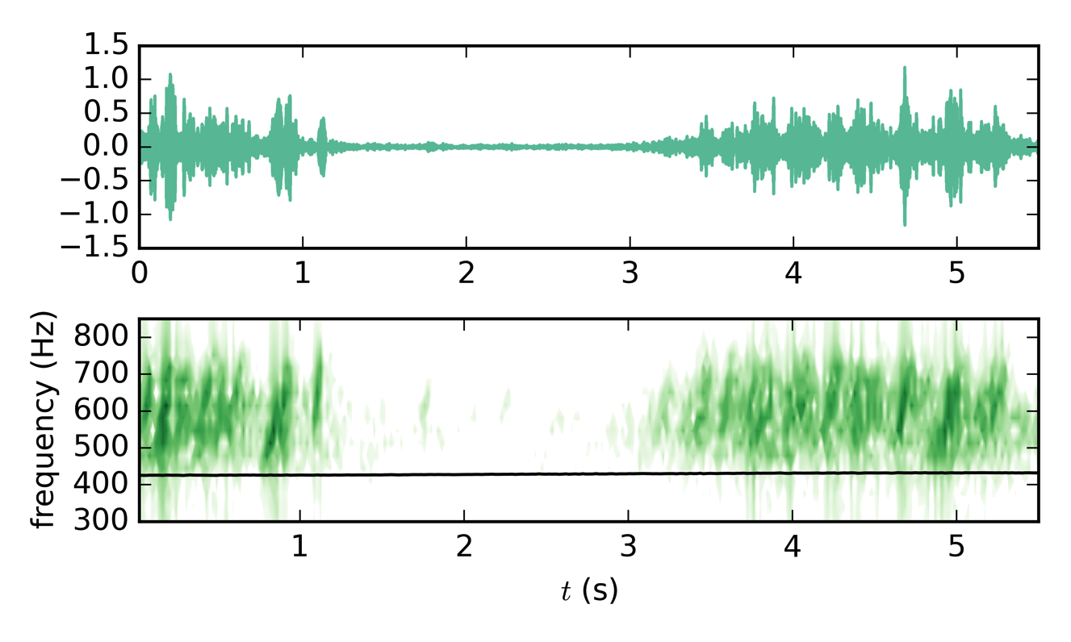
EMFISIS Burst Mode Waveform data of Driven Whistlers: Showing Burstiness and Chirping
RBSP-B
Seconds after 2012-11-14 05:40:32.437892

Slide 24
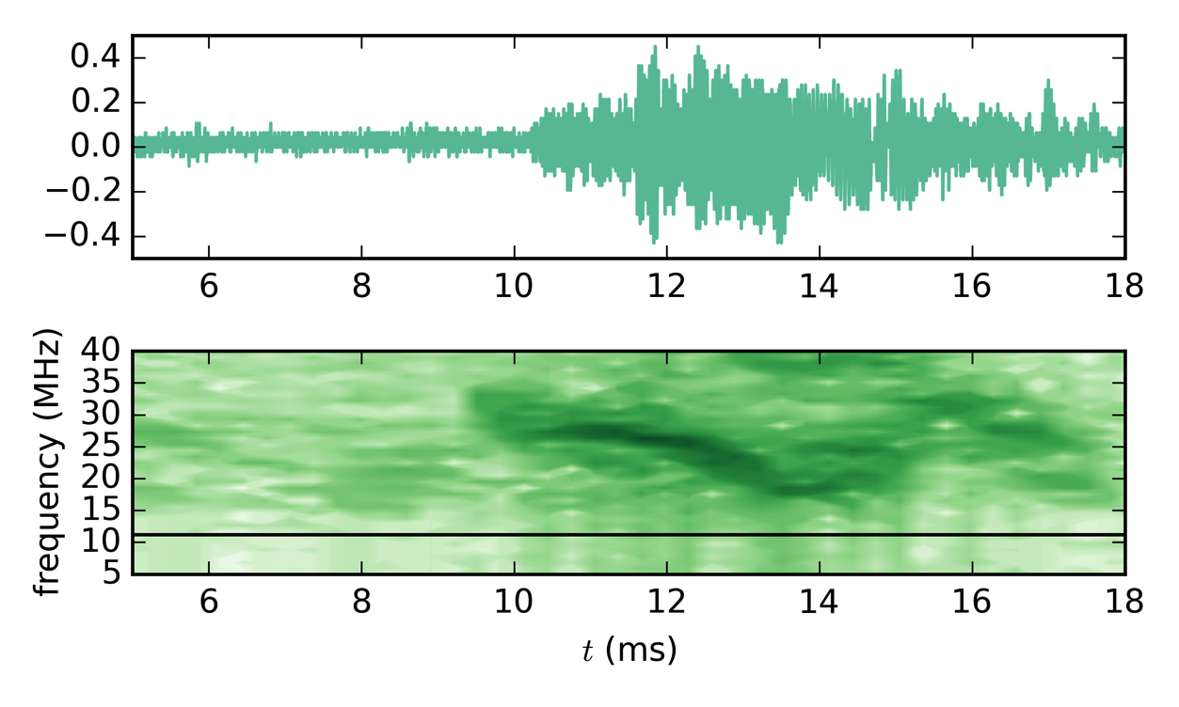
Laboratory data of Driven Whistlers: Showing Burstiness and Chirping

Slide 25
Conclusions
Advanced spectral techniques reveal
  Chorus is composed of multiple waves which is not considered in current NL theories
  New Nonlinear wave physics necessary to explain chorus saturation
  Laboratory techniques combined with theory and satellite observations necessary to unravel new physics
Generation of Electromagnetic Whistlers by boundary layers generated in laboratory
  Consistent with observations in space near boundary layers
  Burstiness and chirping found in these waves too

