Slide 1
Advancements of the TS07D empirical magnetic field model: Increasing resolution of equatorial and Birkeland currents
October 16, 2015
Grant Stephens, Mikhail Sitnov, and Aleksandr Ukhorskiy

Slide 2
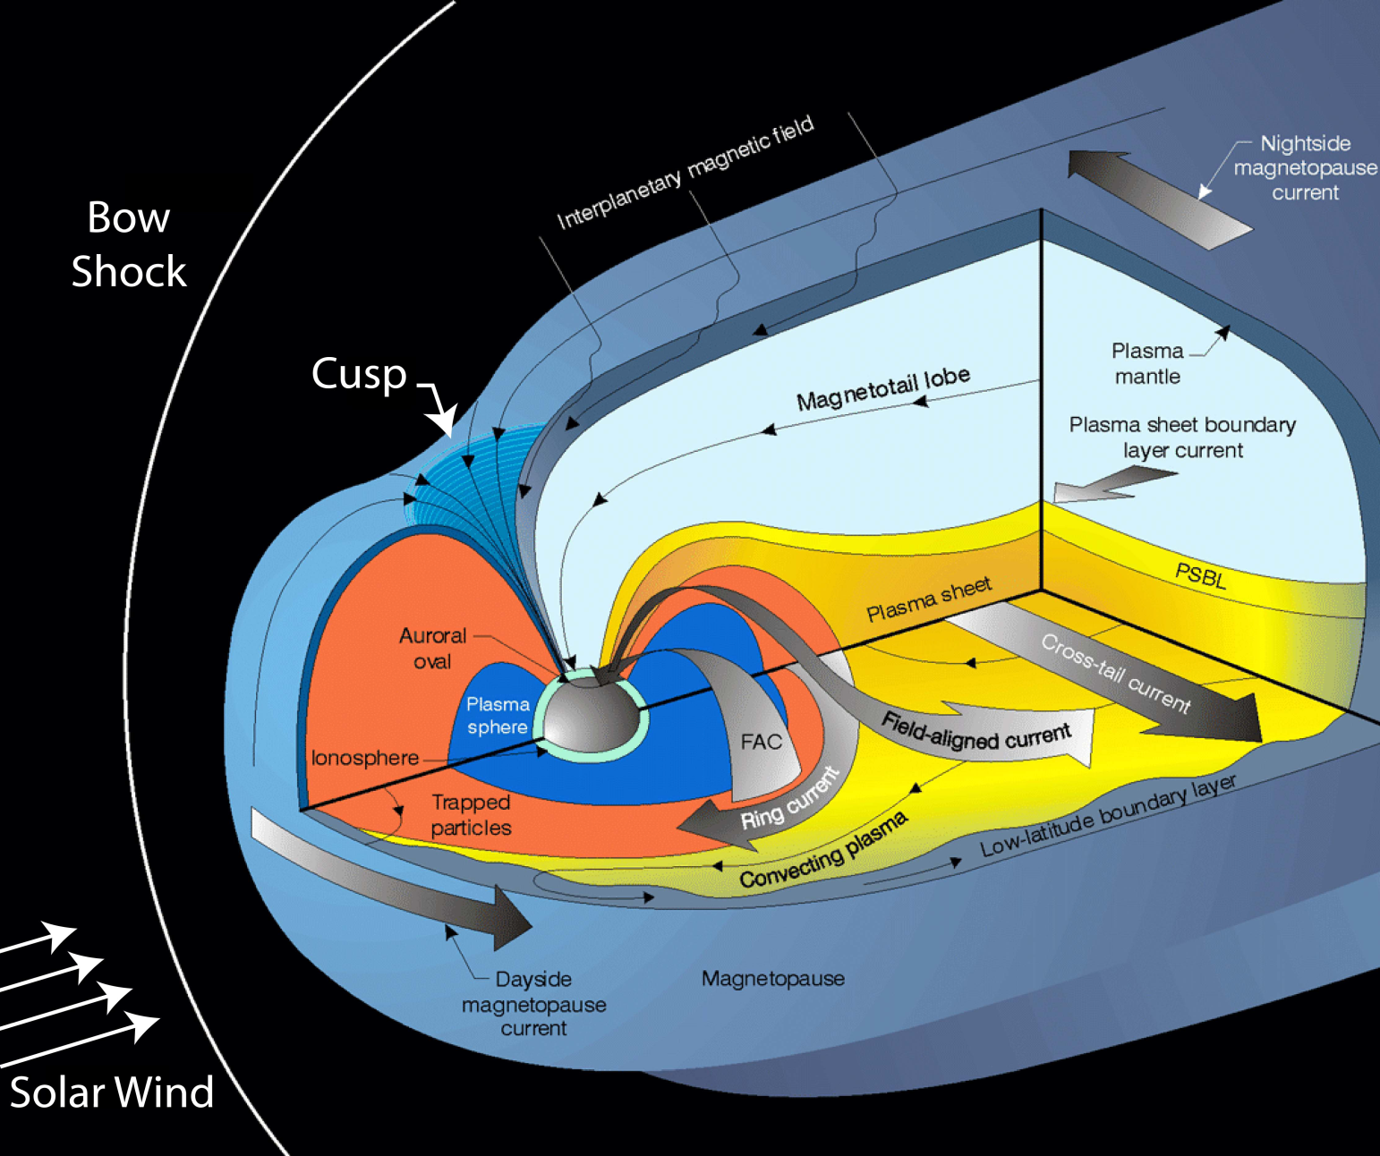
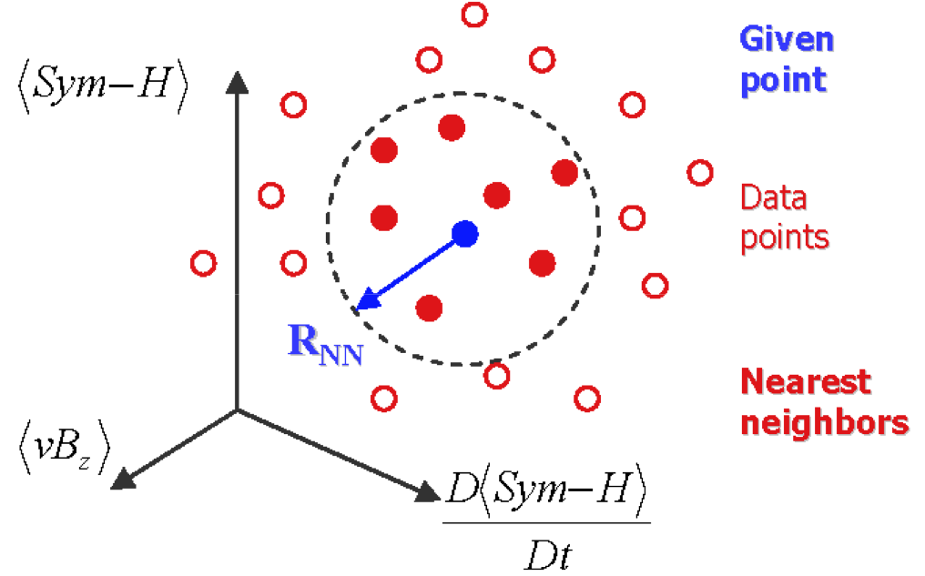
TS07D model: the New Generation of Empirical Magnetic Field Modeling
2 Primary Advancements:
Tail current, symmetric and partial ring currents are replaced by a basis function expansion
Predefined functional temporal dependence is replaced by dynamical approach using Nearest Neighbors
Sitnov et al., 2008

Slide 3
Basic idea: Magnetic field of a current disc [Tsyganenko and Sitnov, 2007]
TS07D: Equatorial Magnetic Field Description
Basic idea: Magnetic field of an current disc [Tsyganenko and Sitnov, 2007]
z
Ampere’s Law:
y
x
When z ≠ 0:
Solution of Laplace’s Eq.:
Magnetic Vector Potential:

Slide 4
TS07D: Equatorial Magnetic Field Description
Basis Function Expansion:
Add dynamic pressure dependence:
Add dipole tilt angle (Ψ) dependence:
this deforms and warps the current sheet

Slide 5
Classic vs. New Generation of Models
TS05
vs.
TS07D
TS07D is free of restrictions intrinsic to earlier models
  This allows for realistic topology and temporal evolution of storm-time equatorial currents
  Spatial resolution of equatorial currents are bounded by available magnetometer data
This makes it agreeable for scientific studies
  Such as to study storms with different solar wind drivers: CMEs [Sitnov et al. 2008] and CIRs [Sitnov et al. 2010]
  And different convection modes such as SMC [Stephens et al. 2013]

Slide 6
TS07D: Equatorial Magnetic Field Description
Basis Function Expansion representation of equatorial field gives arbitrary spatial resolution
Bounded only by ability to fit magnetometer data to expansion
TS07D uses N = 5, M = 4, for 90 equatorial coefficients (current model)
This is too coarse to describe the inner magnetosphere
For N = 20, M = 6, we now have 520 coefficients!
We need more magnetometer data to constrain the model

Slide 7
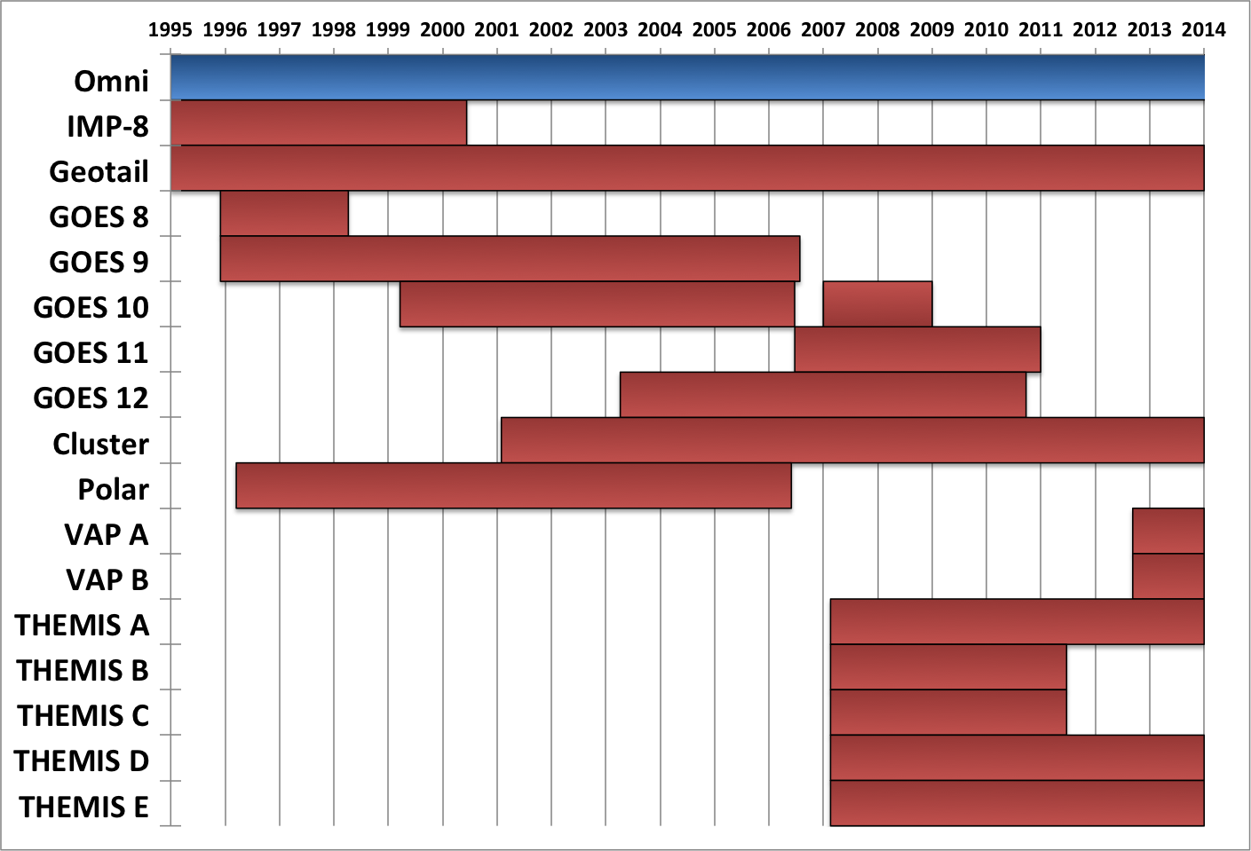
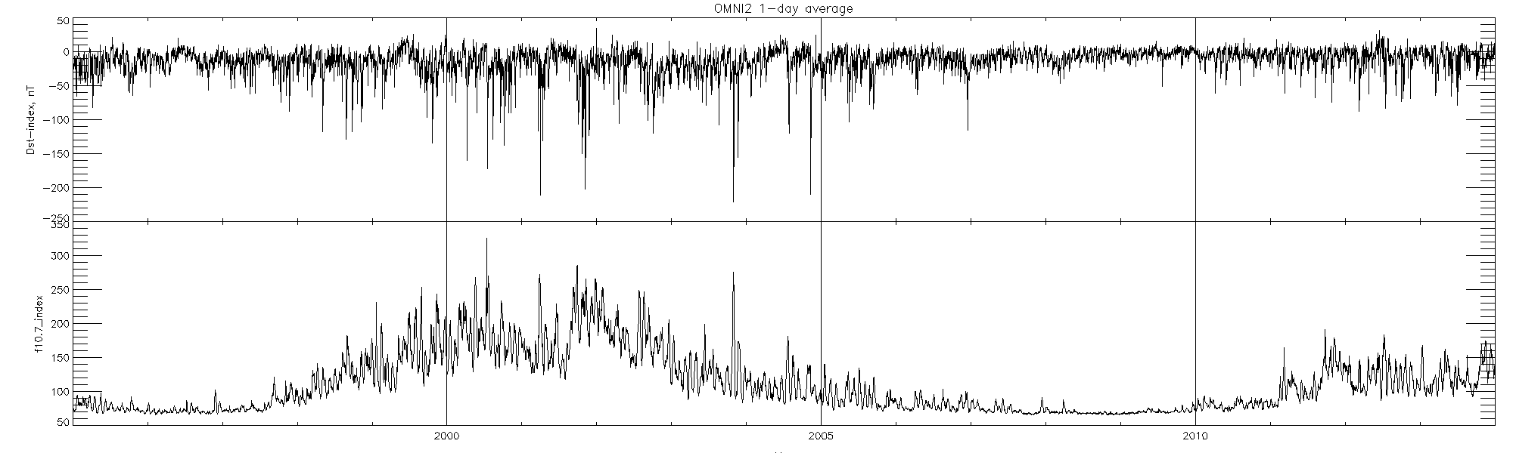
Expanding the magnetometer database
Current Model
Magnetometer data from CDAWeb
New inner magnetosphere data sources
Daily Average DST
From OMNI
Daily Average F10.7

Slide 8
Utilizing Van Allen Probes to reconstruct the inner magnetosphere
TS07D Model M=4, N=5
Model fit to VAP with M=4, N=5
Model fit to VAP with M=6, N=8
Eastward Currents
Model fit to VAP with M=6, N=20

Slide 9


Reconstruction of recovery phase of March 2013 storm
2013-076-12:00
Sample database using TS07D database +Van Allen Probes and THEMIS
N=20, M=6
Model clearly resolves both the Westward and Eastward ring currents
Also resolves the ‘Banana current’ postulated by Roelof 1989 and Liemohn et al., 2013

Slide 10
Comparison with other Empirical Studies
2013-077-12:00
Equatorial ring current distribution for -60 nT > Dst* > -80 nT [Le et al., 2004]

Slide 11
Evolution of Eastward Currents
During SymH* min., asymmetries lead ‘Banana’ currents to dominate over symmetric eastward currents
In the recovery, symmetric eastward currents dominate the banana currents
2013-076-12:00
2013-077-04:00

Slide 12
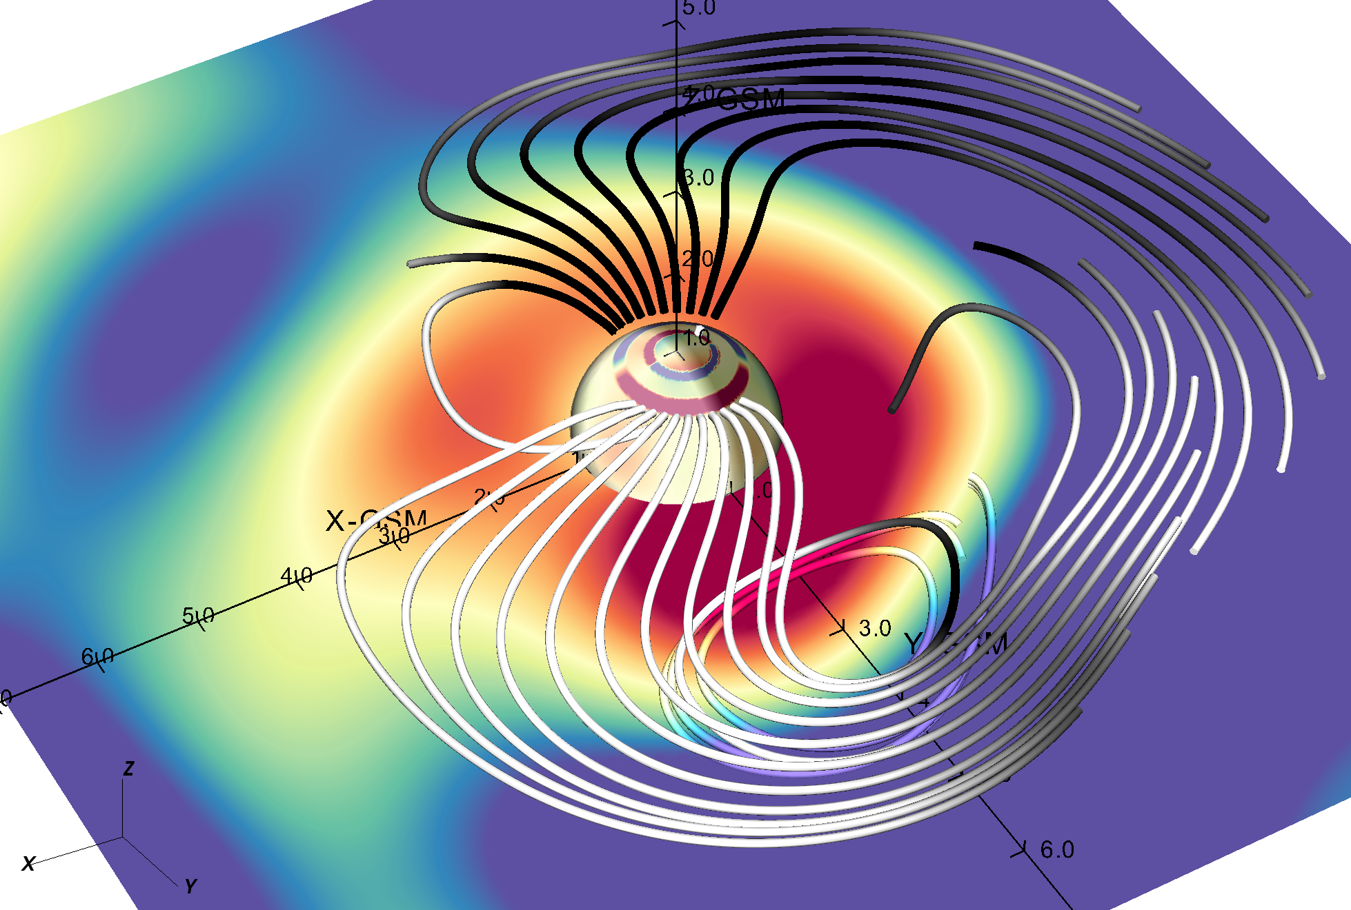
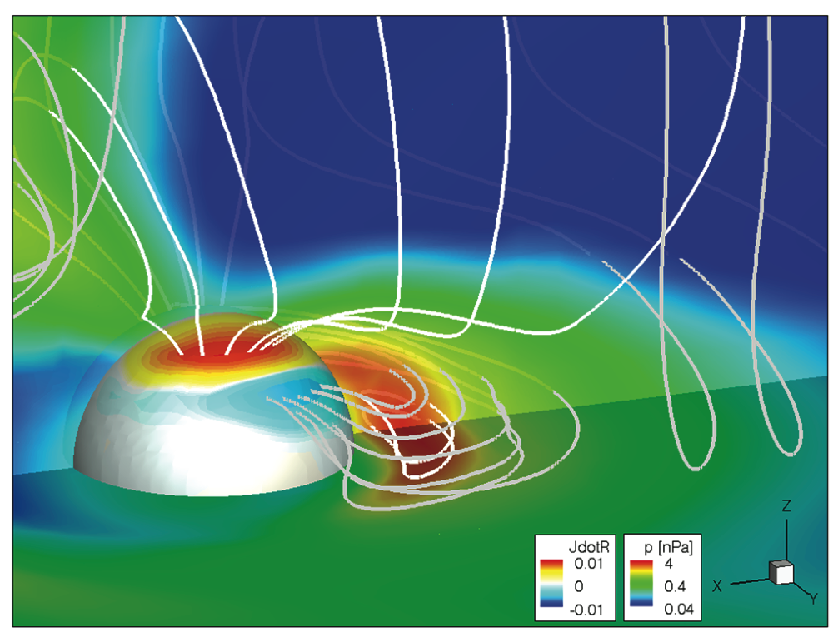
Comparison with ENA images and kinetic models
Roelof et al. [2004]
Empirical current picture (2013-076 12:00)
Liemohn et al. [2013]

Slide 13
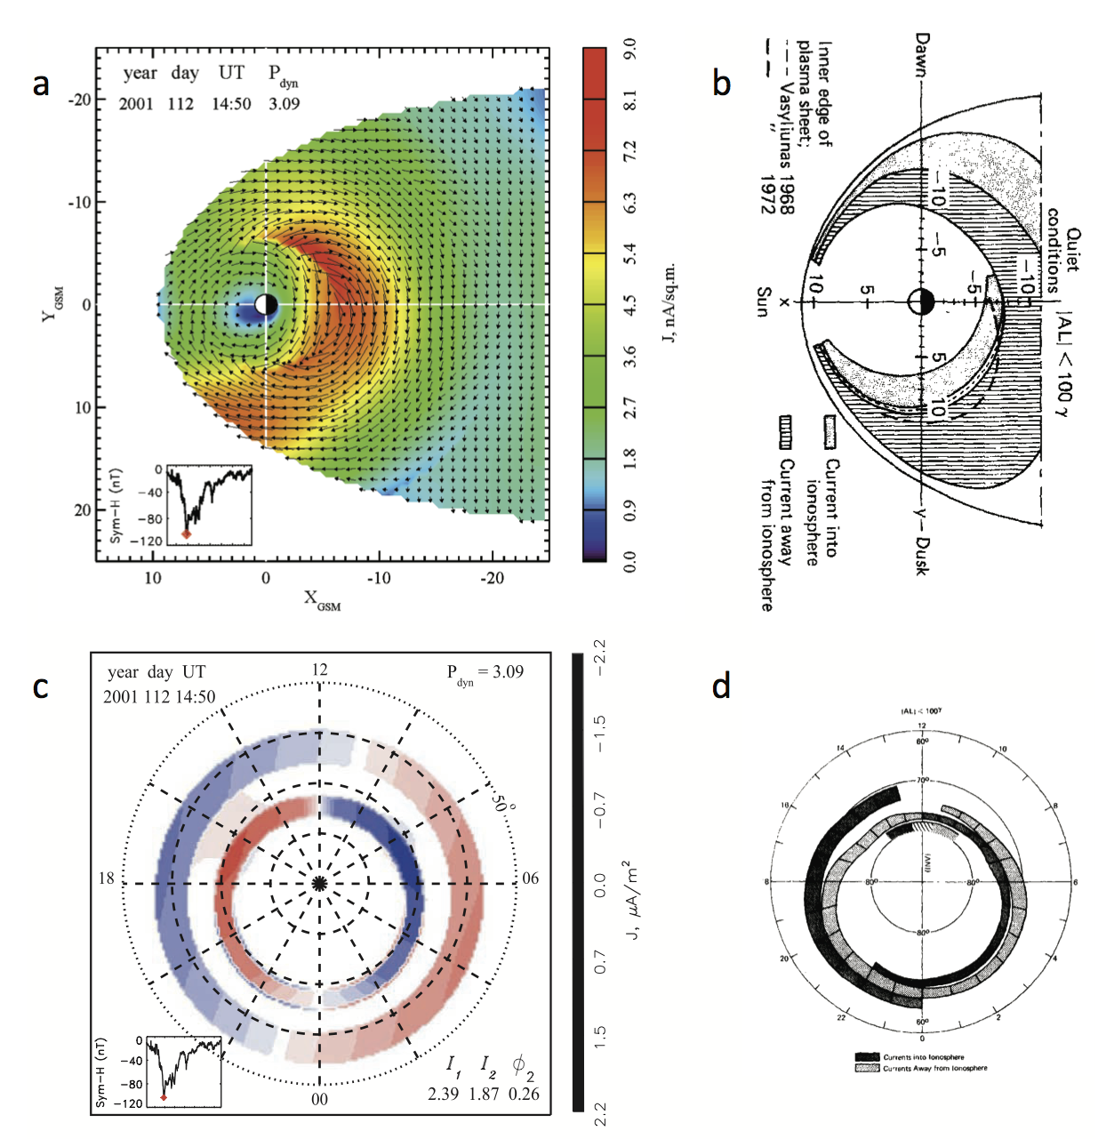
Advancements in Field Aligned currents
Current TS07D model
Potemra [ASS, 58, 207,1978]

Slide 14
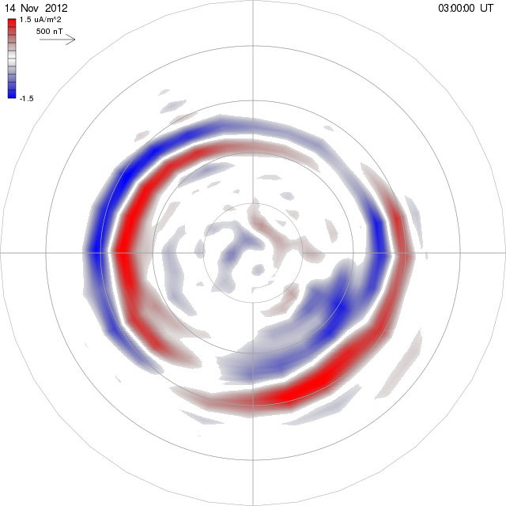
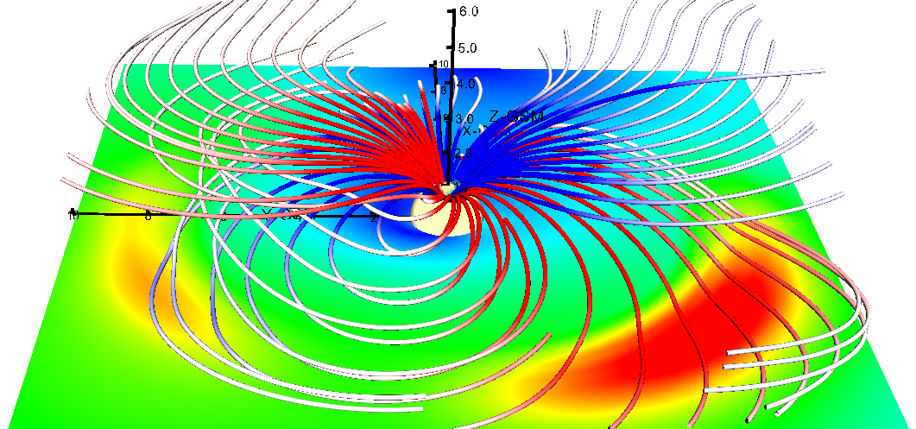
Advancements in Field Aligned currents
Original TS07D
TS07D w/ advanced FAC
AMPERE data
Harang discontinuity
14 November 2012 storm (319-03:00)
319 03:00
P_{dyn}=1.78

Slide 15
Using TS07D: Dynamic Inputs
Static Shielding Coefficients
TS07D Model
Model Coefficients (101)
Dipole Tilt
Magnetic Field
Dynamic Pressure

Slide 16
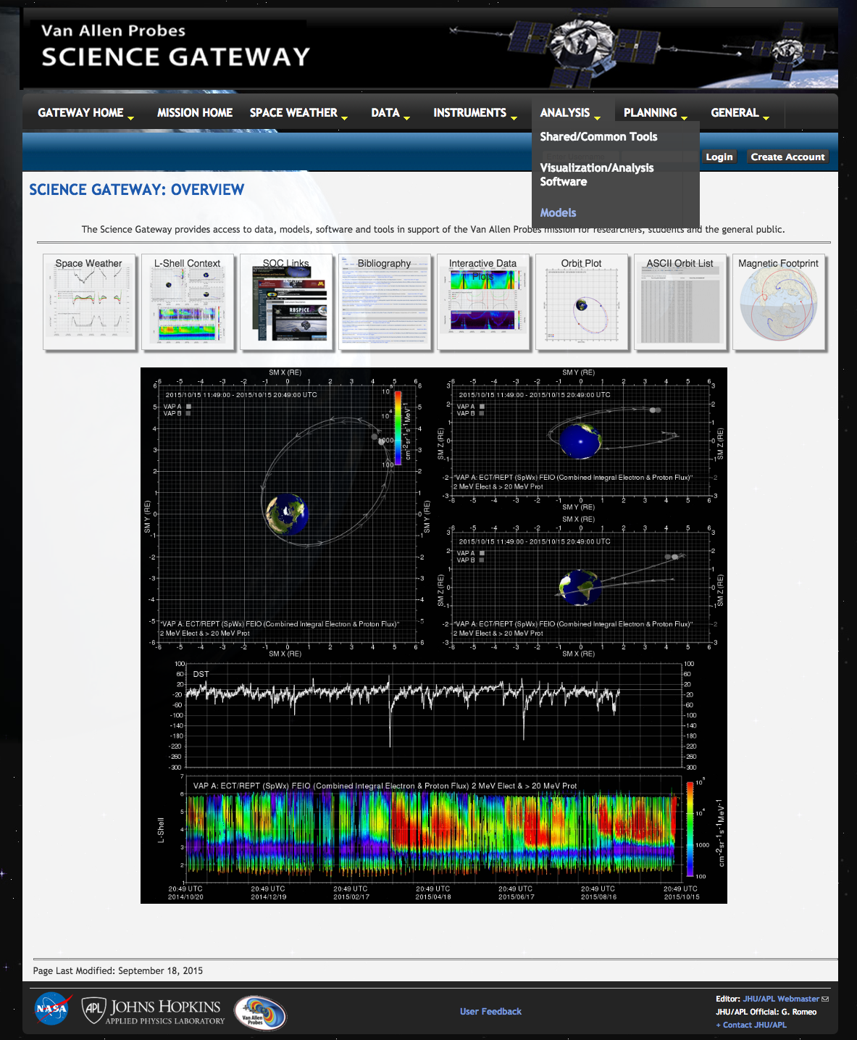
Using TS07D
Model link is on Van Allen Probes Science Gateway
http://rbspgway.jhuapl.edu/

Slide 17

Using TS07D
Tsyganenko’s Geopack link
TS07D link, including source code, static shielding coefficients, and dynamic model coefficients

Slide 18
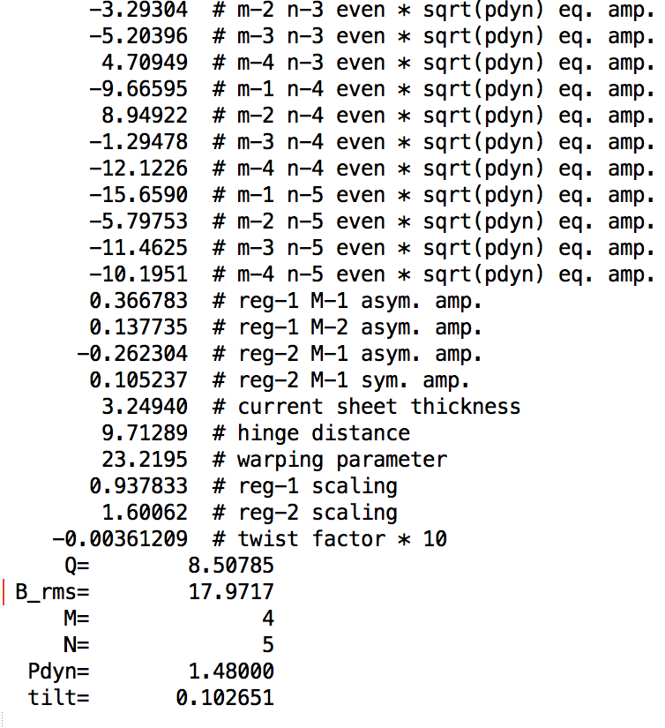
Accessing Coefficients
Hourly coefficients files have been pre-computed for January 1, 2007 – August 31, 2015
Interpolated files have been created for every 5-min.
These are also on the Science Gateway
Files will continue to be updated as new OMNI files are released
Coefficient Files have been augmented to include Dynamic pressure and dipole tilt

Slide 19
Future Products
The TS07D modeled magnetic field and magnetic vector potential will be written out to VTI cubes
  FORTRAN software will be provided that can read and interpolate the cubes
L* will be computed for the Van Allen probes ephemeris

Slide 20
Conclusions
Current magnetic field models are inadequate in reconstructing the inner magnetosphere and field aligned currents
The Basis Function expansion approach along with the Nearest-Neighbors binning method and plenty of magnetometer data make it possible to reconstruct the inner magnetosphere
This approach can clearly resolve both the symmetric Eastward currents and the asymmetric Eastward ‘Banana’ currents
By introducing overlapping FAC modules, the model can reconstruct the realistic ‘spiral’ Birkeland current pattern
A new higher spatial resolution model would be valuable tool in inner-magnetospheric and space weather studies

Slide 21
Grant.Stephens@jhuapl.edu

Slide 22
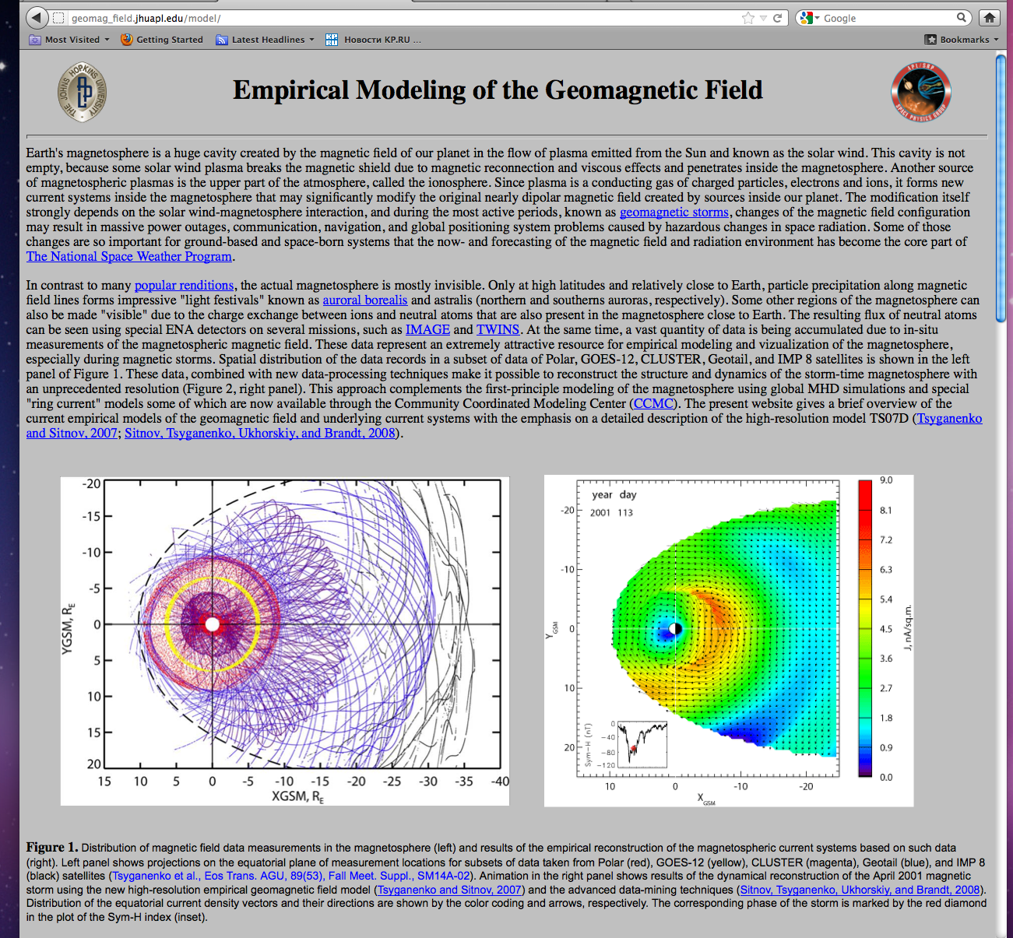
Using TS07D
Model website
http://geomag_field.jhuapl.edu/model/

Slide 23
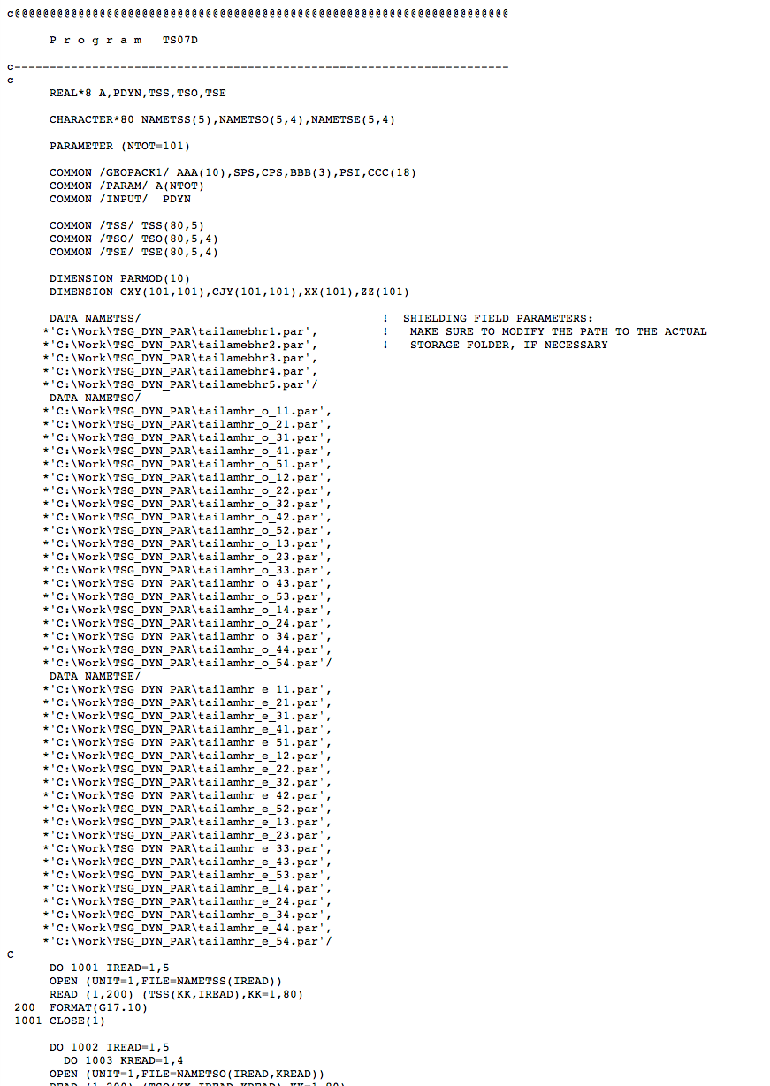

Using TS07D
Source Code
http://geomag_field.jhuapl.edu/model/
Model website
Necessary Static Data Files

Slide 24
Complementing First-principles models
MHD equations
Adjusting storm time scale equation of state
RCM equations
Adjusting external boundary conditions

Slide 25
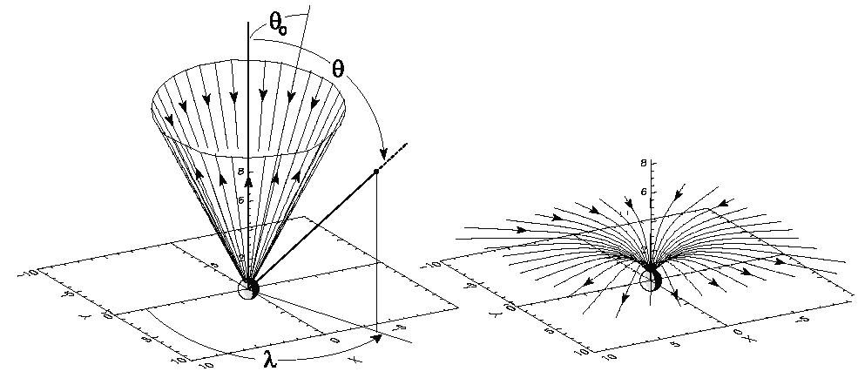
TS07D: Other current Systems
Currents corresponding to
deformed magnetic field
Field Aligned Current Module [Tsyganenko, 2002]
Undeformed
conical current
Shielding Fields:

Slide 26
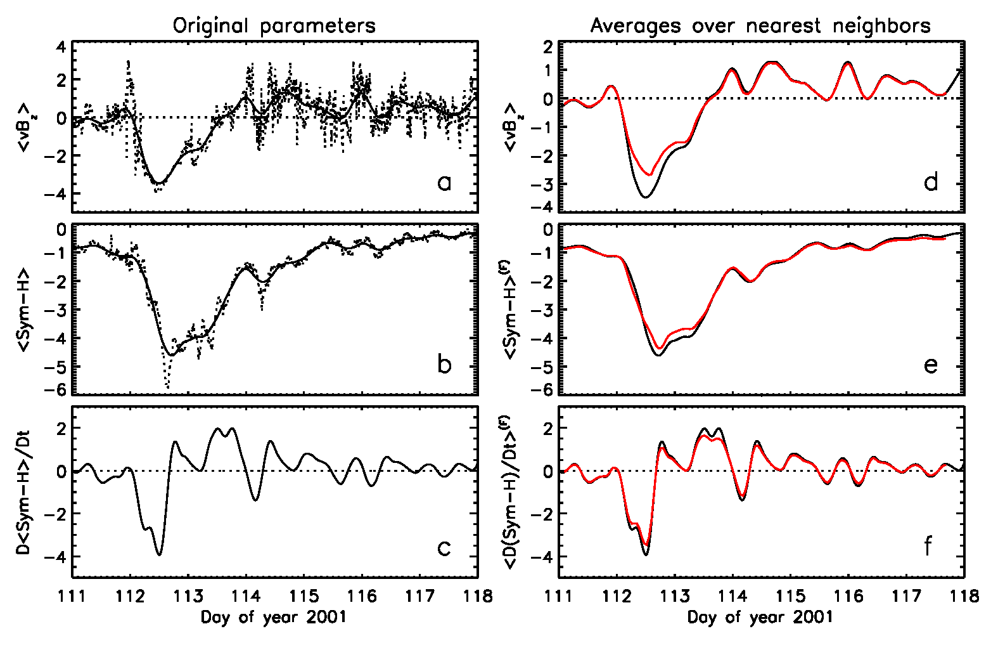
TS07D: Dynamical binning using Nearest Neighbors
NN parameters are based BMR formulism, relating vBz, Dst, and d/dt(Dst) to global state of the magnetosphere during storms [Burton et al. 1975]
Selects other magnetometer data that is most similar to epoch we are modeling
Balance between statistical approach and event oriented models
NN=8000

Slide 27
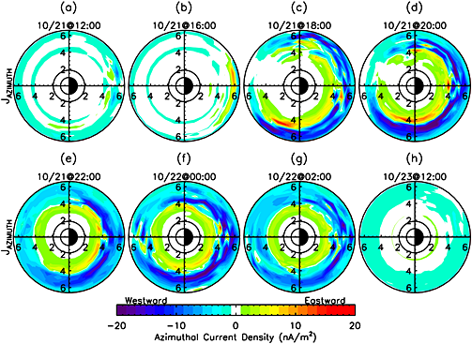
Comparison with HEIDI simulations
Near Dst* minimum
Recovery
Empirical Magnetic Field Model
Hot Electron and Ion Drift Integrator with Self-Consistent electric field [Liemohn et al., 2013]

Slide 28
Complementing First-principles models
MHD equations
Adjusting storm time scale equation of state
RCM equations
Adjusting external boundary conditions

