Slide 1
Depletion of multi-MeV electrons and its relation to the minima in phase space density
Drozdov A. Y.¹, Aseev, N. A.², Shprits, Y. Y.^{2,3,1}, M. Usanova⁴, F. Effenberger² , D. Turner ⁵ , A. Saikin¹
University of California, Los Angeles, CA, USA
GFZ German Research Centre For Geosciences, Germany
University of Potsdam, Germany
University of Colorado at Boulder, CO, USA
The Aerospace Corporation, CA, USA
Acknowledgments
RBSP ECT Team, OMNIWeb, NASA #80NSSC18K0663, #80NSSC18K1034, Hoffman 2

Slide 2
Outline
Goal of the study
Signatures of EMIC wave scattering
Narrow pitch angle distribution
Minima in PSD profiles
Deletions during storms
Pitch angle dependence of depletion events during storms
Search of electron flux depletion
EMIC waves and minima in PSD profiles
Search of the PSD minima
Conclusions
Introduction
Storms
Not only storms and PSD min

Slide 3
Goal
The main scientific goal in this study is: the investigation of the role of the Electro Magnetic Ion Cyclotron (EMIC) waves and the magnetopause in the depletion of ultra-relativistic electrons.
To achieve this goal, we use the data from multiple satellites (Van Allen Probes, GOES, THEMIS). We identify the depletion events during storm times and analyze the pitch angle distribution. Additionally, we identify the depletion events search for and presence of minimum in PSD profiles regardless of the geomagnetic activity. In the future, we will use the modeling to validate our findings.

Slide 4
Narrow pitch angle distribution caused by EMIC waves
EMIC wave scattering is fast at low pitch angles and significantly slower at high pitch angles, causing a narrowing in electron pitch angle distribution, more pronounced at high energies.
This signature of EMIC waves was previously observed
The narrowing of the pitch angle distribution successfully reproduced by the Versatile Electron Radiation Belt (VERB) code during the January 17, 2013 storm.
[Shprits et al., 2016]

Slide 5
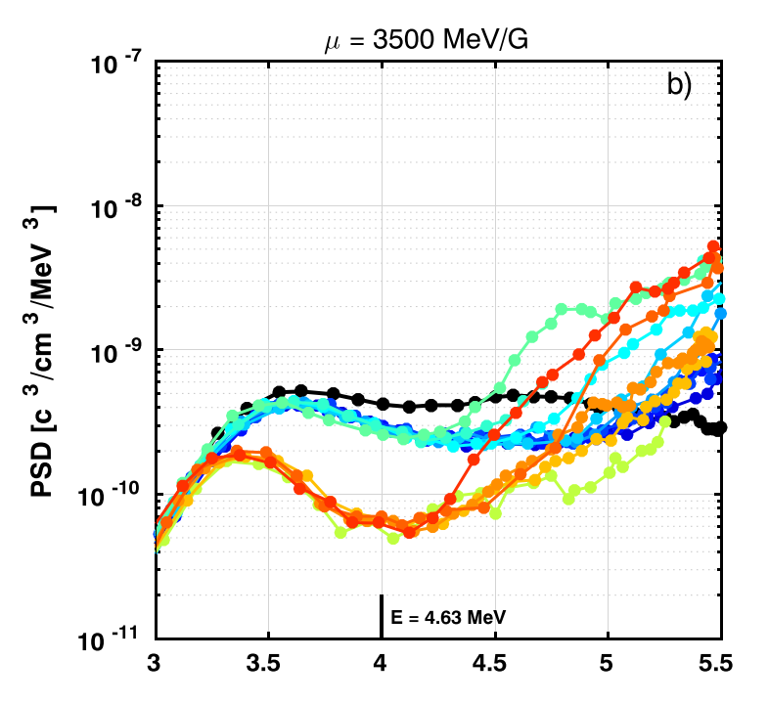
Minima in PSD profiles due to the fast local losses
EMIC waves provide fast localized loss forming the minima in PSD profiles.
Observations µ =700 MeV/G
Observations µ =3500 MeV/G
L*
L*
Local Losses
[Shprits et al., 2017]

Slide 6
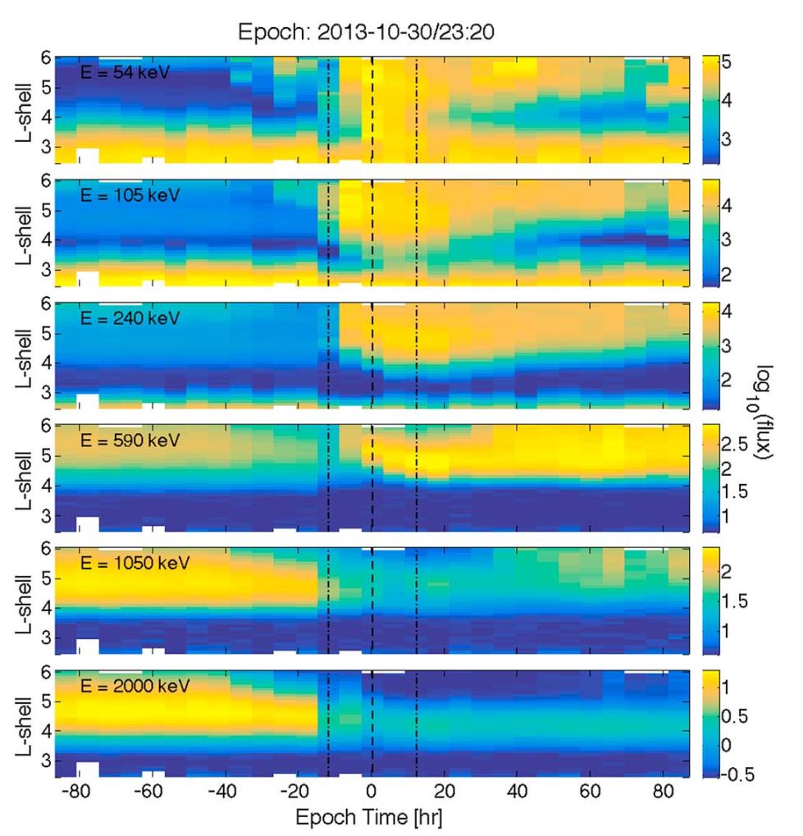
Electron depletions during storms
Turner et al. [2015; 2019] showed that around 36% of the storms result a depletion of the high-energy electrons at high L-shells (∼2 MeV and above. Turner et al. used omnidirectional electron flux for the analysis.
We performed a statistical study of 110 storms (from October 2012 until October 2017) analyzing the response of Earth’s outer radiation belt electrons over a broad range of energies and pitch angles. We confirmed the conclusion for the trapped electrons at $(α_{eq}={75}^{∘}$).

Slide 7
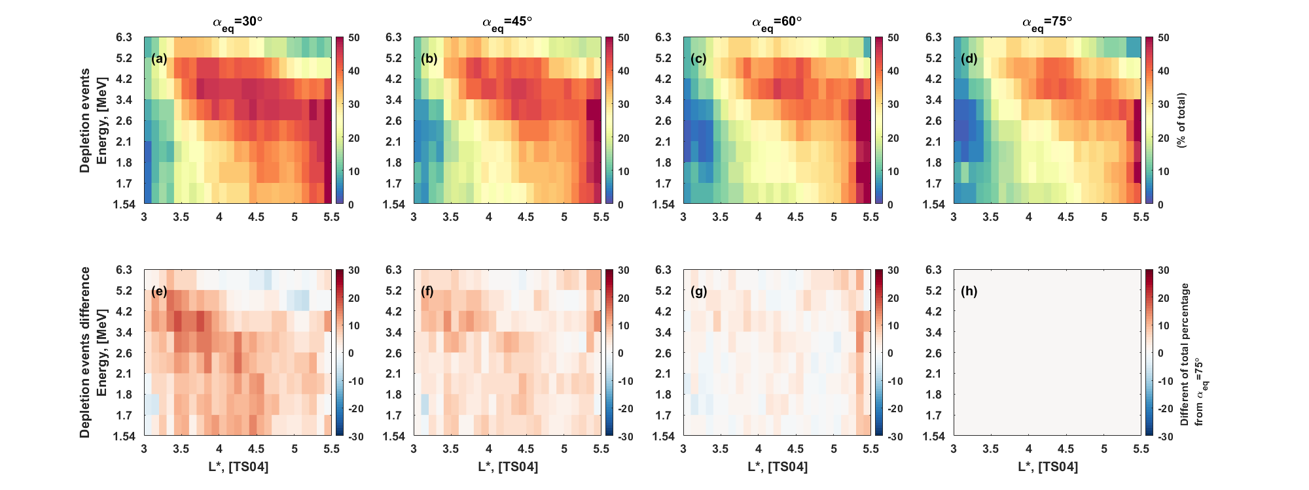
Pitch angle dependence of depletion events during storms
$P_{d}(α_{eq})$
$$difference=$$
$P_{d}(α_{eq})$ - $P_{d}(α_{eq}={75}^{∘})$
The difference is generally larger at low L∗ and low pitch angles indicating the potential electron scattering by the EMIC waves.

Slide 8
Normalized median PADs 36 hours before and 36 hours after the storm time
The normalized PADs indicate that EMIC wave scattering plays a potentially important role in the formation of a narrow PAD of high-energy electrons, which is supported by the simultaneous lack of significant narrowing at lower energies, excluding an adiabatic variation effect acting at all energies

Slide 9
Multi-MeV electron flux depletion events from January 1, 2013 until January 1, 2014
The histograms show that flux depletion events are identified more often at high L∗, low energy and high pitch angle. This is an indication of the magnetopause shadowing. The peak at low pitch angle is potentially due to the EMIC waves.
Statistical analysis of the deletion events
We identified a flux depletion by following criteria
$$ΔL=1, Δt=12 h \\ \frac{\log_{10}\left(\overline{j_{t_{−1}}}\right)−\log_{10}\left(\overline{j_{t_{+1}}}\right)}{2Δt} \\ ≤\log_{10}\left(\frac{1}{3}\right)$$

Slide 10
Local minimum in PSD and narrow pitch angle distributions associated with EMIC waves
Aseev et al., 2017

Slide 11
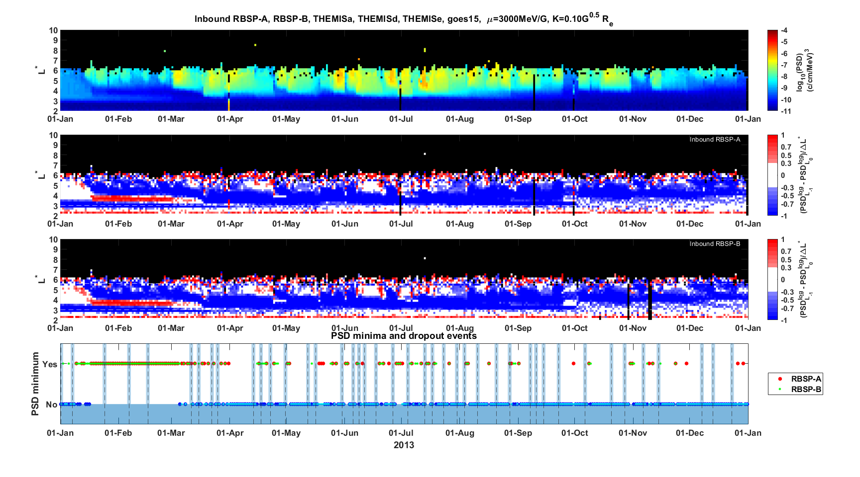
Search of the PSD minima
We attempt to identify PSD minima using derivative of the PSD profile.
$L^{∗}∈(3.0, 5.6)$
Drop rate of PSD ∼ 1 order over $ΔL^{∗}=1$
$$\left|\frac{\log_{10}\left(PSD_{L_{−1}} \right)−\log_{10}\left(PSD_{L_{0}}\right)}{ΔL}\right| \\ ≥0.3$$

Slide 12
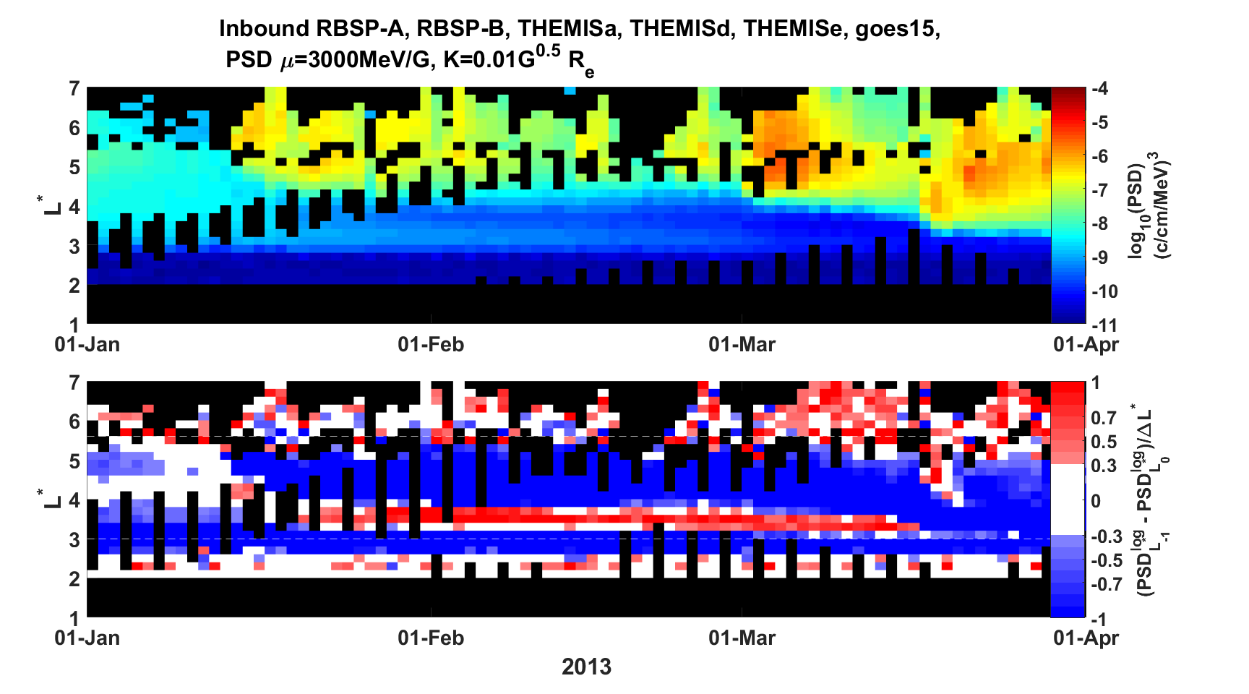
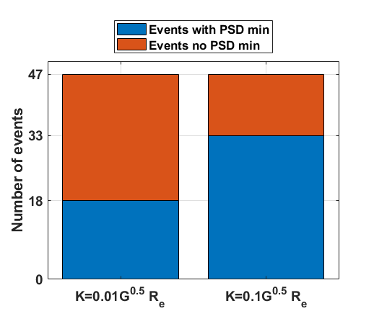
Search of the PSD minima
We attempt to identify PSD minima using derivative of the PSD profile.
$L^{∗}∈(3.0, 5.6)$
The histograms on the right show that PSD minima is commonly observed during a depletion of the electron flux.
Drop rate of PSD ∼ 1 order over $ΔL^{∗}=1$
The histogram of identified depletion events in conjunction with identified PSD minima at different K
$$\left|\frac{\log_{10}\left(PSD_{L_{−1}} \right)−\log_{10}\left(PSD_{L_{0}}\right)}{ΔL}\right| \\ ≥0.3$$
$$K=0.01G^{0.5}R_{e}$$
$$K=0.1G^{0.5}R_{e}$$

Slide 13
Conclusions
Almost half of the storms result in a depletion of multi-MeV electrons, and majority of depletions are produced by EMIC waves
Probability of observed storm depletions of multi-MeV electrons depends on the pitch angle
Up to 15% more storms result in multi-MeV electron depletion at low pitch angle which may be a result of the EMIC waves activity.
The analysis of the depletion events (regardless of the storms) during 2013 showed a that there are significantly more events at high equatorial pitch angles and high L*, which is an indication of the magnetopause shadowing effect.
Many flux depletion events are detected at low equatorial pitch angles (signature of EMIC wave scattering) .
The observation of the localized PSD minimum (signature of EMIC wave scattering) during an electron depletion is not uncommon. There are more events associated with the PSD minima at high adiabatic invariant K (low equatorial pitch angle).

Slide 14
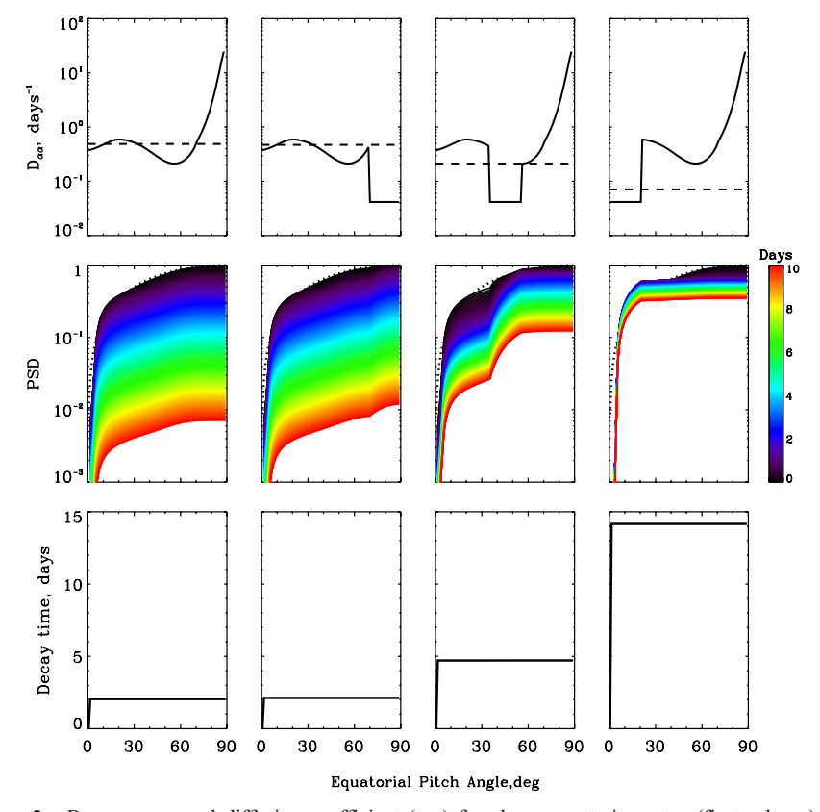
EMIC waves work together with other waves
Radial diffusion only
+ EMIC
+ EMIC
+ Chorus
+ EMIC
+ Chorus
+ Hiss
Shprits et al. 2006

Slide 15
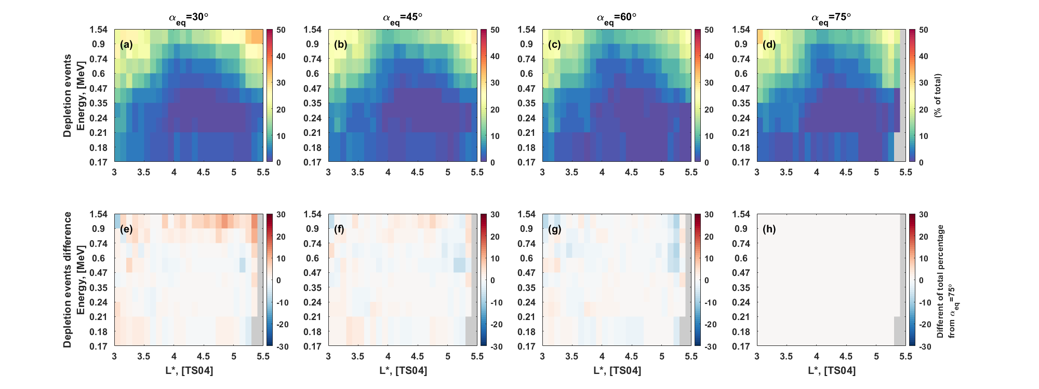
Pitch angle dependence of depletion events during storms
$P_{d}(α_{eq})$
$$difference=$$
$P_{d}(α_{eq})$ - $P_{d}(α_{eq}={75}^{∘})$

Slide 16
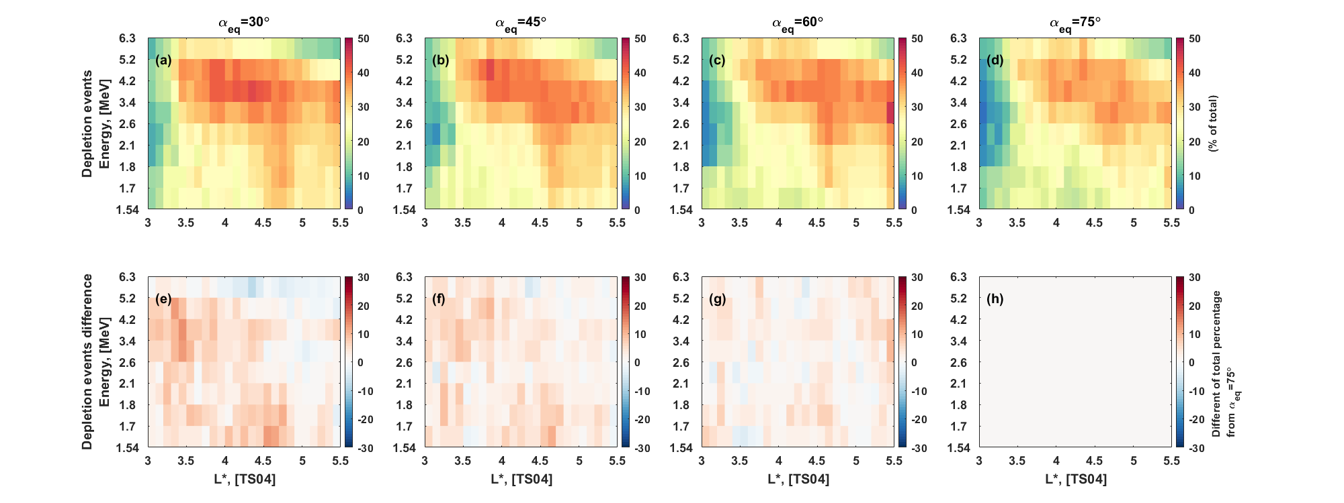
Pitch angle dependence of depletion events during storms (72 hours)
$P_{d}(α_{eq})$
$$difference=$$
$P_{d}(α_{eq})$ - $P_{d}(α_{eq}={75}^{∘})$

Slide 17
Depletion evens, background corrected

Slide 18
Selection of the range of L* and pitch angle

Slide 19
Multi-MeV electron flux depletion events from January 1, 2013 until January 1, 2014
We identified a flux depletion by following criteria
$$ΔL=1, Δt=12 h \\ \frac{\log_{10}\left(\overline{j_{t_{−1}}}\right)−\log_{10}\left(\overline{j_{t_{+1}}}\right)}{2Δt} \\ ≤\log_{10}\left(\frac{1}{3}\right)$$

Slide 20
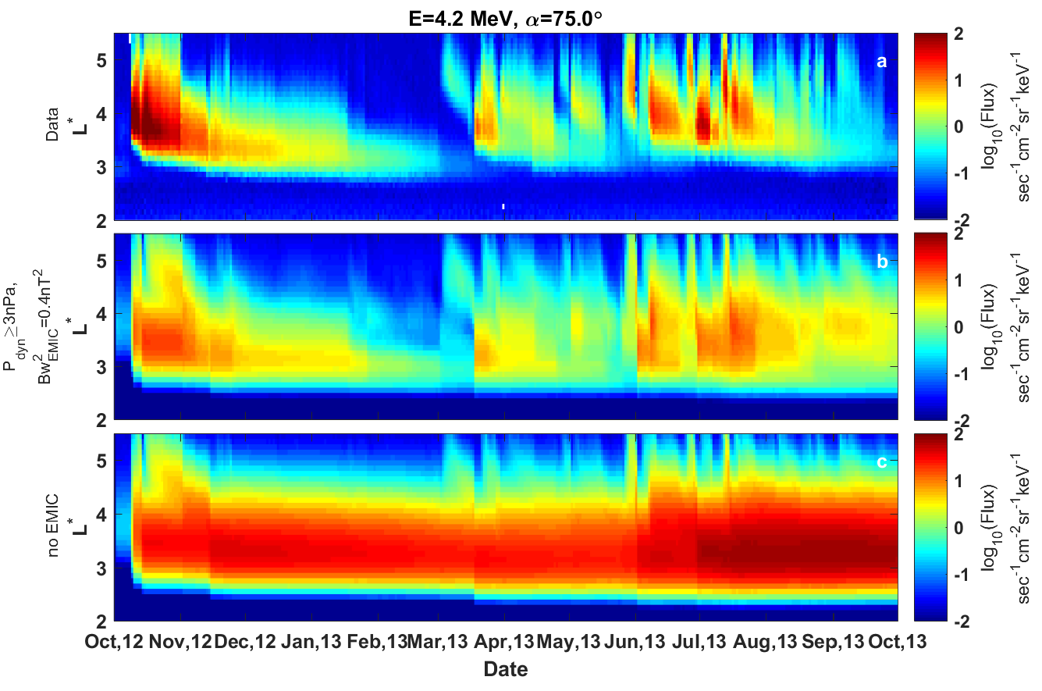
Effects of EMIC waves (long-term)
Oct. 2012 – Oct. 2013
Observations
Model
with EMIC
Model
without EMIC
[Drozdov et al., 2017]

Slide 21
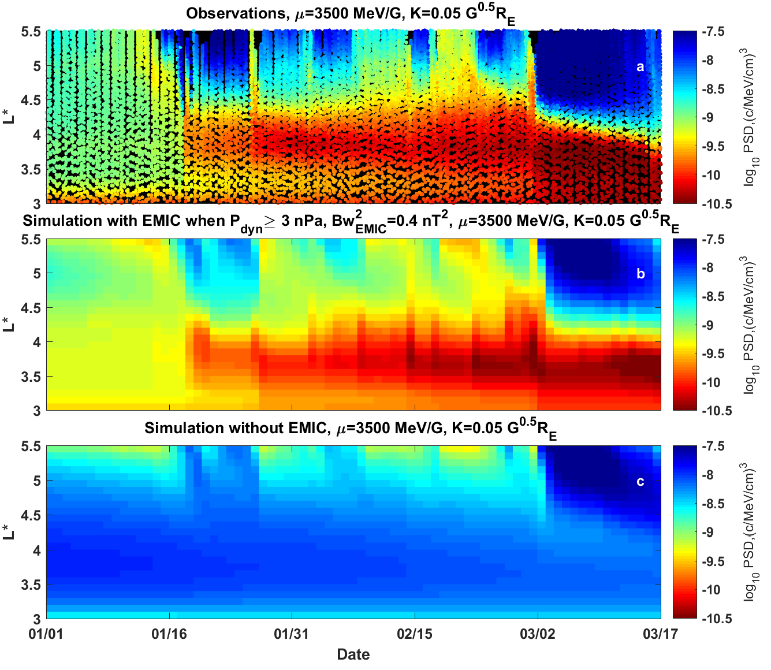
PSD local minimum
Maximum
Inverted colorbar
Observations
REPT 4.2 MeV
Minimum
Model
with 0.4 nT² EMIC parameterized with $P_{dyn}$ ≥ 3 nPa
We reproduce the local minimum in PSD profiles
Model
without EMICs
Drozdov et al. 2017

Slide 22
Statistical analysis of the deletion events with association of PSD minima
The statistics of identified events in conjunction with identified PSD minima, for different K
The histograms of the identified flux depletion events.
The histograms on the let show that flux depletion events are identified more often at high L∗, low energy and high pitch angle. This is an indication of the magnetopause shadowing. The peak at low pitch angle is potentially due to the EMIC waves.
The histograms on the right show that PSD minima is commonly observed during a depletion of the electron flux.

Slide 23
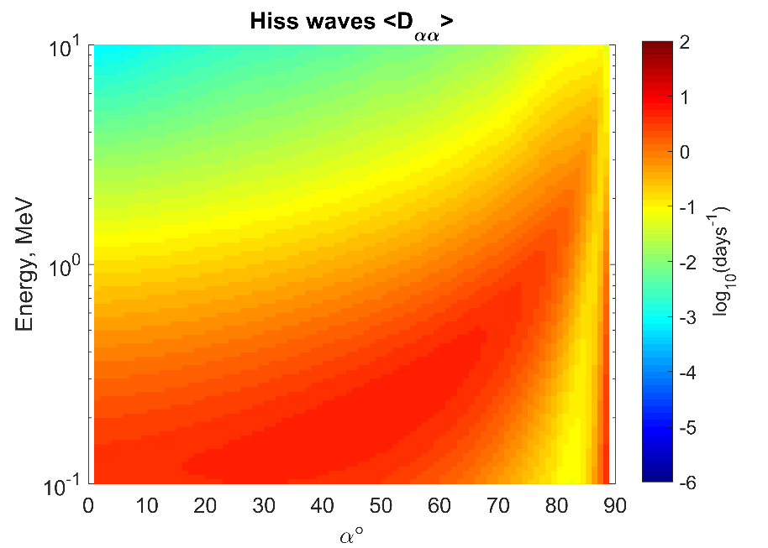
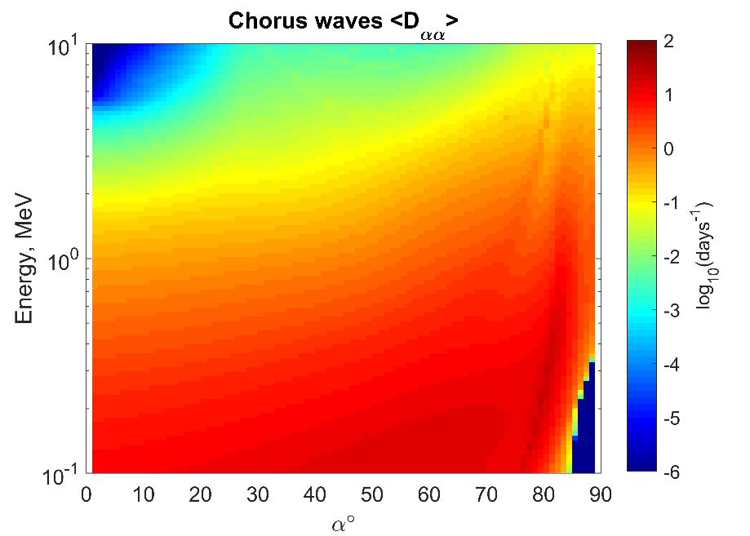
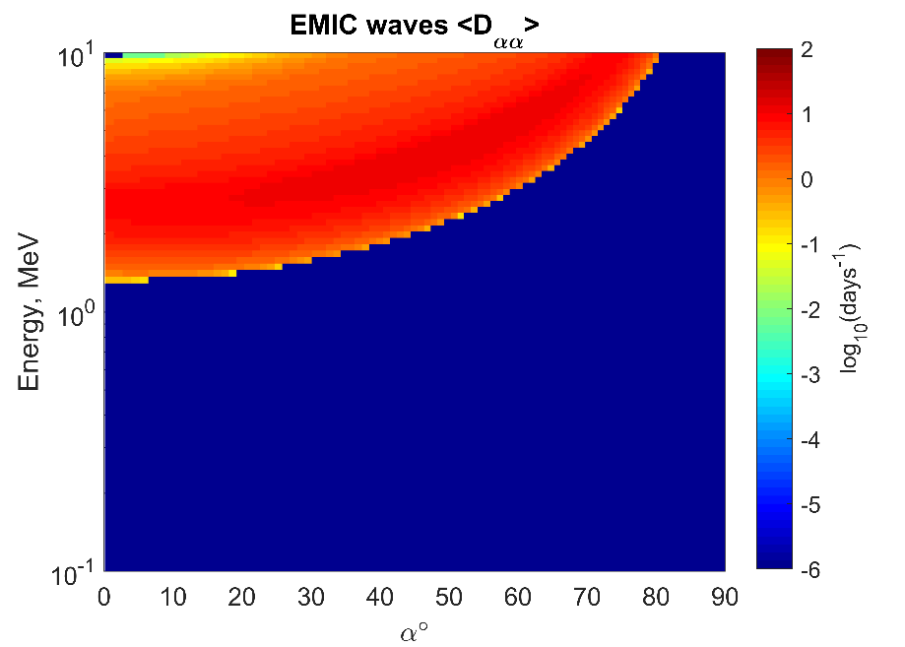
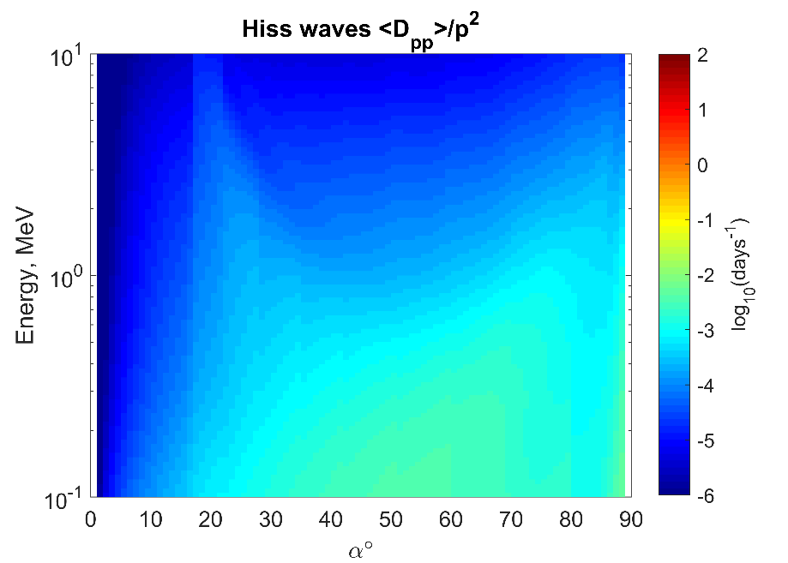
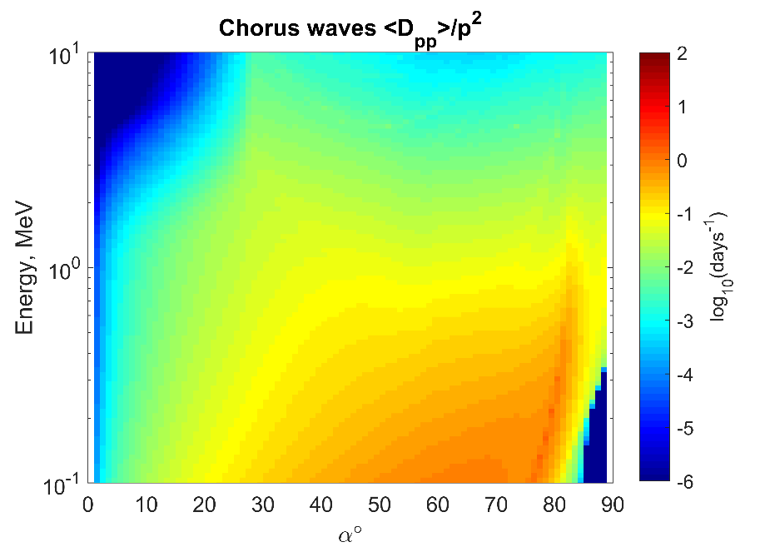
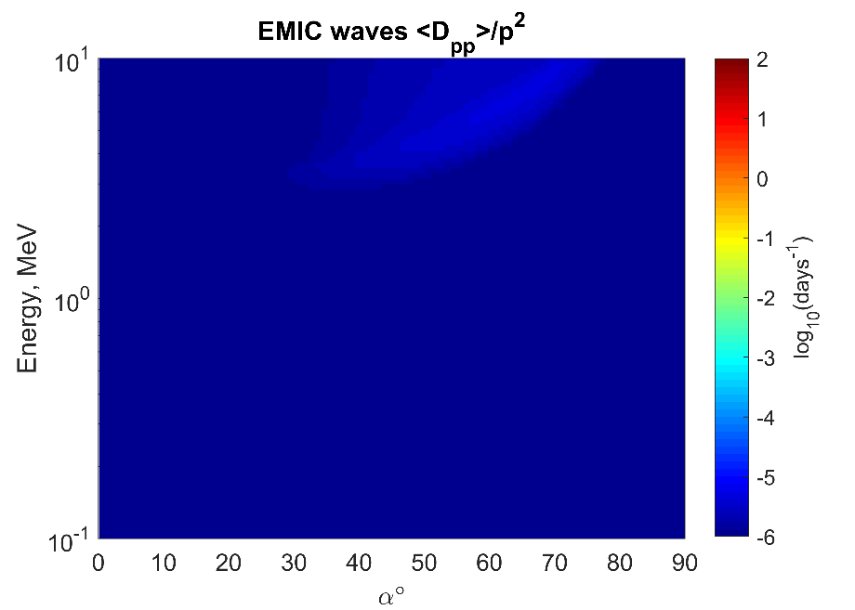
Local Diffusion Coefficients
Hiss
Chorus
EMIC
1 MeV
$$D_{αα}$$
$$D_{pp}$$

Slide 24
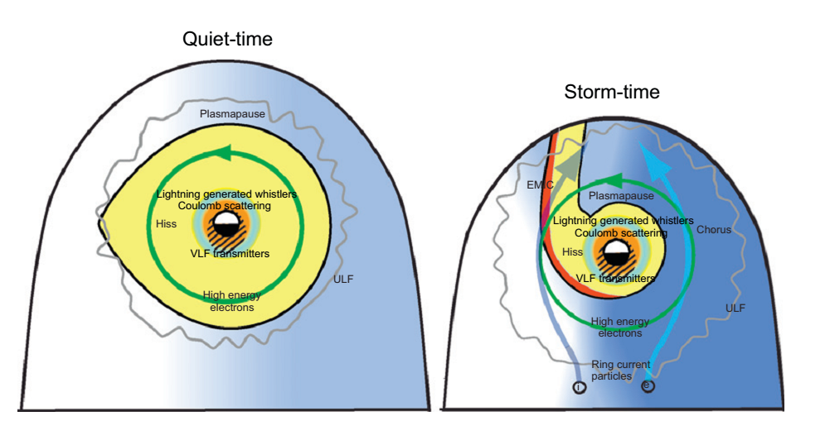
Fokker-Planck equation and the VERB code
Phase-space density dynamics
VERB code
Radial diffusion
Local diffusion
Pitch-angle
Energy
Mixed-terms
Loss into atmosphere or magnetopause
Waves:
ULF
Hiss
Chorus
VLF transmitters
Lightning whistlers
EMIC
Shprits et al., 2008
$$\frac{∂f}{∂t}=L^{∗2}\frac{∂}{∂L^{∗}}{\left.​\right|}_{μ,J}\frac{1}{L^{∗2}}D_{L^{∗}L^{∗}}^{}\frac{∂f}{∂L^{∗}}{\left.​\right|}_{μ,J}+\frac{1}{p^{2}}\frac{∂}{∂p}{\left.​\right|}_{α_{0},L}p^{2}\left(D_{pp}\frac{∂}{∂p}{\left.​\right|}_{α_{0},L}f+D_{pα_{0}}\frac{∂}{∂α_{0}}{\left.​\right|}_{p,L}f\right)$$
$$+\frac{1}{T\left(α_{0}\right)\sin\left(2α_{0}\right)}\frac{∂}{∂α_{0}}{\left.​\right|}_{p,L}T\left(α_{0}\right)\sin\left(2α_{0}\right)\left(D_{α_{0}α_{0}}\frac{∂}{∂α_{0}}{\left.​\right|}_{p,L}f+D_{α_{0}p}\frac{∂}{∂p}{\left.​\right|}_{α_{0},L}f\right)−\frac{f}{τ}$$
$$\frac{∂f}{∂t}=?$$

