Slide 1
A Four-Belt Structure in Earth’s Van Allen Belts
Allison N. Jaynes, C. Pollock, J. Doucette, D. N. Baker, X. Li, H. Zhao, S. G. Kanekal

Slide 2
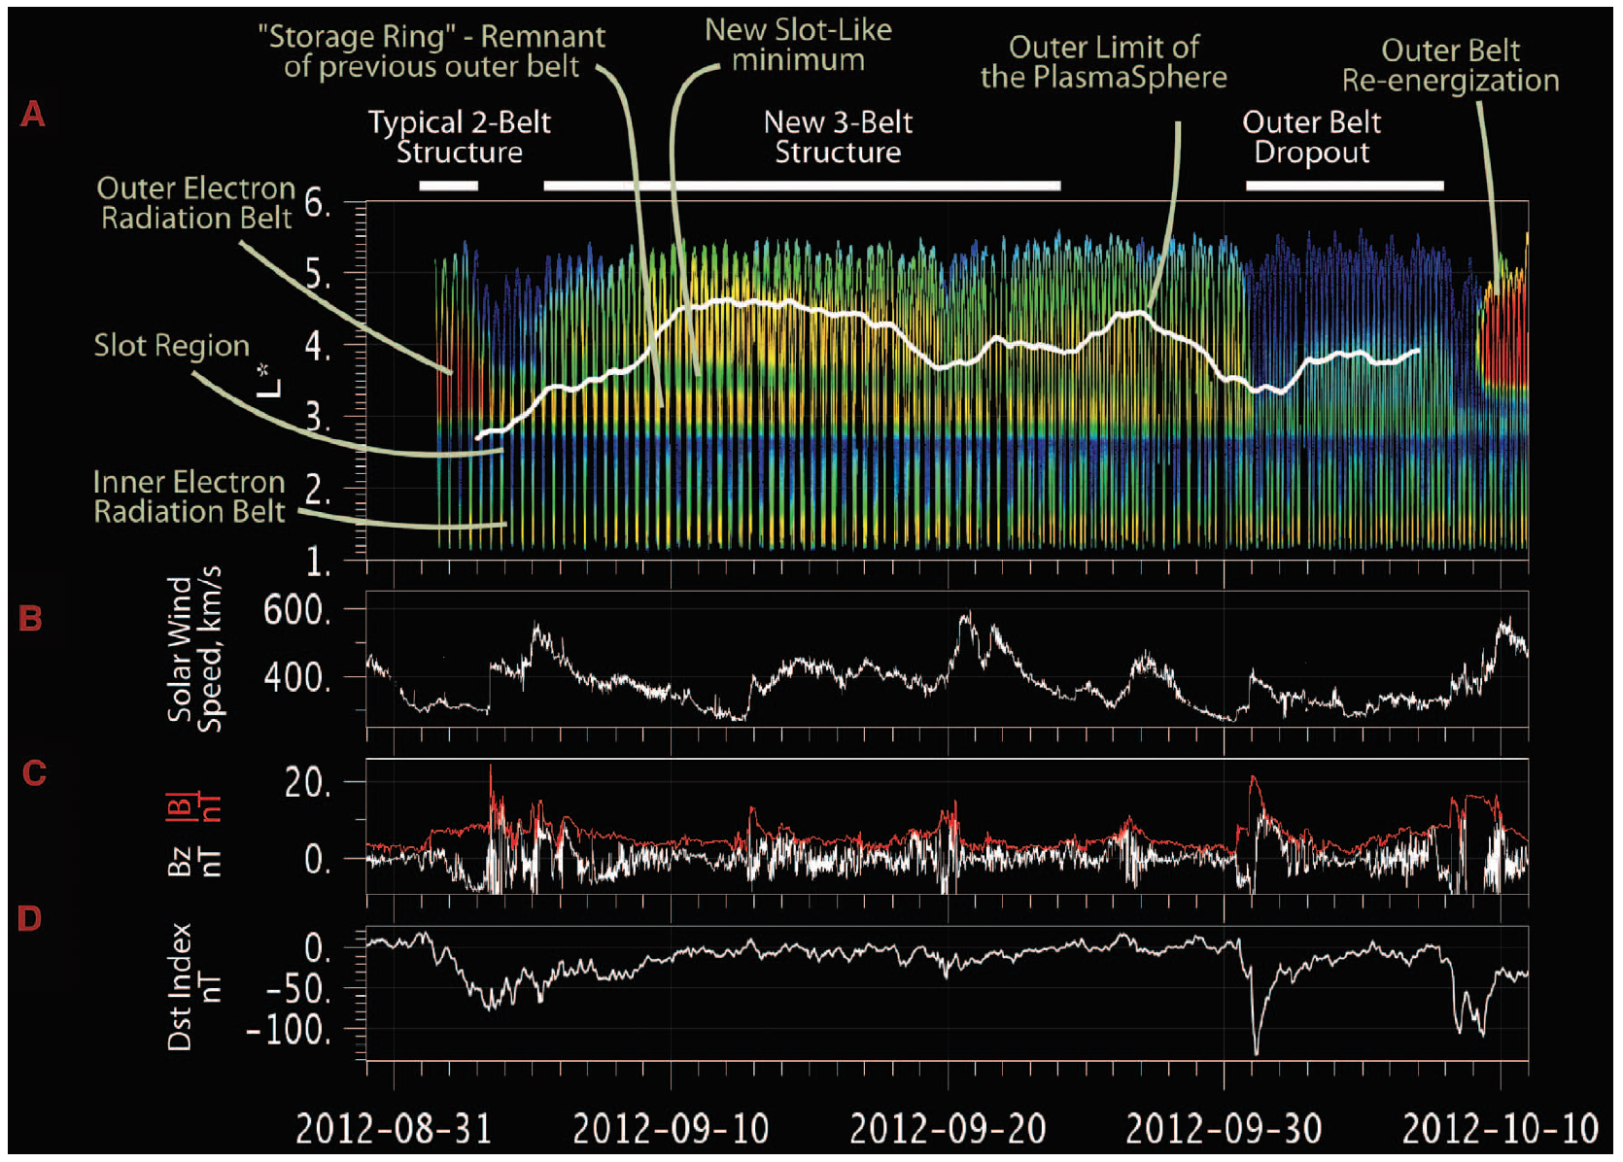
Baker+ 2013

Slide 3
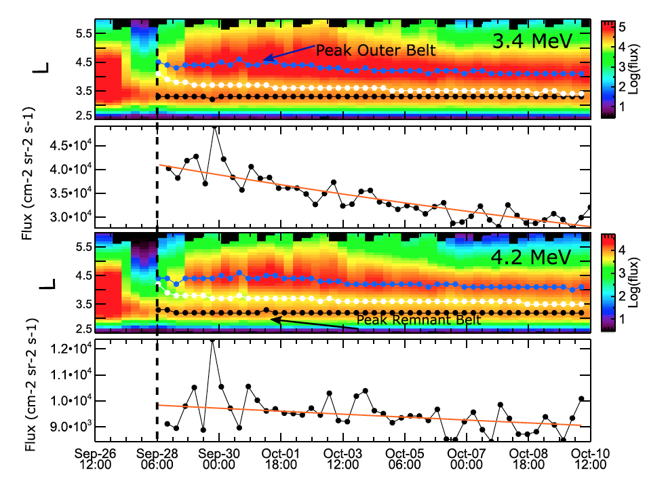
30 three-belt structures identified within 5 years of data
18% of storms produced this feature
Occur most often during weak to moderate storms
Some of the existing belt is protected inside plasmapause
Relationship to magnetopause standoff distance
Pinto+ 2018

Slide 4
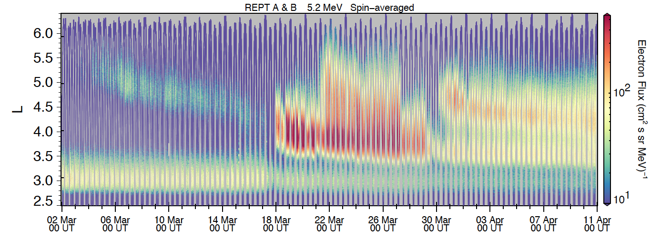
A four-belt structure beginning on March 30, 2013 (inner zone region not pictured)

Slide 5
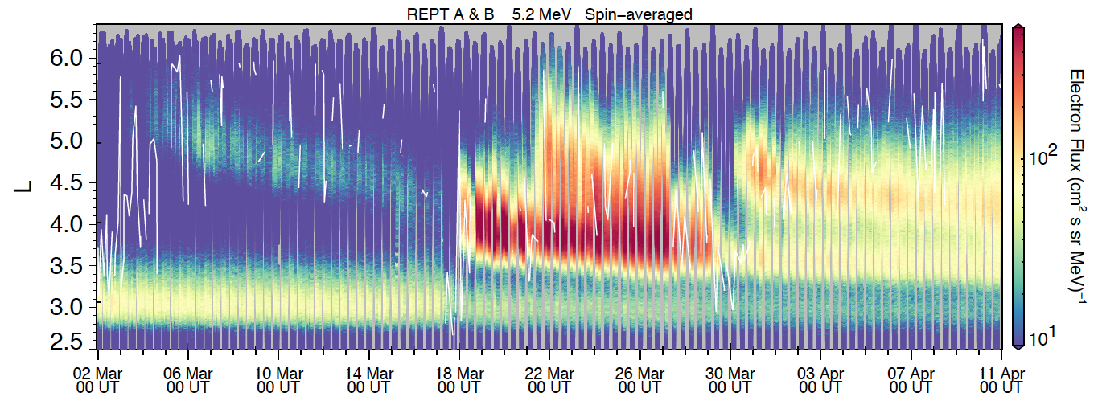
2013
EFW-derived plasmapause over-plotted
Take a time slice for a handful of subsequent orbits

Slide 6
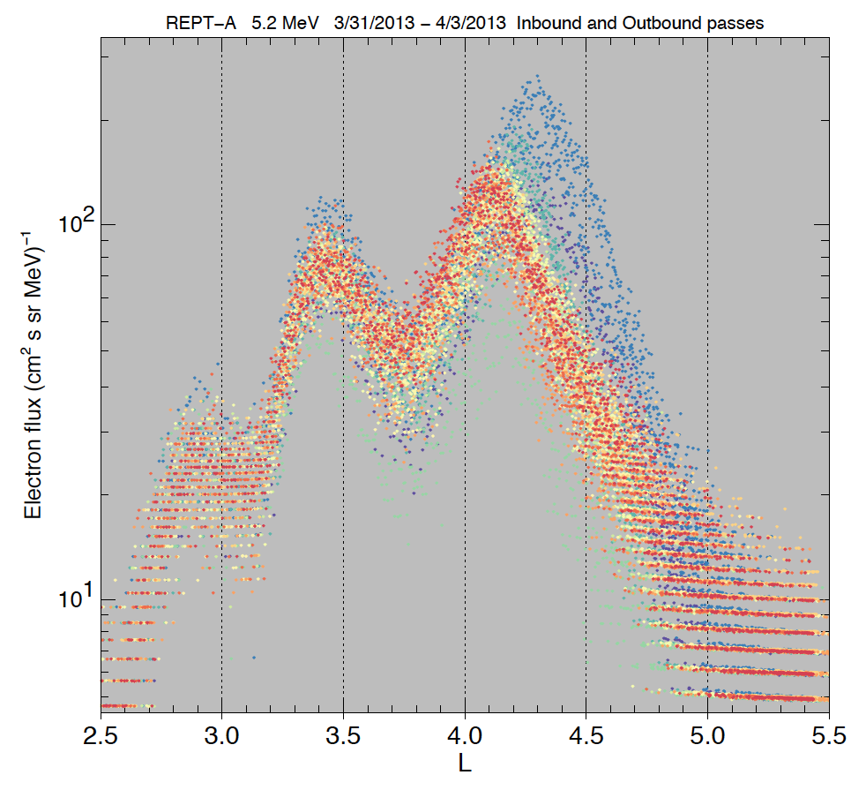
Three outer belts shown over multiple inbound and outbound orbits
Final peaks at: L=2.9, 3.4, 4.1

Slide 7
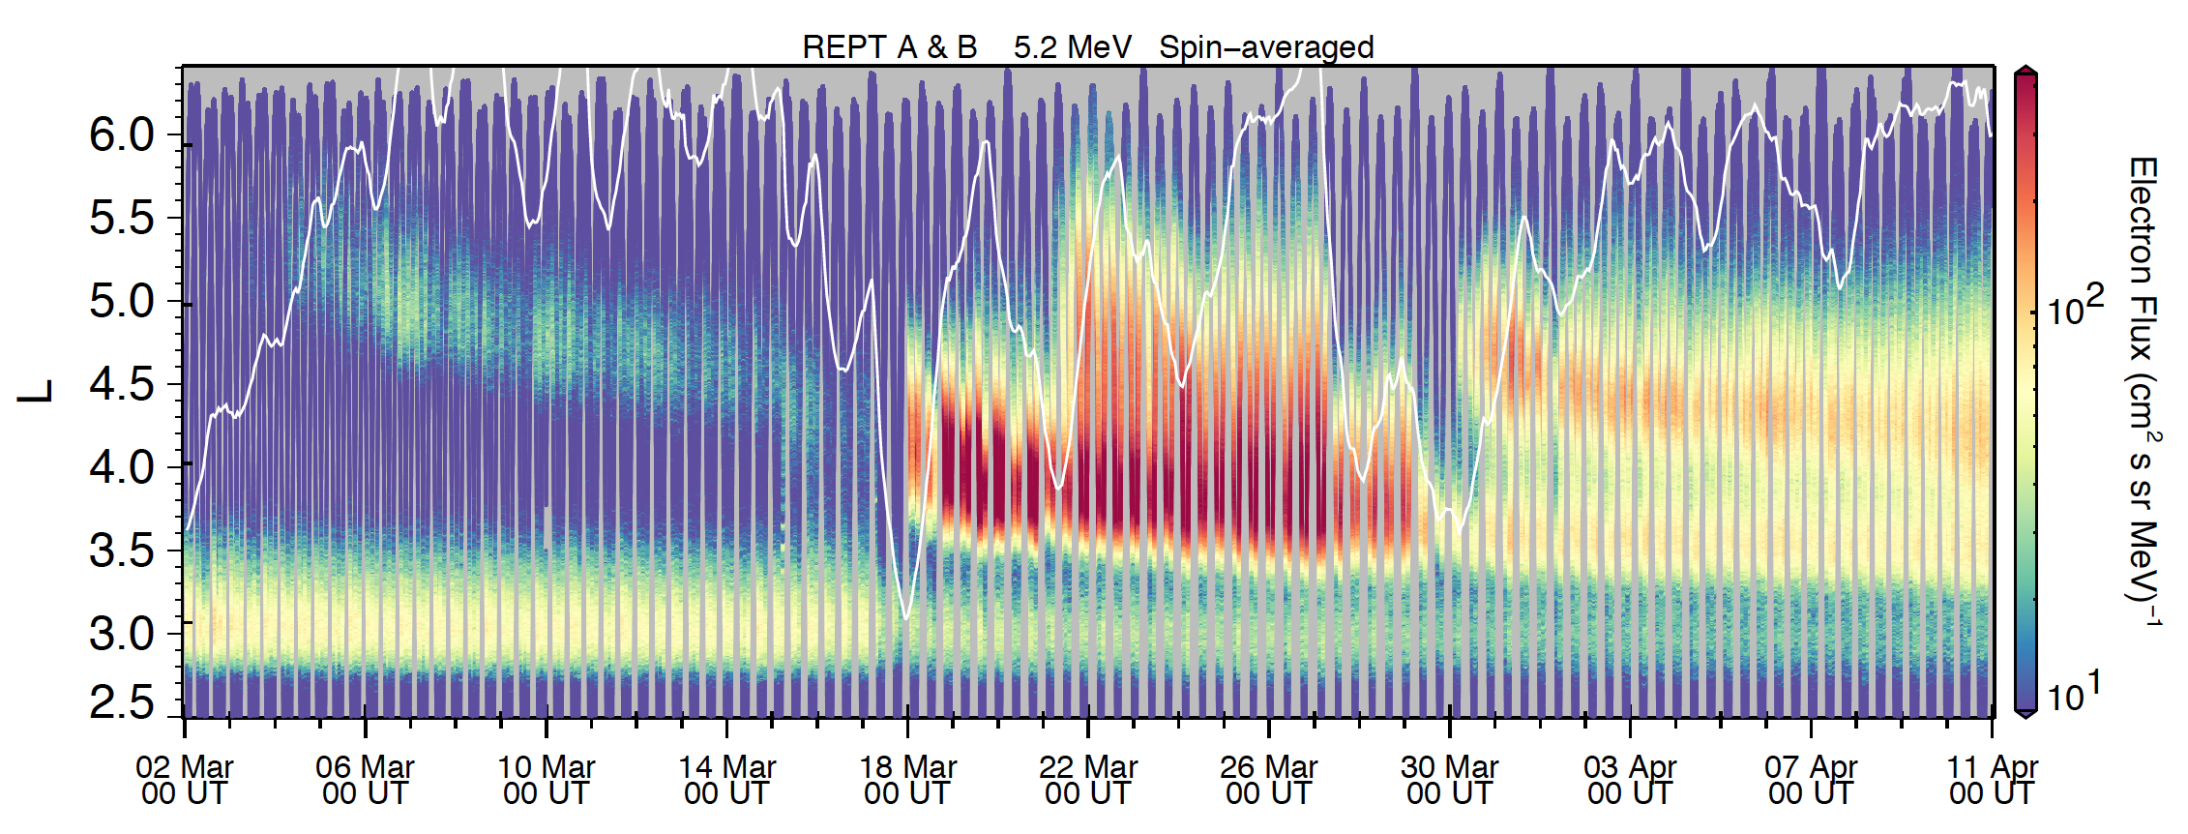
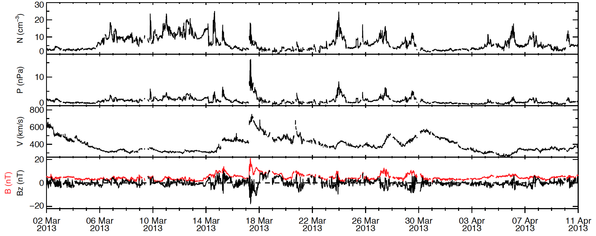
MLT-averaged plasmapause model from Liu & Liu 2014 (based on THEMIS data)
Solar wind parameters

Slide 8
Localized acceleration event
Another localized acceleration event
Remnant belt shielded
Erosion of third belt down to within L=4 to form second remnant belt
Recipe for four-belt structures:
Requires strong acceleration mechanism(s), just after PP erosion and losses within L=4.

Slide 9
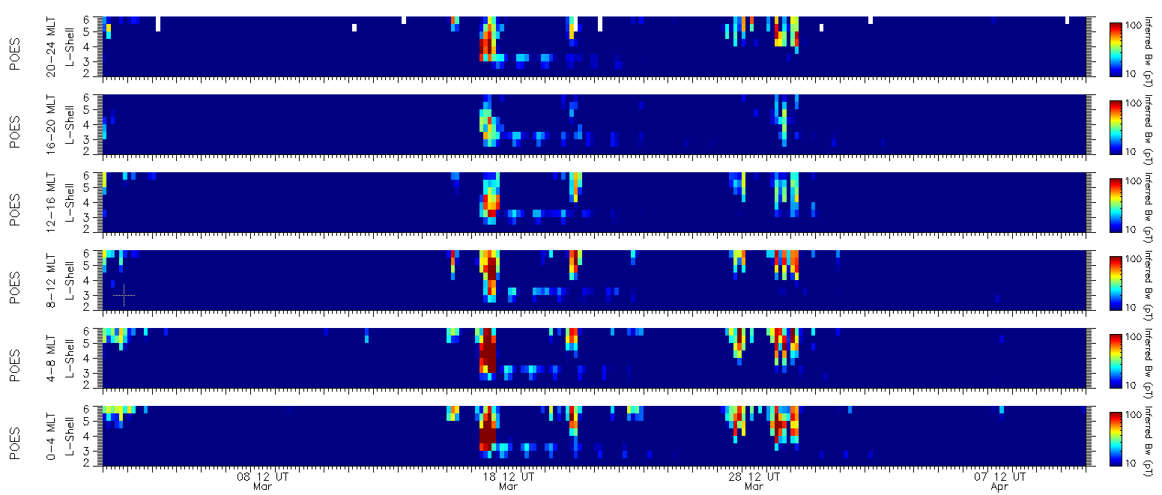
Chorus wave proxy derived from POES, Chen+ 2014:

Slide 10
Working on implementing the Li+ 2014 chorus wave proxy to compare with results from Chen+ 2014 method
Looking at decay times of both remnant belts
Would like to see modelling of this event
Is the acceleration mechanism between L=4-5 due to chorus or ULF waves?

Slide 11
Backup Slides

Slide 13
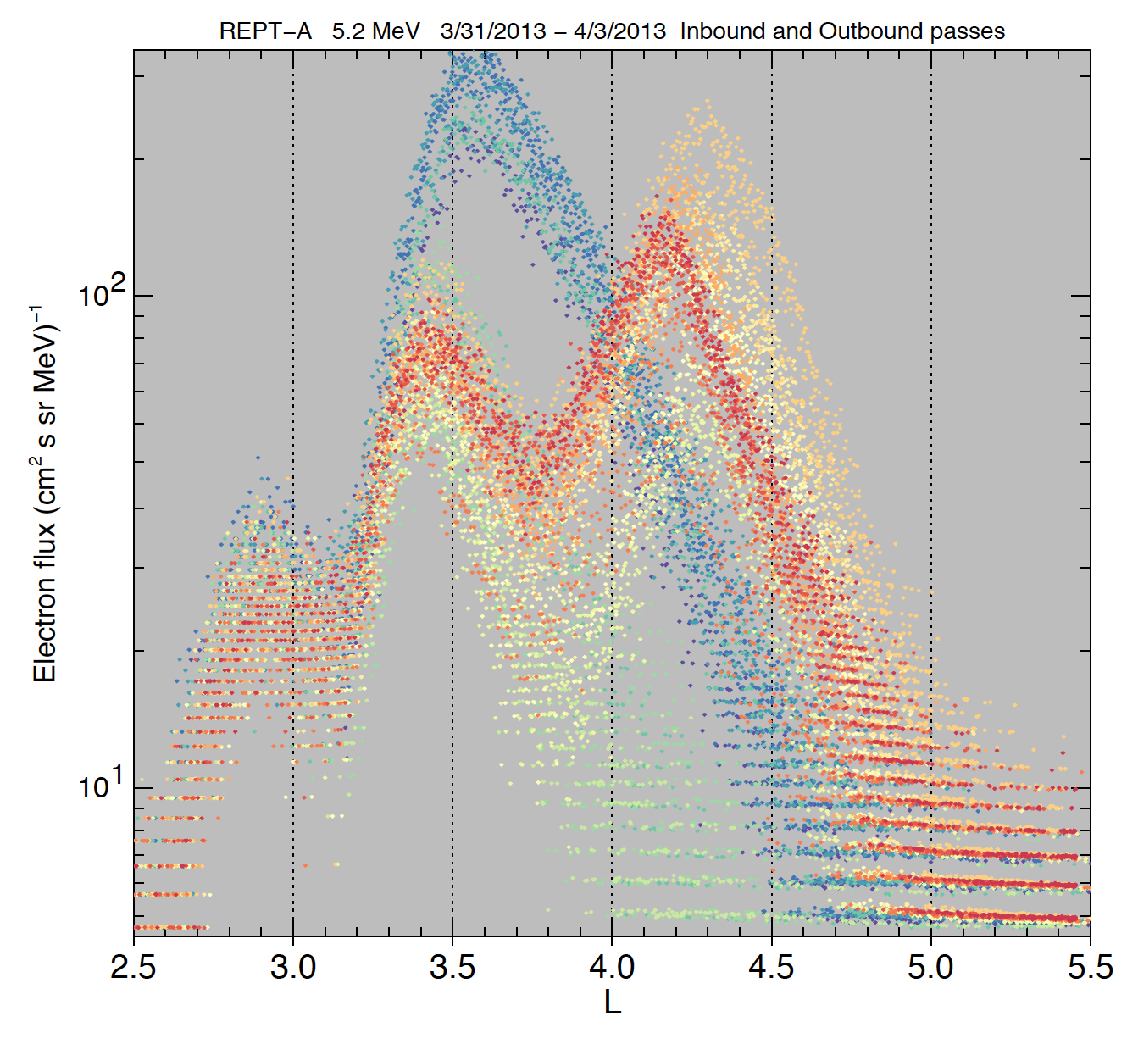
REPT-A 5.2 MeV 3/28/2013 – 4/1/2013 Inbound and Outbound passes
A look at the formation of 3 outer belts:
Three-belt structure to start
Third belt is eroded (green)
New fourth belt produced quickly outside of that (orange-red)

Slide 14
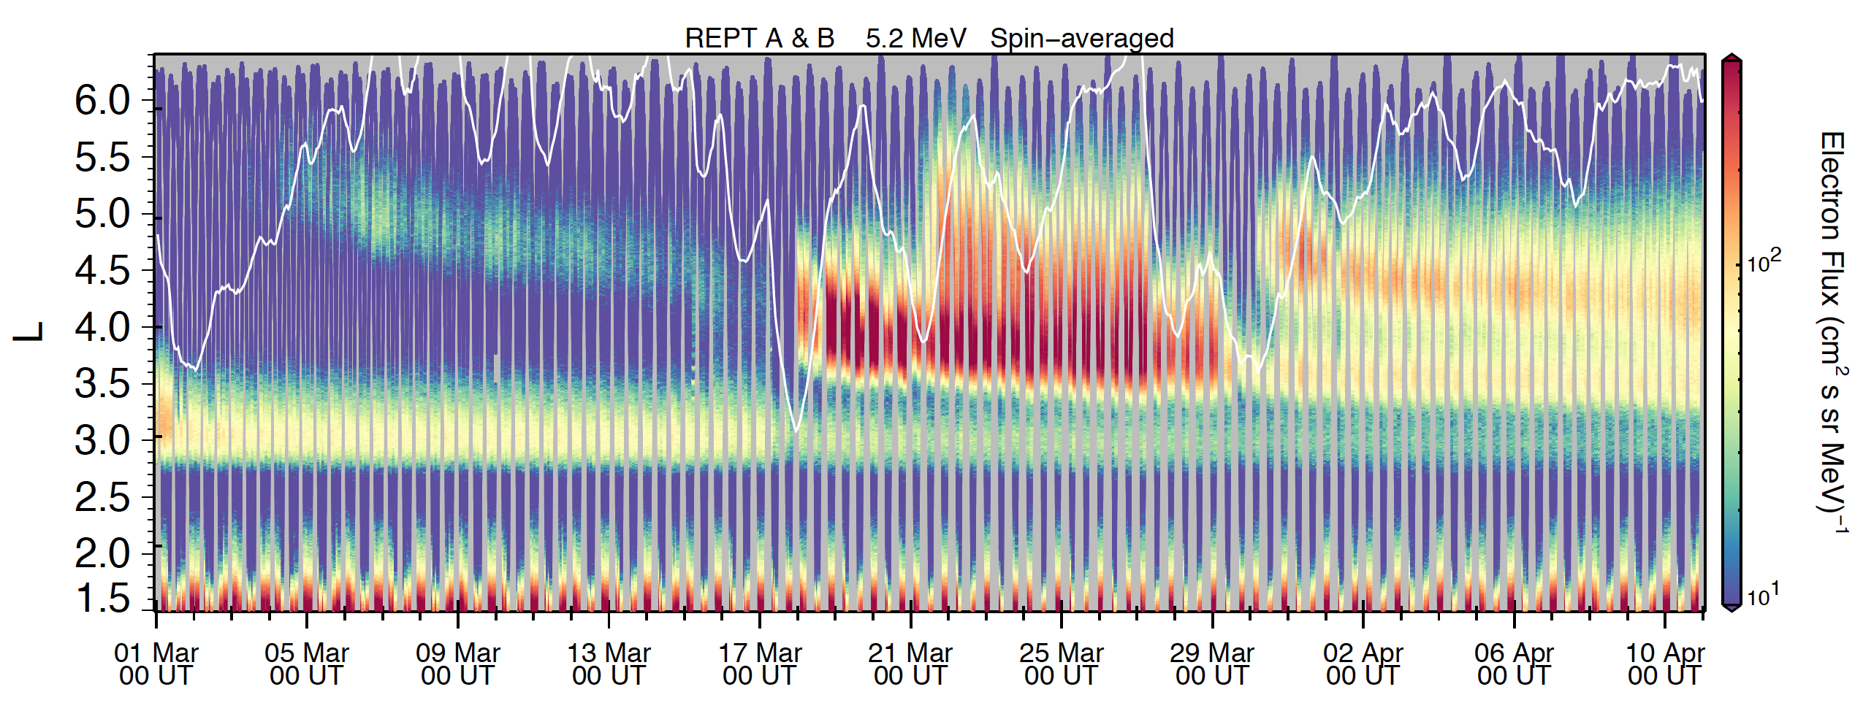
Inner zone region included

Slide 15
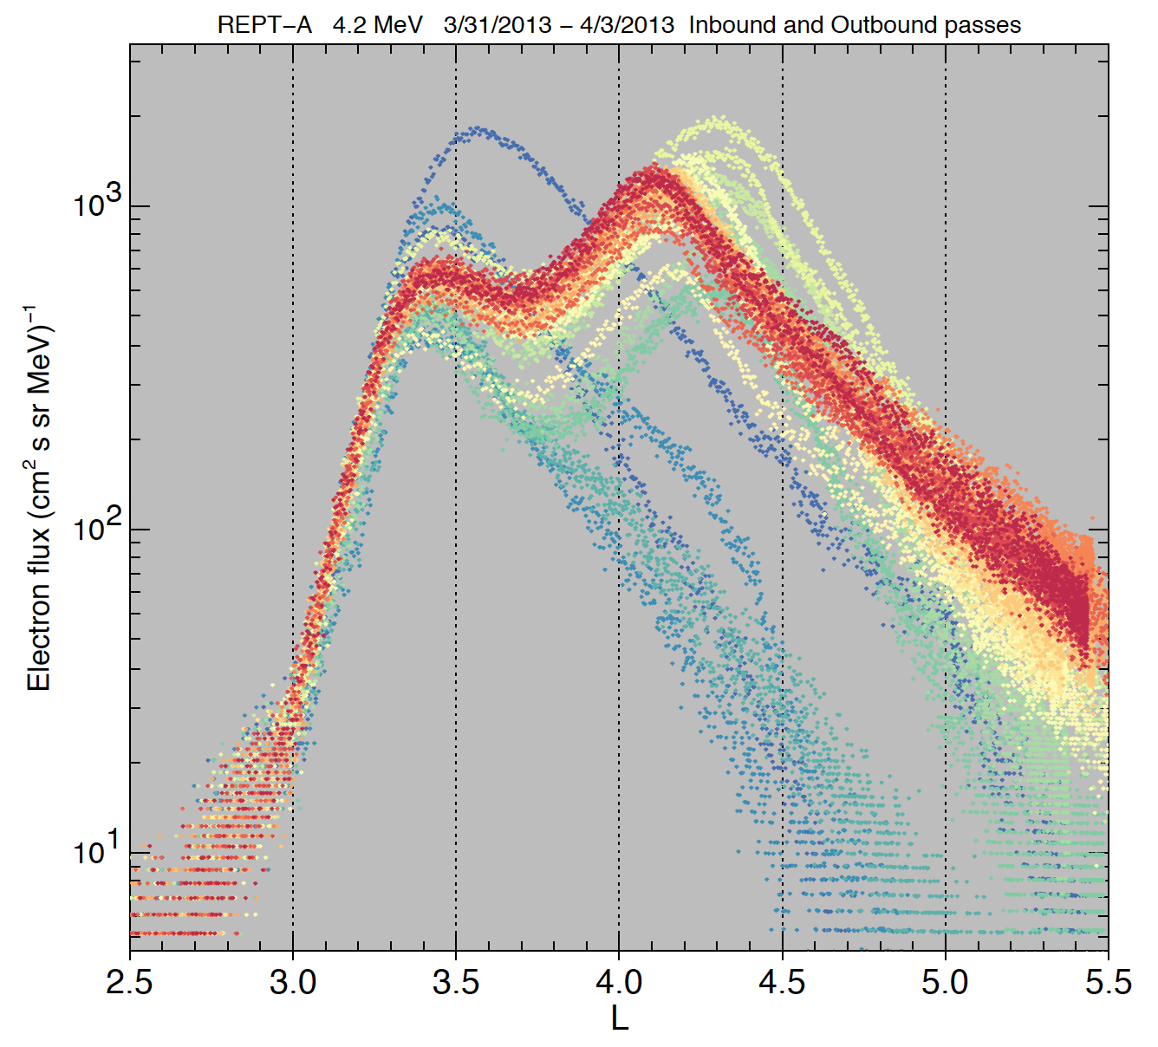
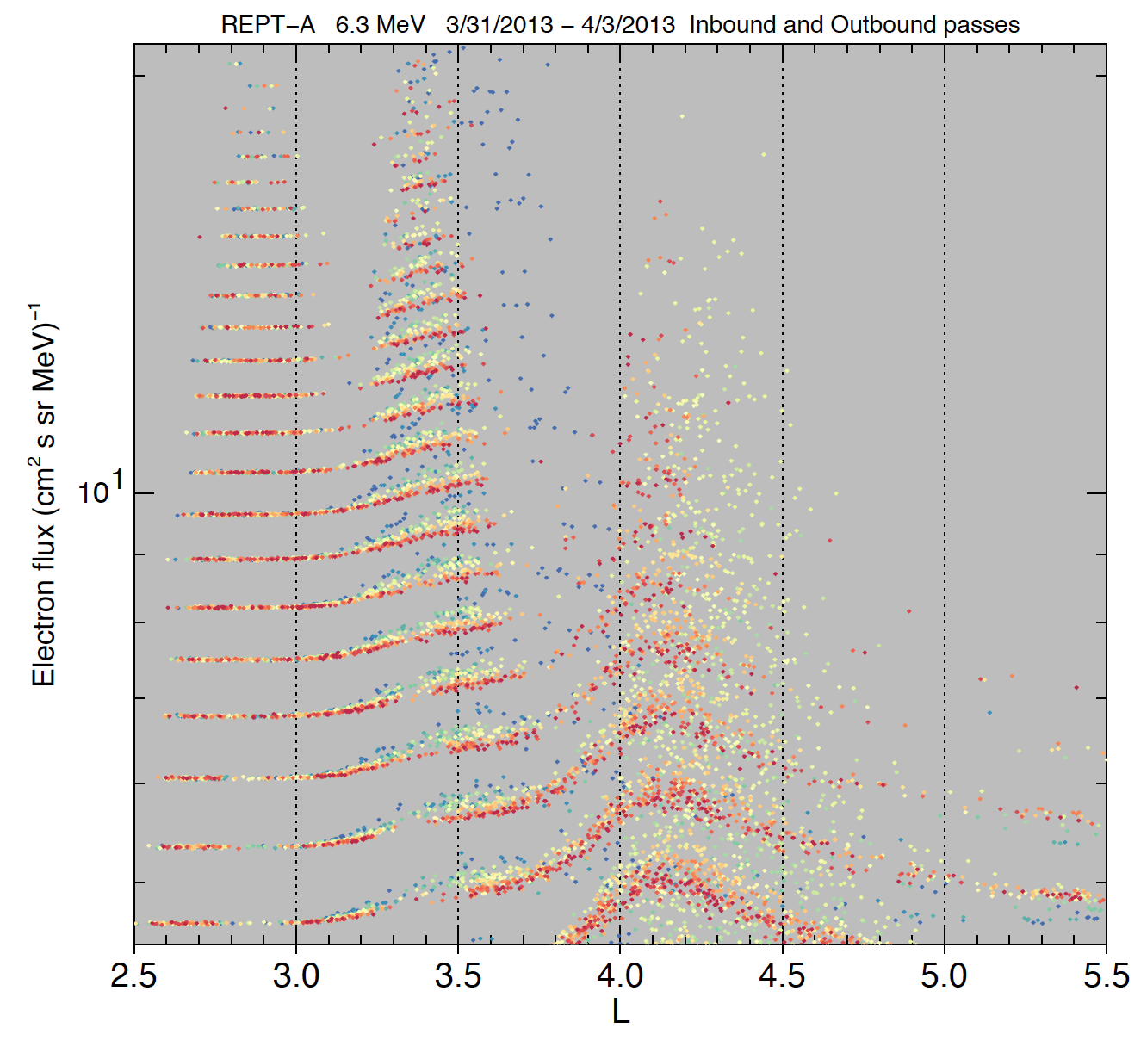
REPT-A 4.2 MeV 3/28/2013 – 4/3/2013 Inbound and Outbound passes
REPT-A 6.3 MeV 3/28/2013 – 4/3/2013 Inbound and Outbound passes
4.2 MeV doesn’t have the innermost remnant belt, and 6.3 MeV is too close to the noise floor (but does show evidence of the four belt structure)

