Slide 1
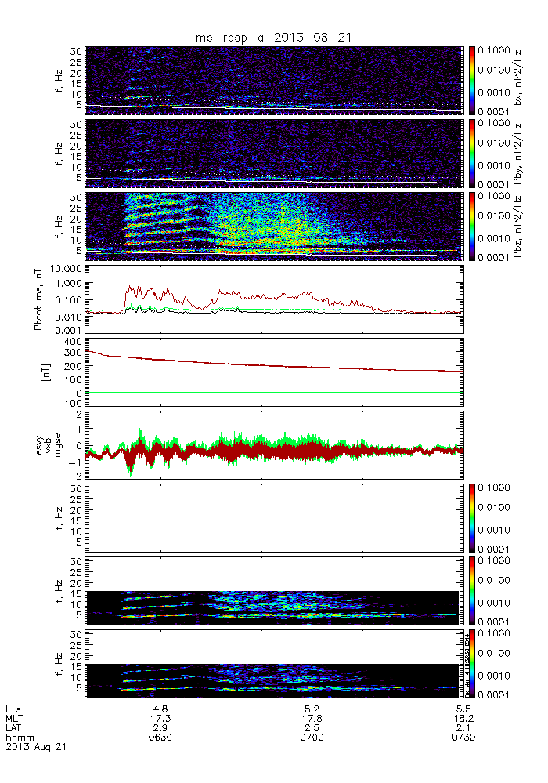
Motivation: Can bounce resonance with MS waves kick those electrons out of equatorial plane?
Lunjin Chen
Equatorial mirroring electrons: V||=0
But most electrons need V// to be scattered by gyro-resonance ω-k||v|| = nΩ_{e}/γ .
L~4.8
MLT 17
RMS amplitude ~ nT
Starting from 1 fcp (4 Hz)
Seen in 64 Hz B from MAG, 32 Hz E field from EFW, also in waveform of EMFISIS.

Slide 2
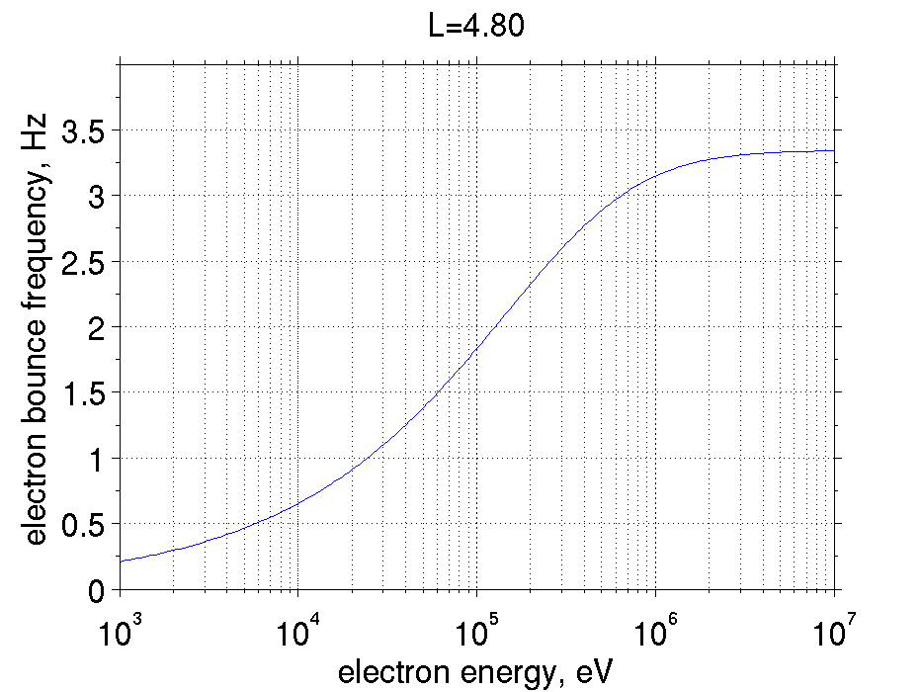
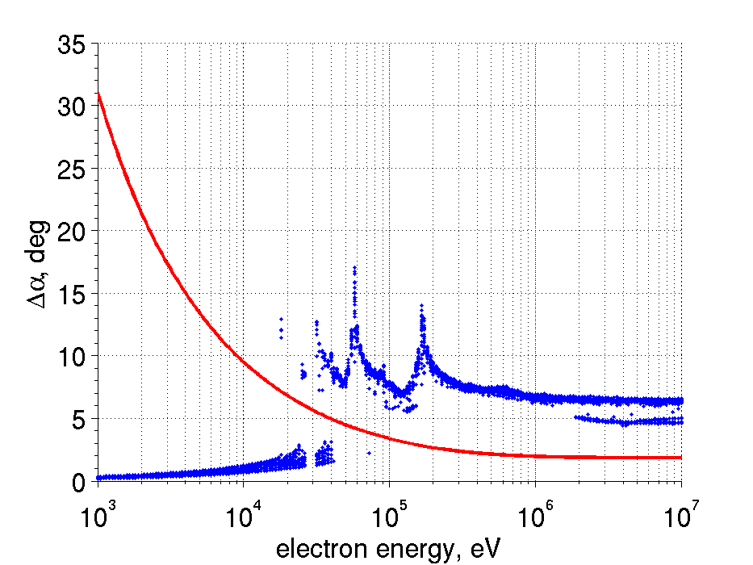
Interested at examine high resolution pitch angle distribution from MagEIS.
decreases in 90 deg flux at bounce resonance energy
broaden pitch angle distribution near 90 deg
HOPE energy range
The change of pitch angle required for Landau resonance with MS waves
MagEIS energy range
Deviation from 90 deg.
f/5
f/3
fb=f/2
f/4

Slide 3
