Slide 1
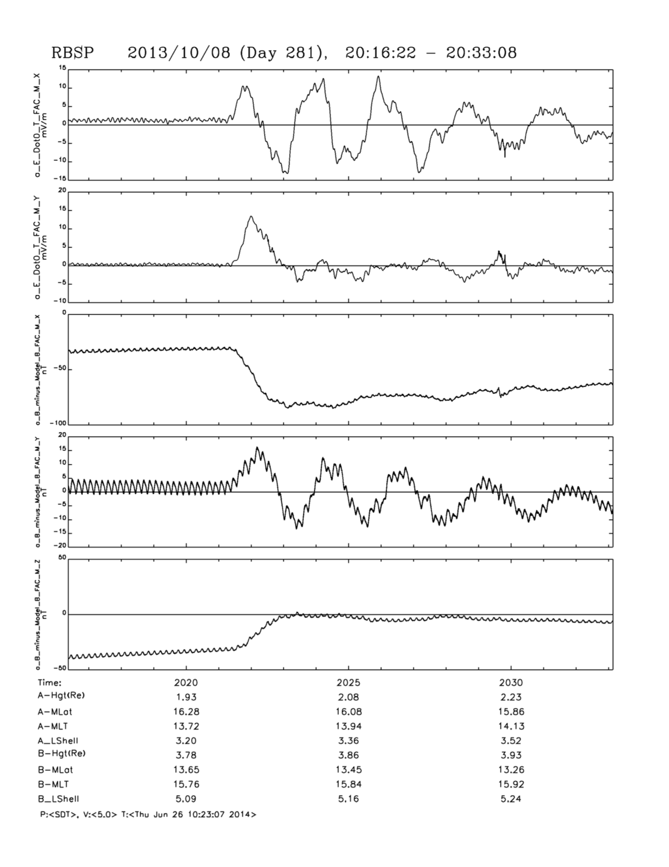
Shock Impact: Compression; Toroidal, Compressional plus MOre
E-Field ( neg) Radial perp to B
Ttoroidal)
E- field (neg) Azimuthal perp to B
(Shock Compressional plus Poloidal)
B-Field ( neg) Radial perp to B
(Poloidal)
B- field (neg) Azimuthal perp to B
B-Field Parallel to average B
Shock Compression)
Three wave modes are excited by shock
impact. Relative Strength governed by
where the shock hit and how it propagates
to Probe. Plus there is the issue of Fast rarefraction
waves inducing sunward convection

Slide 2
Coronitti and Kennel, JGR 1973

Slide 3
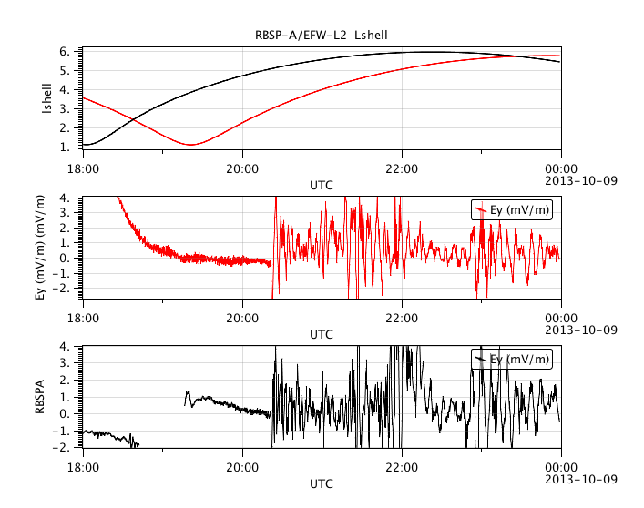
RBSP B
After the spike associated with the shock ramp there is 'prompt" on set of net
sunward convection – toward the magnetopause. This onset is more rapid than expected from
the "Dungey Cycle". IMF was negative. This is consistent with a scenario of how the change in the\
reconnection rate at the frontside magnetopause is transmitted through out the magnetosphere.
MMS at and upsteam of the magnetosphere is a necessary component of a precision study of
the changes in reconnecion driving and the response of dayside convection.

Slide 4
