Slide 1
EMFISIS-Waves
August 2015 Lapping
Barrel Sweden Campaign
G. B. Hospodarsky, C. A. Kletzing, W. S. Kurth

Slide 2
August 2015 Lapping
Predicted Separation Distance (periods < 1000 km)
  18:40 2015/08/14 767 km
  03:41 2015/08/15 437 km
  12:42 2015/08/15 206 km
  21:44 2015/08/15 377 km
  06:48 2015/08/16 700 km
  07:43 2015/08/18 484 km (perigee)
  08:23 2015/08/18 485 km (perigee)
Have not looked at the data in detail yet

Slide 3
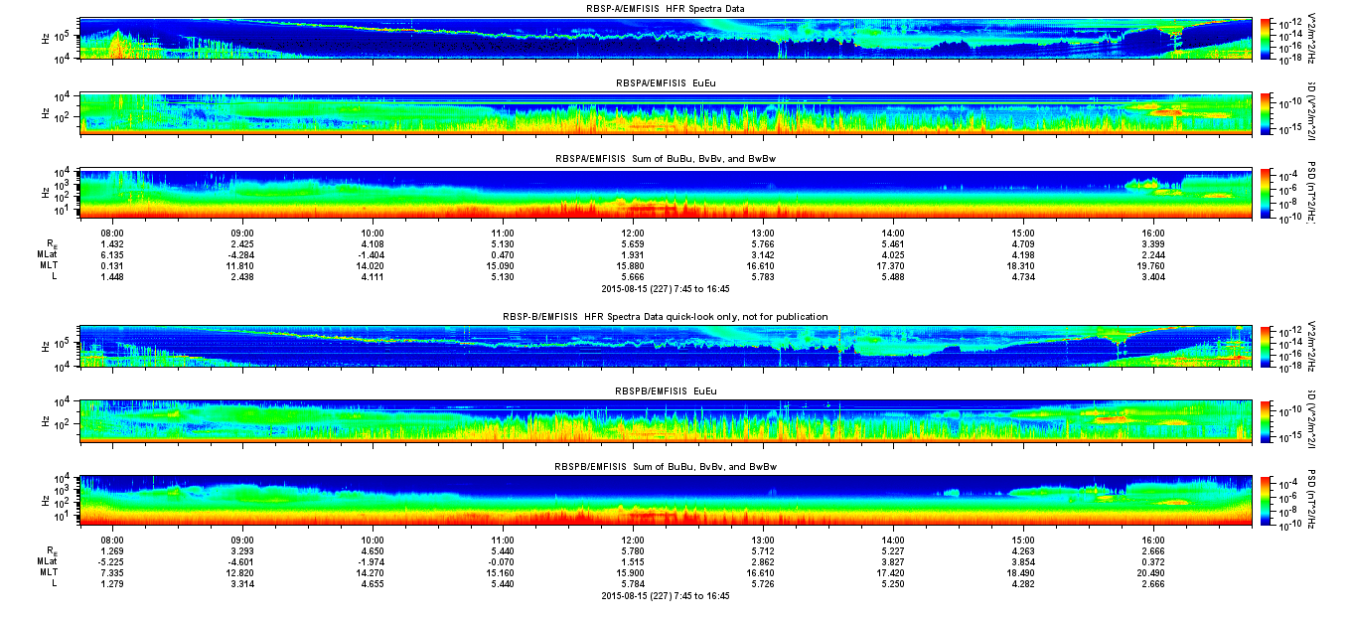
2015/08/15 12:42 ~206 km

Slide 4
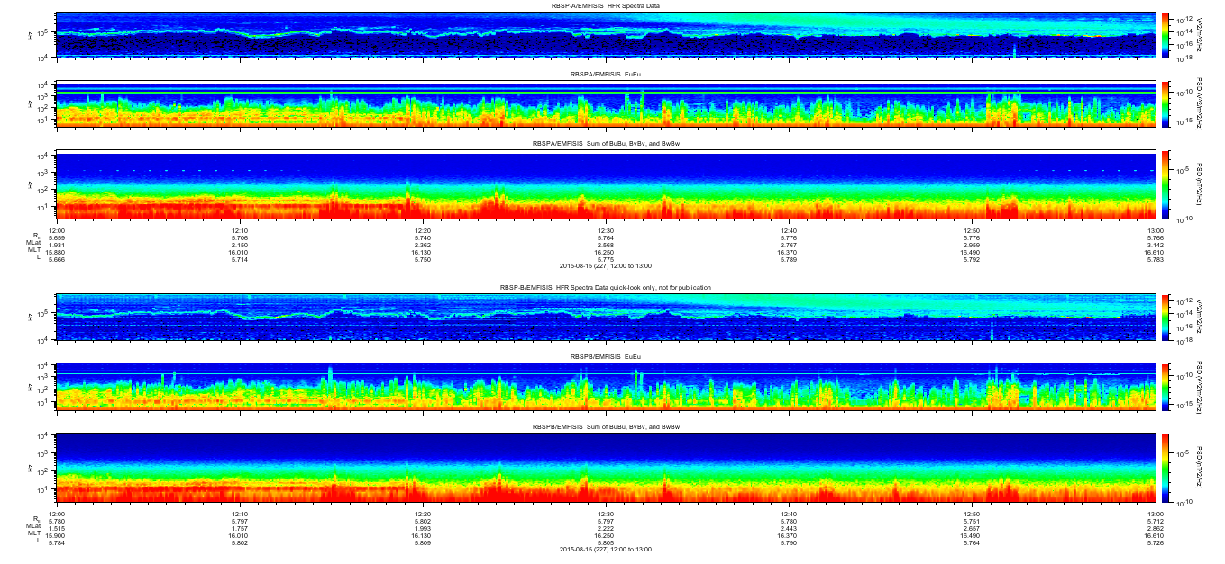
2015/08/15 12:00 to 13:00

Slide 5
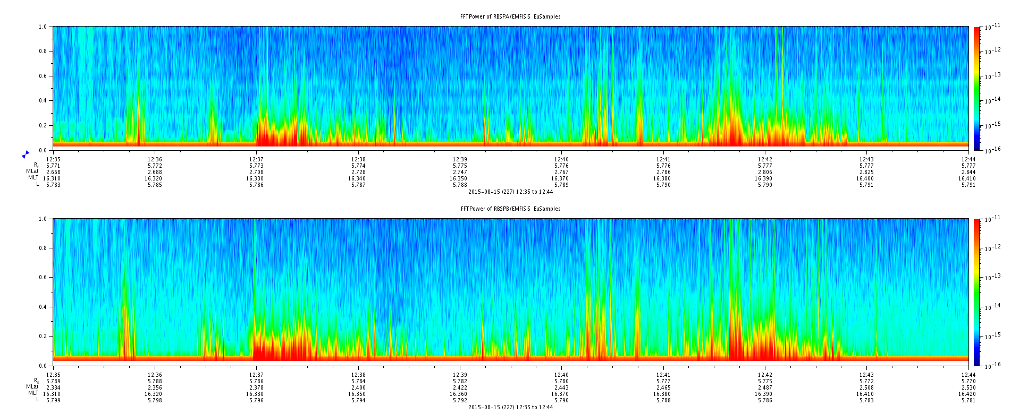
2015/08/15 12:35 to 12:44 Eu burst data

Slide 6
Barrel Sweden Campaign
Balloon Launches
3A
  8/10/2015 ~14:00 to 21:00
3B
  8/13/2015 ~06:00 to 11:00
3C
  8/17/2015 ~13:00 to 8/18/2015 ~04:00
3D
  08/19/2015 ~07:00 to 13:00
3E
  08/21/2015 07:00 to ????

Slide 7
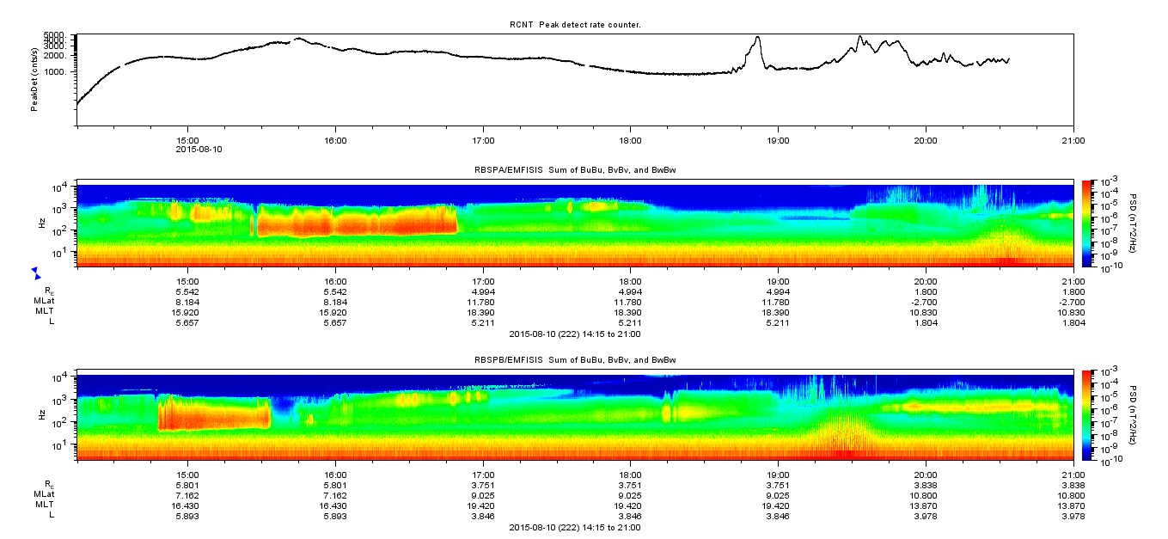
Balloon 3A: August 10, 2015

Slide 8
RBSP footprints: 14:15 to 21:00 August 10, 2015
19:10
14:15
20:10
14:15
SCB
SCA

Slide 9
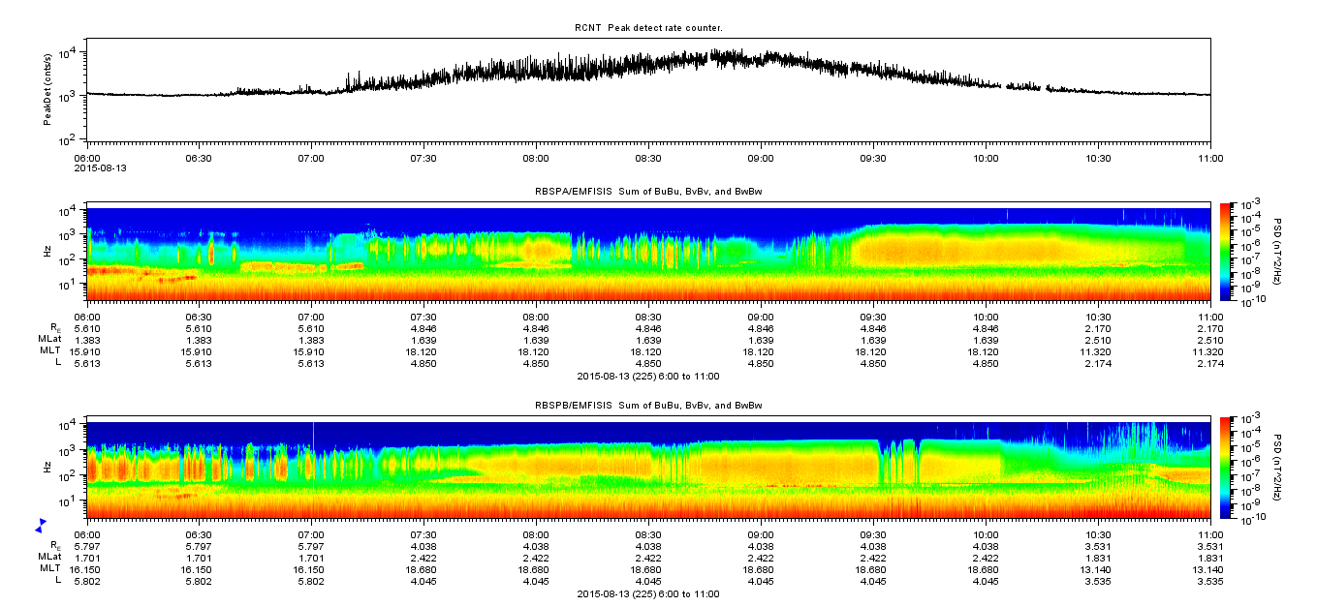
Balloon 3B: August 13, 2015

Slide 10
RBSP footprints: 06:00 to 11:00, August 13, 2015
11:00
10:15
SCB
SCA
06:00

Slide 11
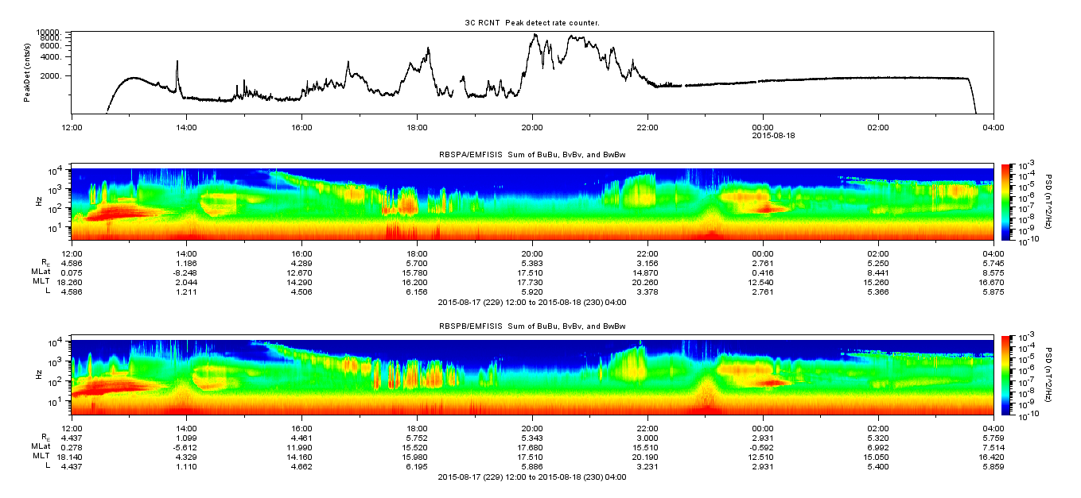
Balloon 3C: August 17, 2015

Slide 12
RBSP footprints: 12:00 August 17 to 04:00 August 18, 2015
2015/08/17
12:00
2015/08/18
04:00
2015/07/18
08:00

Slide 13
RBSP footprints: 12:00 August 17 to 04:00 August 18, 2015
14:00
14:00
SCB
SCA
11:00

Slide 14
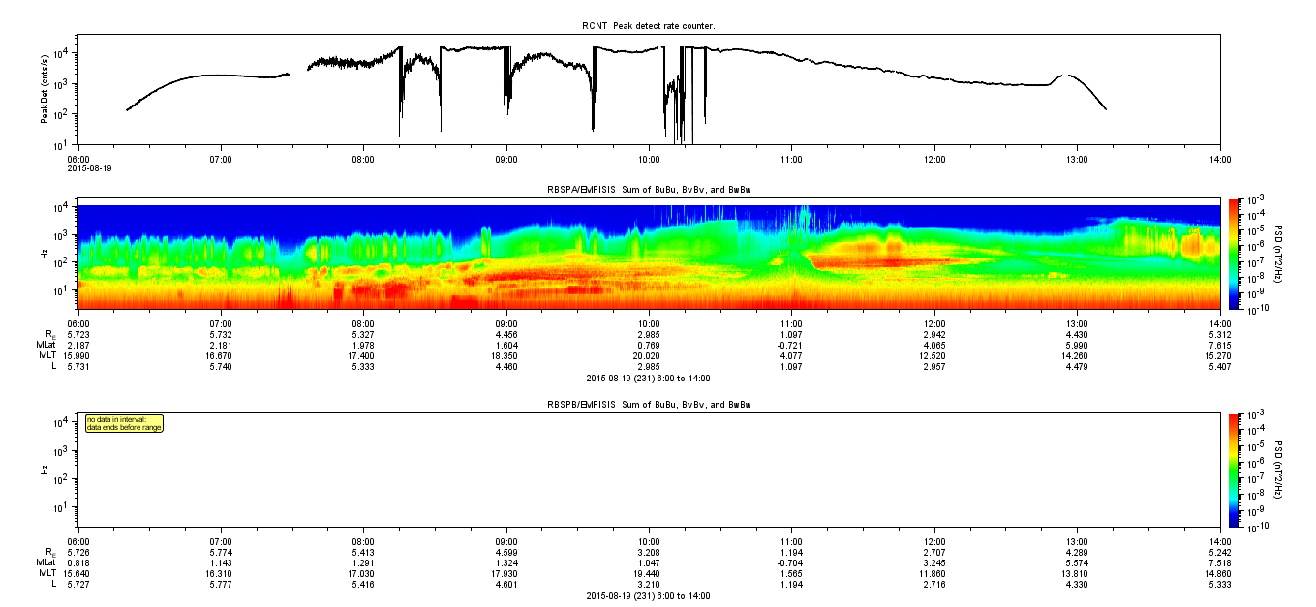
Balloon 3D: August 19, 2015
SCB data not available yet

Slide 15
Balloon 3E: August 21, 2015
Just launched this morning (no data available when I made the slide)

